Slide 1
Warm-Up
1) Find the handout that says “Culture Notes.”
2) Read each definition.
3) Reword the definition in YOUR OWN WORDS.
4) Come up with an example for your own life. (Hints are given to help you).

Slide 2
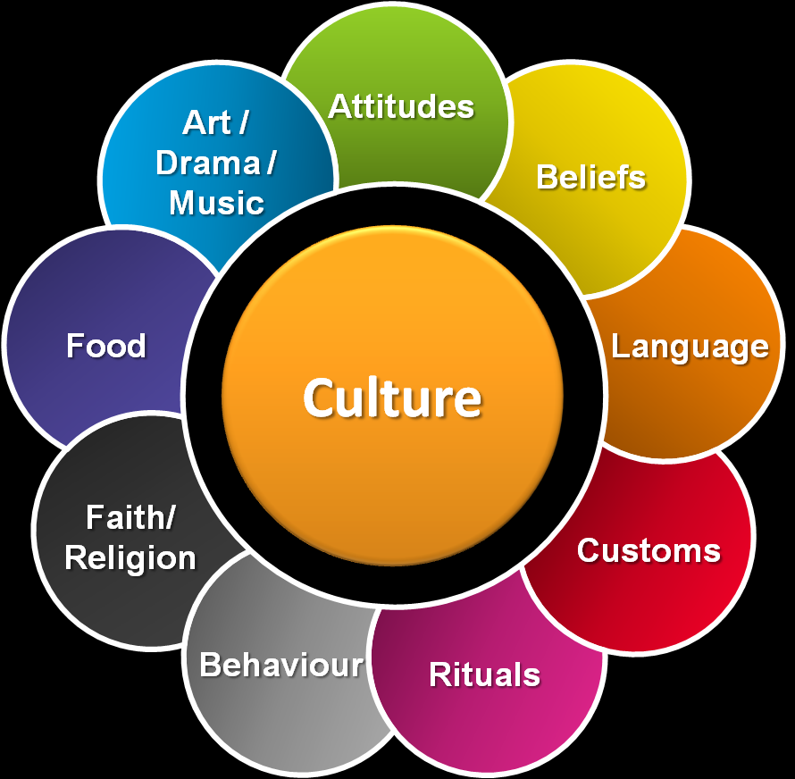

Slide 3
UNUSUAL CULTURAL CUSTOMS/TRADITIONS/RITUALS
https://www.youtube.com/watch?v=qBND33BNfZw
https://www.youtube.com/watch?v=XEWmynRcEEQ
https://www.youtube.com/watch?v=1vvb16VyVEY
https://www.youtube.com/watch?v=2OOs1l8Fajc
Fill out your graphic organizer as we watch!

Slide 4
Google Work #1
Use Google to find an unusual cultural custom (that we did not talk about today).
Read about it, watch videos, whatever you need to do to understand the tradition or ritual.
Write a one-paragraph summary and reflection (describe the custom in detail; make sure your reader can understand who, what, when, where, why; and include your personal thoughts, reflections, and questions on it).
The assignment is due on Friday.

Slide 5
Body ritual among the nacirema
Annotate the text while we read.
Complete the reading handout.
After reading: Reading Response Questions.
Turn in your completed handout (or finish for homework if needed).

Slide 6
Warm-Up
Fold your blank white paper into an 8 square graphic organizer. Label each square as follows (make sure you leave lots of room to write in the box!):
Items + objects
Daily sights
Smells
Tastes
Sounds
Traditions
Family stories
Favorites

Slide 7
WHERE I’M FROM Poems
Annotate as we read.
UNDERLINE examples of sensory details.
CIRCLE and LABEL examples of figurative language.
STAR anything that stands out to you.

Slide 8
WhERE I’m from – ROUGH DRAFT
Use the template but feel free to add/change as needed. Deleting is not an option – you must maintain this length at minimum.
Use your foldable and your annotated poems to help you add sensory details and figurative language to your writing.

