Slide 1
Warm-Up: 6 week grade reflection
Please take the work out of your student folder. Review your work, and put it in your binder. Do NOT throw it away!! You will want it to go back and review.
Begin completing the End of the First 6 Weeks Grade Reflection Sheet.
This sheet will need to be completely filled out, and signed by you and your parent/guardian. When you return the signed form you will earn the opportunity to do extra credit (if you want to).

Slide 2
What’s a picture worth?

Slide 3
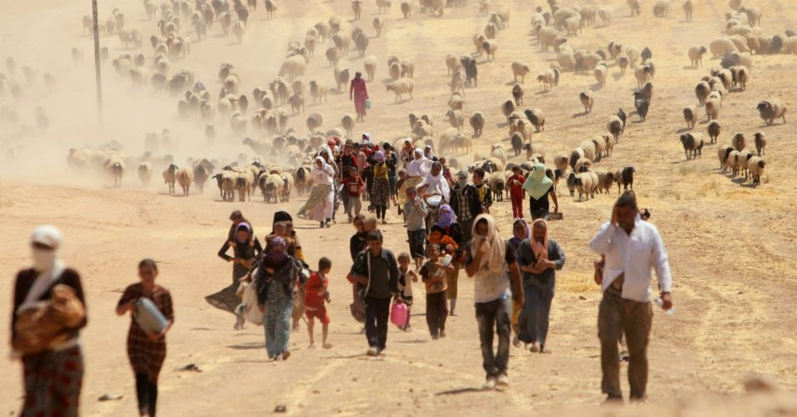
#1

Slide 4
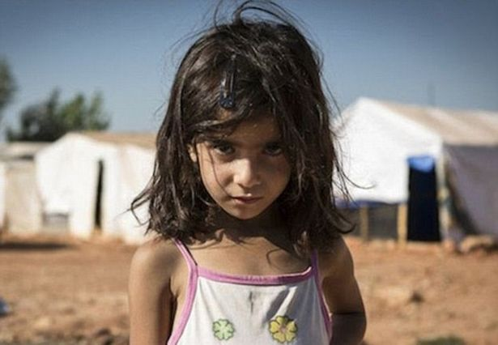
#2

Slide 5
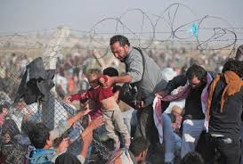
#3

Slide 6
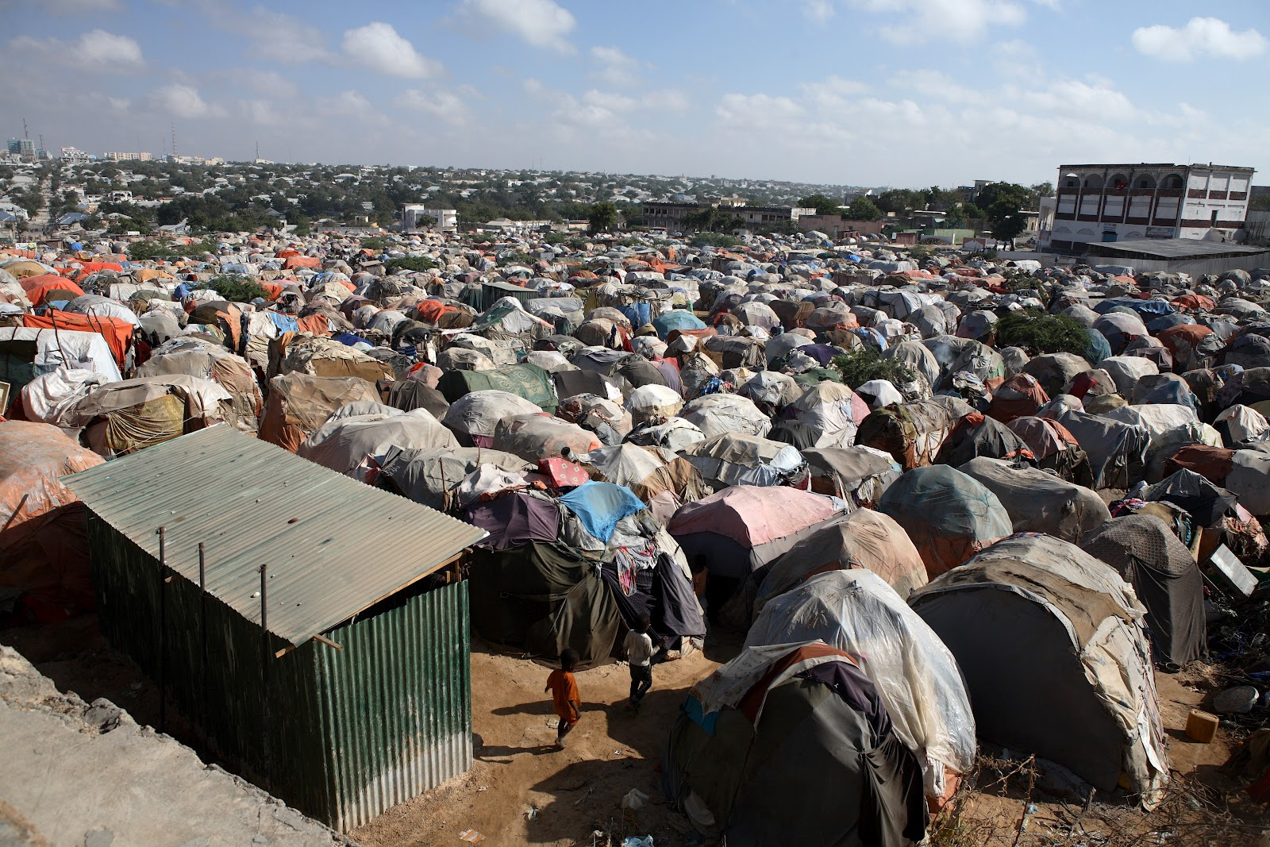
#4

Slide 7
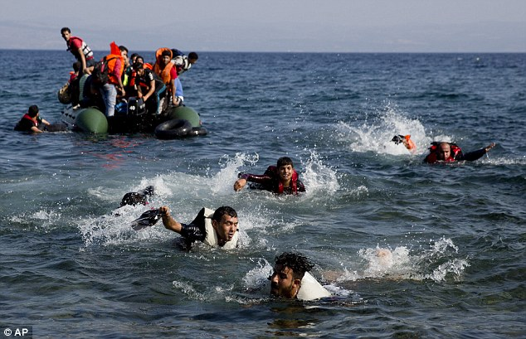
#5

Slide 8
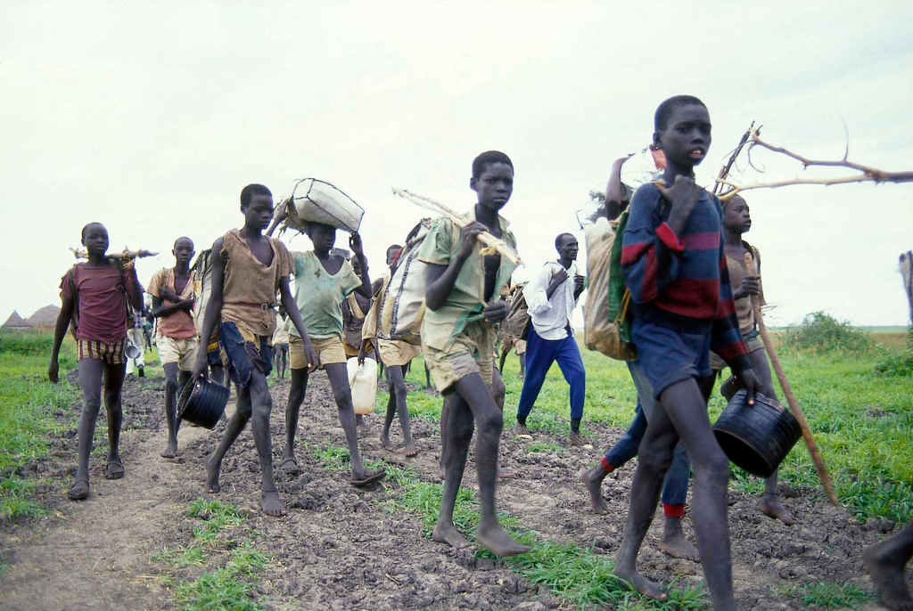
#6

Slide 9
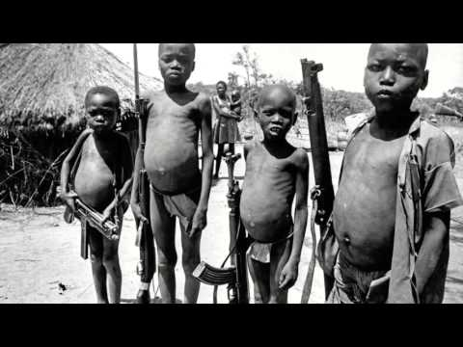
#7
#2

Slide 10
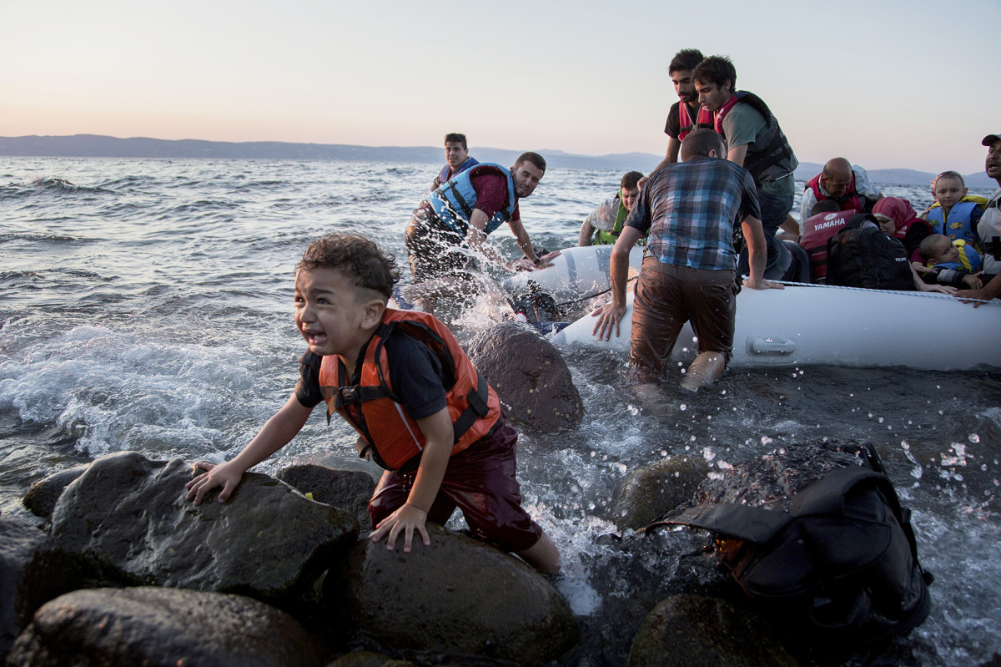
#8

Slide 11
What is a refugee?
Forced to leave
Lives are in danger – war, persecution, natural disaster, famine, etc.
Human rights are there to protect their ability to seek asylum in another country

Slide 12
The Lost Boys of Sudan
Read and annotate the background article.
Summarize:
Who
What
When
Where
Why

