Slide 1
Monday 11/28: Welcome back!
Warm-Up: Please complete the UNIT 4 ANTICIPATION GUIDE. Make sure you choose an opinion and provide an explanation for each statement.

Slide 2
What is a perfect world?
1) Please read “Diddy-Wah-Diddy.” This is an African folktale that discusses the “idyllic” (perfect) world.
2) With a partner, please annotate five ways in the text that “Diddy-Wah-Diddy” is idyllic.

Slide 3
A perfect world…
On your chart, brainstorm your version of a utopia, or a perfect world. You may want to consider everything from the weather and scenery, to your education and healthcare, to your country’s system of government and economics. Please fill in each box, and feel free to add new categories as needed.

Slide 4
An imperfect world…
Now imagine that it has all been taken away. There is a new leader, and the new leader switches everything in your perfect world to the opposite.
Fill out the “dystopia” side of your chart with the opposite of each category.

Slide 5
What is an imperfect world?

Slide 6
Dystopian Characteristics
Oppressive societal control
Propaganda used to control the citizens
Information, independent thought, and freedom are restricted
A figurehead or concept is worshipped by the citizens
Constant surveillance
Citizens have a fear of the outside world
Dehumanization
The natural world is banished and distrusted
Uniform expectations; no individuality
Illusion of a utopia

Slide 7
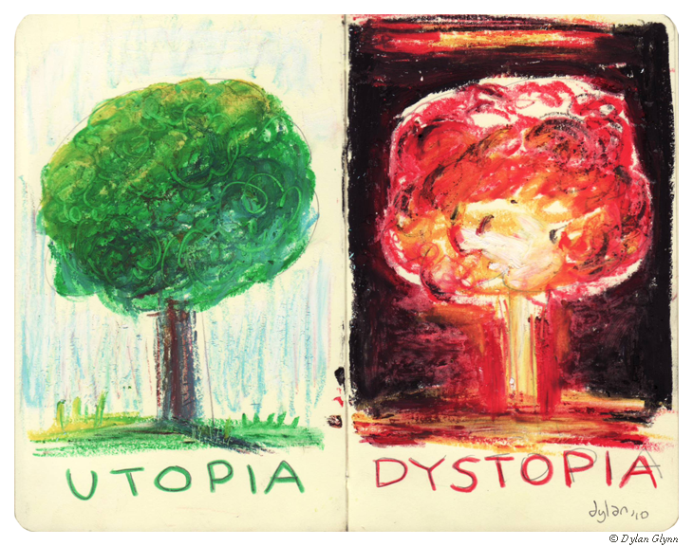

Slide 9
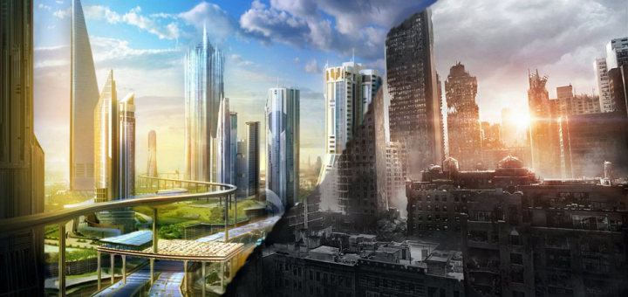

Slide 10
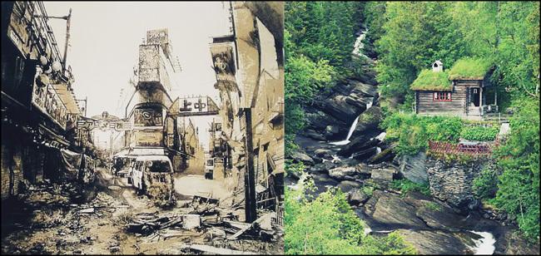

Slide 11
Track the dystopian characteristics.
Wall-E: https://www.youtube.com/watch?v=h1BQPV-iCkU

Slide 12
Anticipation Guide Discussion
Meet with three people you don’t normally talk to, and discuss the items on the anticipation guide you did as a warm-up.
Be prepared to share out on one statement.

Slide 13
Tuesday 11/29 Journal
Is it better to be unaware/ignorant of the realities of the world and happy, or completely aware of the truth with the chance that you could be completely miserable with your knowledge of the truth? Support your answer with details/examples.

Slide 14
Dystopias of the Past, Present, and Future
Each group (2-3 people) has a different article to read and discuss.
As a group, create a small poster that includes the following:
Your Topic (from the article)
At least three ways it relates to dystopia
Is it a dystopia of the past, present, or future?
Each group will present to the class after 40 minutes of work time.

Slide 15
Dystopias of the Past, Present, and Future
Fill out your graphic organizer based on each group’s presentation.
Homework: Come up with at least two more examples for each category.

Slide 16
Wednesday 11/30 Journal
What will the world be like in 2081?
Include at least 6 specific predictions. Things to consider: human rights, laws, equality, environment, economy, technology, health, gender, race, population, etc.

Slide 17
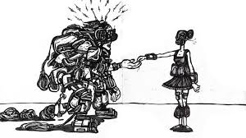
“Harrison Bergeron”
by Kurt Vonnegut
published 1961

Slide 18
Thursday 12/1 Journal
If you lived in the world of “Harrison Bergeron,” you would have at least one handicap. A “handicap” is a “condition that markedly restricts a person's ability to function physically, mentally, or socially.
If you had a handicap that took away your greatest strength, what would it be?
Include a) what the handicap would be/take away from you, b) what your life would be like, and c) how you would feel about this.

Slide 19
“2081”
While viewing: Complete the Venn diagram.
After viewing: Complete the Handicap Activity on the back.

Slide 20
Friday 12/2 Warm-Up
Read and ANNOTATE the song lyrics to “The Trees”
Underline any words/phrases/lines that stand out to you.
In the margins, write WHY these stand out to you and HOW you think they might connect to our unit.
Highlight any UNKNOWN WORDS; in the margins, write your guess about what the word means (use context clues).
The whole song is a metaphor. On the bottom, under the song lyrics, write 2 sentences explaining WHAT THE METAPHOR IS AND MEANS. Why do you say this?

Slide 21
Number 12 Looks Just Like You
https://www.youtube.com/watch?v=7Y2ml24bc78

Slide 22
Eye of the Beholder
https://www.youtube.com/watch?v=aeWxpAFKw6A

