Slide 1
Hello!
Directions:
Pick up your handouts and one folder from the table.
Turn in your signed syllabus form AND your homework (info sheet and your letter – please staple them together and put them in the tray.)
Get out one piece of paper and number from 1-10.
Please await further directions.

Slide 2
LOGB Test
Find the handout that says “The 5-Minute Personality Test.” Notice that you must rank each set of words, with 4 being the most like you and 1 the least like you.
Ms. Yeganegi’s Example:
1. 1 Likes Authority 3 Enthusiastic 2 Sensitive Feelings 4 Likes Instructions
2. 3 Takes Charge 1 Takes Risks 4 Loyal 2 Accurate

Slide 3
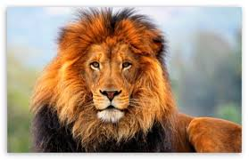
L = Lion
Lions are leaders. They are usually the bosses at work…or at least they think they are!
They are decisive.
They love to solve problems.
They love to seek new adventures
and opportunities.
Lions are very confident and self-reliant.
In a group setting, if no one else instantly takes charge, the Lion will. Unfortunately, if they don’t learn how to tone down their aggressiveness, their natural dominating traits can cause problems with others.

Slide 4
O = OTTer
Otters are excitable, fun seeking,
cheerleader types who love to
talk!
They’re great at motivating
others and need to be in an
environment where they can talk
and have a vote on major decisions.
They can be very loving and encouraging unless under pressure, when they tend to use their verbal skills to attack.
They have a strong desire to be liked and enjoy being the center of attention.
They are often very attentive to style, clothes, and flash.
Otters are the life of any party; and most people really enjoy being around them.

Slide 5
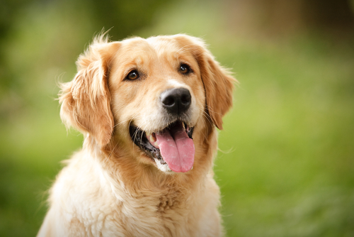
G = Golden Retriever
One word describes these people:
LOYAL.
They can deal with a good deal of emotional pain and punishment but
still stay committed.
They are great listeners, incredibly empathetic and warm encouragers.
They are good team players, but
because they are such pleasers and
care about harmony, they may not be
assertive at times when it’s needed.
Golden retrievers tend to focus on the present and devote lots of time to helping others and building relationships.

Slide 6
B = Beaver
Beavers have a strong need to
do things right and by the book.
They are great at providing
quality control in any situation.
Because rules, consistency and
high standards are so important
to beavers, they are often frustrated with others
who do not share these same characteristics.
Their strong need for maintaining high (and oftentimes unrealistic) standards decrease their ability to express warmth in a relationship.
Beavers are good listeners, communicate details, and are usually diplomatic; they do not like to make decisions.

Slide 7
True Colors Test
Consider each group of words.
Which group best describes you? → Give that a 4.
Which group least describes you? → Give that a 1.
For the two middle groups, the one that is closest to you gets the 3, the one that is farthest from you gets a 2.
Add up your totals for each color.

Slide 8
The Colors GREENS
Are innovative and logical
Seek to understand the world
Need to be competent
Are curious
Question authority
Push themselves to improve
Are slow to make decisions
Value concise communication
Look for intellectual stimulation
Enjoy intriguing discussions
Are sometimes oblivious to emotions
Are detached
Are drawn to technical occupations
Focus on the future
Bring innovation to society

Slide 9
The Colors Orange
Are free and spontaneous
Are impulsive risk-takers
Are active
Are optimistic
Resist commitment
Thrive on crises
Like to be the center of attention
Have great endurance
Are drawn to action jobs
Need variety
Are competitive
Deal with the here and now
Are generous
Have difficulty finding acceptance
Like to live in a casual atmosphere
Bring excitement to society

Slide 10
The Colors Gold
Are dutiful and stable
Need to be useful
Want to be self-sufficient
Value organization
Desire punctuality
Schedule their lives
Make and keep commitments
Are goal-oriented
Value rules
Prepare for the future
Are inclined to join groups
Prefer order and cleanliness
Are responsible and dedicated
Are drawn to respected occupations
Enjoy positions of authority
Desire structure
Bring stability to society

Slide 11
The Colors Blue
Are in search of themselves
Need to feel unique
Must be true to themselves
Value close relationships
Encourage expression
Desire quality time with loved ones
Need opportunities to be creative
Compromise and cooperate
Nurture people, plants and animals
Share emotions
Make decisions based on feelings
Are adaptable
Are drawn to literature
Are drawn to nurturing careers
Get involved in causes
Are committed to ideals
Bring unity to society

Slide 12
Multiple intelligences
Circle the letter before the statement that best describes you.

Slide 13
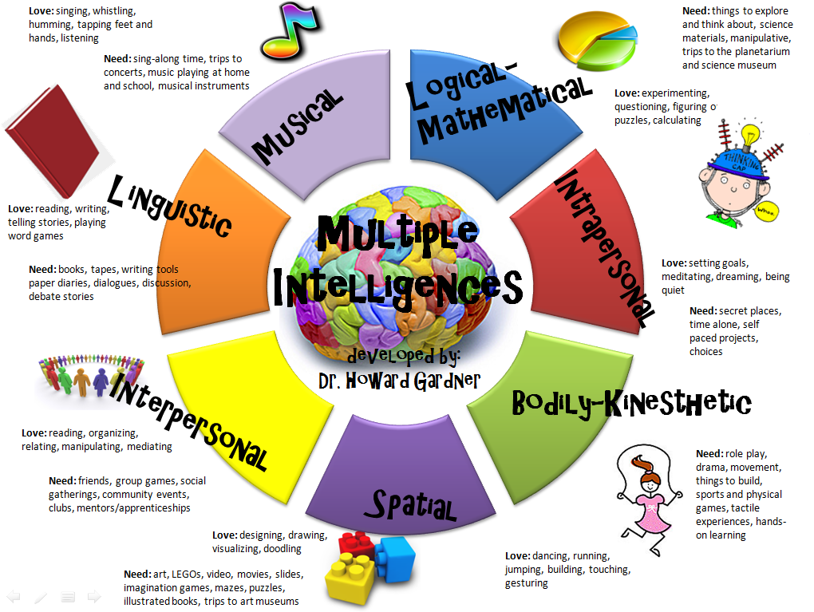
Learning style results

Slide 14
INDEX Card – turn this in
Your LOGB Result Your True Color
Full Name
Block
Your Multiple Intelligences Result(s) Area you prefer to sit in (front/middle/back)

Slide 15
Writing Task – Due Monday
An organized response should have an introduction, body, and conclusion, and your ideas should flow logically and be supported by specific examples and details to flesh out your points. Spelling and grammar matters, so proofread!
Now, please use the information you have discovered about yourself through these activities to write a well-organized constructed response to ONE of the following prompts (your choice):
How accurately, or inaccurately, did these “tests” predict your dominant personality types? Why are the tests accurate or inaccurate? Give specific examples from your life and past performance in school to support your ideas.
How do/have the “strengths” and weaknesses” identified in your personality types influence/influenced you in your life and past school performance? Give specific examples to support your ideas.
How can you use the information on your personality types to better yourself as a student/person/future employee/sibling/daughter/son/etc.? How does understanding your own personality dominance help you to better understand yourself and make yourself a better person?
Solid responses should be between 3-4 paragraphs. You may write more, if you wish.

