Slide 1
Monday 10/10 Warm-Up
Please respond on notebook paper and be ready to turn it in.
1) How do you feel about your current grade?
2) What challenges are you having in this class?
3) What questions do you have about Unit 2?
4) Describe your progress so far on the Unit 2 Project. Be specific.
5) Anything else you need to share?

Slide 2
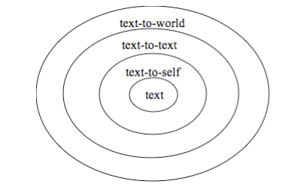
Making Text Connections

Slide 3
“The Good Lie”
Task 1: Making Text Connections
Task 2: Comparing and Contrasting

Slide 4
Tuesday 10/11 Warm-Up
Journal- Imagine that you are a Lost Boy and you have to persuade the American government to let you resettle in the USA. Write three different arguments: one using ethos, one using pathos, and one using logos.

Slide 5
The Good Lie
Please finish both assignments.
Respond to the questions in complete sentences and with thorough detail.
Turn in both assignments when done.

Slide 6
Wednesday and Thursday
In 709 Lab (upstairs)
Working on project
Project is due on Tuesday 10/18!

Slide 7
Friday 10/14 Warm-Up
Please choose 10 warm-ups/in-class activities from Unit 2 to turn in.
Create a Table of Contents that clearly lists the 10 you have chosen.
On the bottom of the table of contents, please give yourself an overall grade for Unit 2 – considering your participation, in-class effort, and out-of-class effort – do you deserve an A, B, C, D, or F? Include a clear and thorough explanation.

Slide 8
Unit 2 Quiz
Please make sure your name is on your paper!
Read and follow directions for each step.
When you are done, please turn it in to Ms. Yeganegi.

