Slide 1
Monday Warm-Up
Please copy the following definitions into your notebook, and then do the following:
Underline key words.
Rewrite the definition in your own words.
3) Draw a picture to help you remember the definition.
CULTURE: Any group of humans that has similar values, beliefs, and habits. CUSTOM: A traditional and widely accepted way of doing things that is specific to a group of people or a place or a time.
TRADITION: A custom that is passed down among a group of people.
RITUAL: A religious or spiritual series of actions done in a particular order.

Slide 4
Quick writes
What culture(s) are you a part of? (This can be related to your race/ethnicity, and also groups that you are involved in, share similar beliefs with, etc.)
What are some cultural customs/traditions that your family has?
Do you and your family practice any rituals? If so, what are they?

Slide 5
UNUSUAL CULTURAL CUSTOMS/TRADITIONS/RITUALS
https://www.youtube.com/watch?v=qBND33BNfZw
https://www.youtube.com/watch?v=XEWmynRcEEQ
https://www.youtube.com/watch?v=1vvb16VyVEY
https://www.youtube.com/watch?v=2OOs1l8Fajc
Fill out your graphic organizer as we watch!

Slide 6
Google Work #1
Use Google to find an unusual cultural custom (that we did not talk about today).
Read about it, watch videos, whatever you need to do to understand the tradition or ritual.
Write a one-paragraph summary and reflection (describe the custom in detail; make sure your reader can understand who, what, when, where, why; and include your personal thoughts, reflections, and questions on it).
The assignment is due on Wednesday.

Slide 7
Body ritual among the nacirema
Annotate the text while we read.
Complete the close reading handout.
After reading: Reading Response Questions.

Slide 8
Tuesday Warm-up
Finish your “Nacirema” Reading Response Questions from yesterday. Make sure you answer EVERY PART and WRITE IN COMPLETE SENTENCES.

Slide 9
Narrative writing
Definition: Writing that tells a real or imagined story.
Put a * next to things you already know how to do in your writing.
Put a ?? next to things you are not sure how to do in your writing.
Underline/circle/highlight key words and phrases.

Slide 10
Narrative Writing Review
Take about 15 minutes to work through the review packet.
Mark anything you don’t remember or need extra help with. It will be important to share these things so we can review!

Slide 11
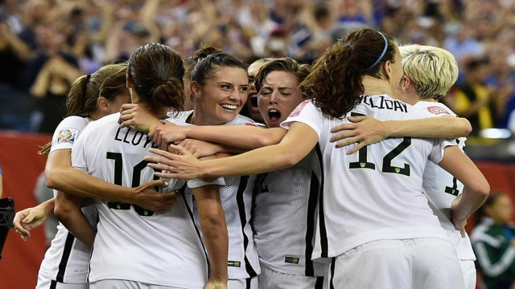

Slide 12
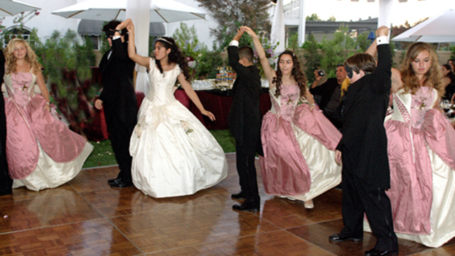

Slide 13
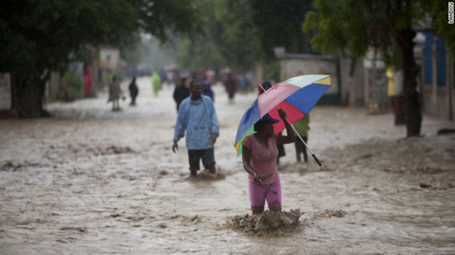

Slide 14
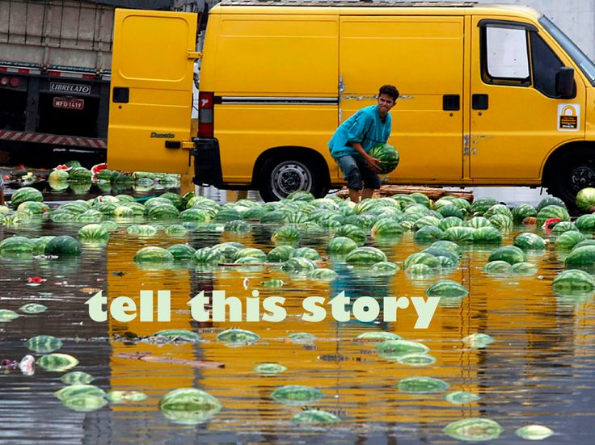

Slide 15
“Fish cheeks” by amy tan
While we read…
Annotate for:
Examples of culture
Examples of figurative language
Examples of imagery

Slide 16
“Fish Cheeks” Questions
Make sure you cite textual evidence whenever the question asks you to.
Respond in complete sentences.

Slide 17
Cultural Customs
Share out your Google homework.
Turn in the assignment, as well as your “Fish Cheeks” questions.

Slide 18
Journal
Imagine you’re stranded on a deserted island. Write about your experience, using plenty of details and figurative language. Remember to show not just tell.

Slide 19
“no speak English” by Sandra cisneros
While we read…
Annotate for:
Examples of culture
Examples of figurative language
Examples of imagery

Slide 20
“no speak english” Questions
Make sure you cite textual evidence whenever you can. Any words directly from the text go in quotation marks.
Respond in complete sentences.
Follow the directions on the last two items.

Slide 21
CULTURE SHOCK NARRATIVE brainstorming
List all cultures you can identify with (groups).
Think of a time when you felt like an outsider because of your culture (“culture shock”)
Explain how this moment represents or defines you as a person.

Slide 22
CULTURAL SHOCK NARRATIVE PRE-WRITING
Use the graphic organizer provided to outline what you will write about.
Make sure that you consider the sensory details you will use
Your writing piece will need to be approximately one page long (about the same as “Fish Cheeks” or “No Speak English.”)
If you prefer to do something different as pre-writing, then use the back of the handout.

Slide 23
Friday Warm-up
Read the story entitled “Hairs” by Sandra Cisneros. Feel free to annotate/mark on it as you read. It is short, so read it twice!
On the handout, identify one example of each type of figurative language listed.
Finally, write a short piece (3-4 sentences) about your own hair, using the same style as Cisneros uses here. Think about how to make someone imagine the touch, texture, and appearance of your hair.

Slide 24
CULTURE SHOCK NARRATIVE ROUGH DRAFT
Using your pre-writing from yesterday, you will write a rough draft of your culture shock narrative on notebook paper.
Your piece should be approximately one page (about the same as “Fish Cheeks” and “No Speak English.”
Use your narrative writing cheat sheet as you draft.

Slide 25
CULTURE SHOCK NARRATIVE peer revision
Switch papers with a peer.
You will read the narrative you have on your desk.
Use the Peer Revision Handout to check over the narrative. You are looking for an engaging hook, a clear narrator, figurative language, details, spelling and grammar errors, etc.
Fill out the handout completely. When you’re done, return the handout and the narrative to the writer.
Use your peer’s comments to improve your rough draft.

Slide 26
Weekend work
Finish your rough draft, using your peer’s comments.
Be ready to turn your rough draft into me on Monday for my review.
Have a wonderful weekend!

