Slide 1
Warm-Up: Monday 9/12: Complete an OPTIC.

Slide 2
Sonia Nazario and Enrique’s Journey
Please set up a 3-2-1 graphic organizer on your paper.
3 Facts
2 Surprises
1 Question
Video Clip: https://www.youtube.com/watch?v=SNW8hvtaVEU

Slide 3
Double-Entry Reading Journal – You need at least 5 entries per chapter. Today: CH. 1 & 2
From the Text (include Chapter #)
Your Reaction/Connections/Follow-Up
Quote directly from the reading (words, phrases, or sentences that you either like or clearly suggest a meaning or importance to you).
Anything you find challenging or interesting – an idea, an image, or something that strikes you in some way
A part you don’t understand, or have a question about, or have a problem with.
Unknown vocabulary words
Pictures or diagrams to help you understand the reading, if you are a visual learner.
Your commentary on the quote – either why you like it, why it is significant, or why/how you connect to it.
Explain/Analyze why you found it challenging, interesting, or striking.
Write your questions. Try to answer them or explore why you find it puzzling or hard to understand.
Define the terms after consulting a dictionary.
Explain your drawings to achieve further understanding of the reading.

Slide 4
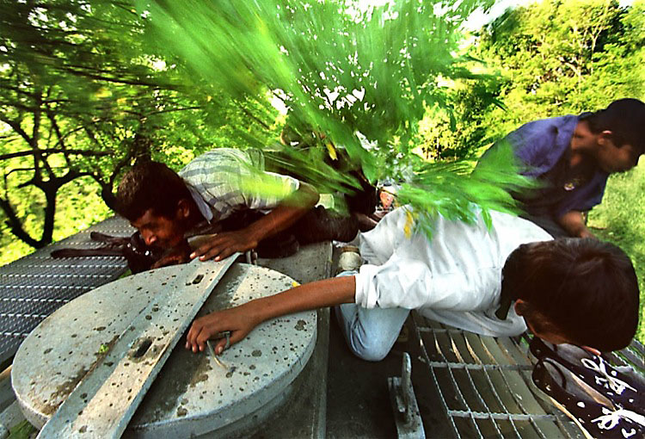
Tuesday 9/13 Warm-Up

Slide 5
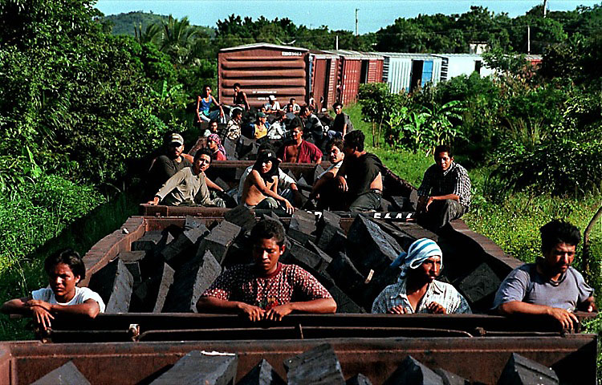

Slide 6
Double-Entry Reading Journal – You need at least 5 entries per chapter. TODAY: CH. 3 & 4
From the Text (include Chapter #)
Your Reaction/Connections/Follow-Up
Quote directly from the reading (words, phrases, or sentences that you either like or clearly suggest a meaning or importance to you).
Anything you find challenging or interesting – an idea, an image, or something that strikes you in some way
A part you don’t understand, or have a question about, or have a problem with.
Unknown vocabulary words
Pictures or diagrams to help you understand the reading, if you are a visual learner.
Your commentary on the quote – either why you like it, why it is significant, or why/how you connect to it.
Explain/Analyze why you found it challenging, interesting, or striking.
Write your questions. Try to answer them or explore why you find it puzzling or hard to understand.
Define the terms after consulting a dictionary.
Explain your drawings to achieve further understanding of the reading.

Slide 7
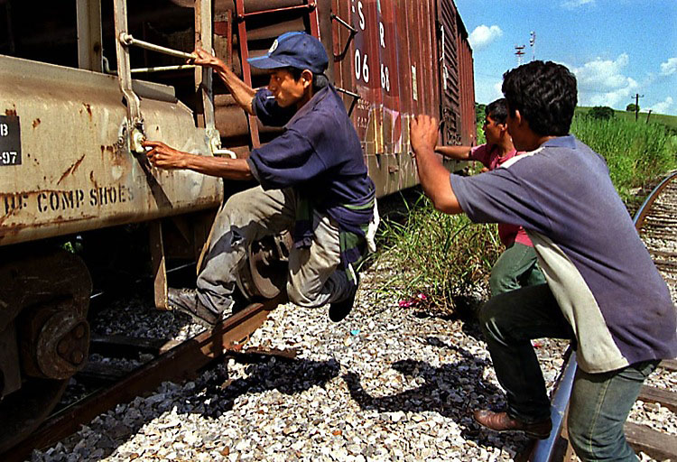
Wednesday 9/14 Warm-Up

Slide 8
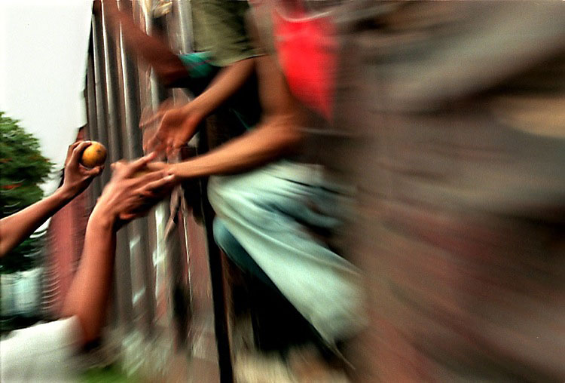

Slide 9
Double-Entry Reading Journal – You need at least 5 entries per chapter. TODAY: CH. 7 & 8
From the Text (include Chapter #)
Your Reaction/Connections/Follow-Up
Quote directly from the reading (words, phrases, or sentences that you either like or clearly suggest a meaning or importance to you).
Anything you find challenging or interesting – an idea, an image, or something that strikes you in some way
A part you don’t understand, or have a question about, or have a problem with.
Unknown vocabulary words
Pictures or diagrams to help you understand the reading, if you are a visual learner.
Your commentary on the quote – either why you like it, why it is significant, or why/how you connect to it.
Explain/Analyze why you found it challenging, interesting, or striking.
Write your questions. Try to answer them or explore why you find it puzzling or hard to understand.
Define the terms after consulting a dictionary.
Explain your drawings to achieve further understanding of the reading.

Slide 10
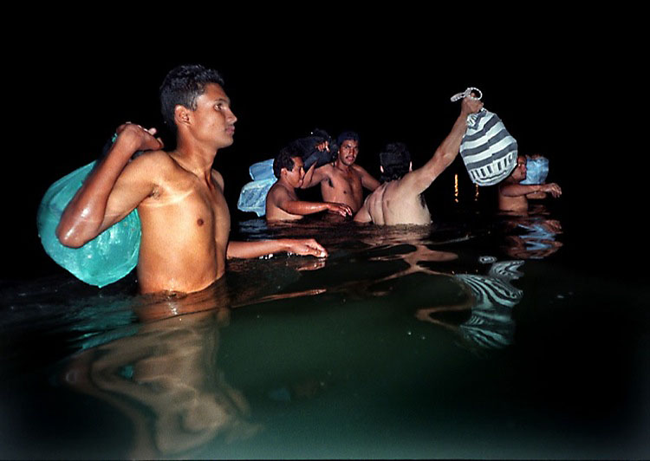
Thursday 9/15 Warm-Up

Slide 11
“Which Way Home”
Keep up with your graphic organizer during viewing (tracking push and pull factors and ethos, pathos, and logos).

Slide 12
Friday 9/16 Warm-Up
Based on the chapters from Enrique’s Journey, the film “Which Way Home,” and anything else you know about, give 3 reasons why these children could be considered immigrants.
Now, give 3 reasons why these children could be considered refugees.
Describe your personal feelings and reactions so far to this situation. How does it make you feel to learn about what these children/adolescents are going through?

Slide 13
“Which Way Home”
Keep up with your graphic organizer during viewing (tracking push and pull factors and ethos, pathos, and logos).

Slide 14
Persuasive Claim – Immigrants or Refugees?
Are these child migrants IMMIGRANTS or REFUGEES?
Create a persuasive claim using the graphic organizer.
You must have three reasons to support your opinion.
You must have at least one piece of evidence to support each reason. (Use the chapters from EJ, the film, or real-world connections).
Persuasive/Argumentative Writing always requires a counter-argument, or a nod to the other side (not your opinion). Come up with ONE reason why some may disagree with you, then immediately disprove it and go back to your opinion.
Finish strong – restate your argument in your conclusion.

