Slide 1
Warm-Up
Begin working on the handout you received at the door. Please be thorough and thoughtful in your responses.

Slide 2
What is a brochure?
A small book or magazine containing pictures and information.
*May be written to inform, to persuade, AND to entertain.

Slide 7
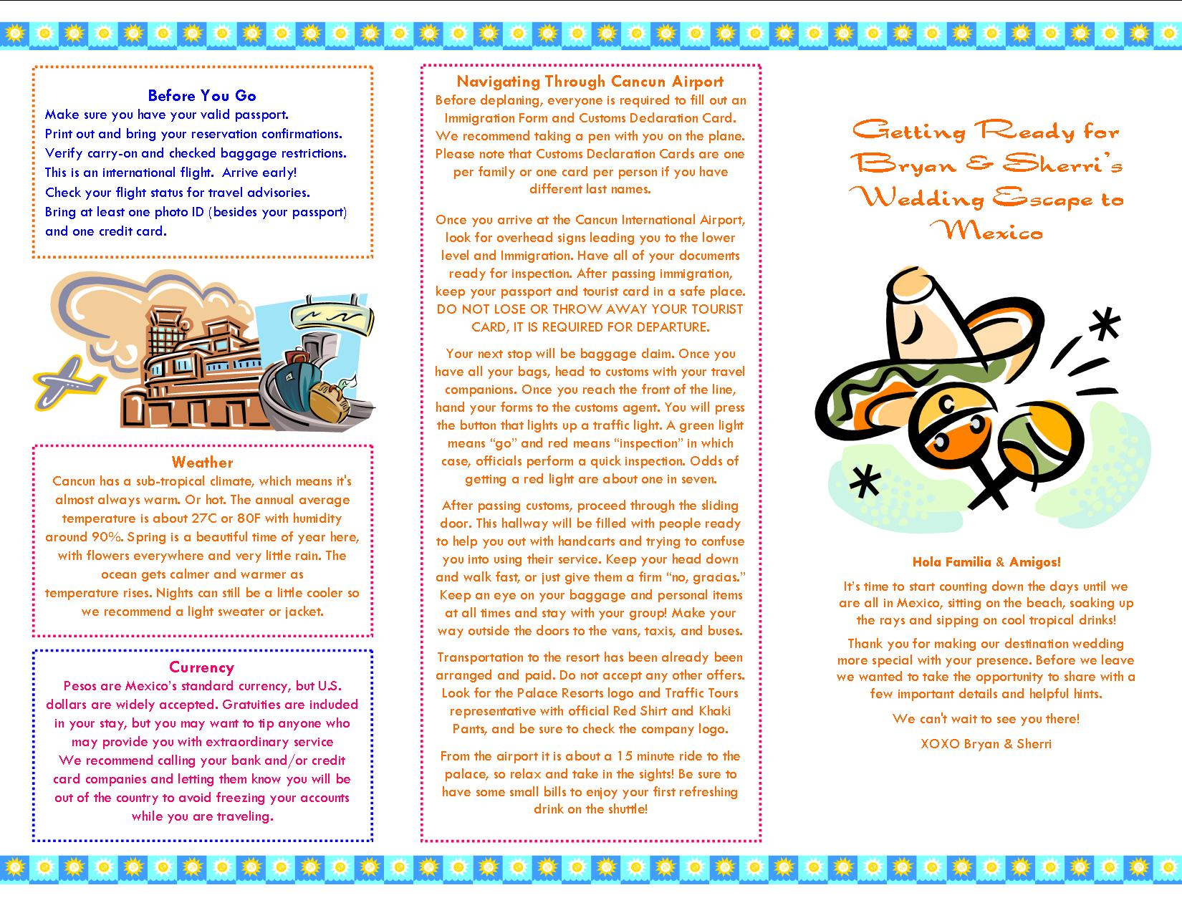

Slide 8
Advanced Composition Brochure
As the “essay” part of your final exam, you will create a brochure that will be used to inform, persuade, and entertain a future student in this course.
Think about what you learned and turn that into INFORMATION about the class.
Draw on your expertise to PERSUADE the student on how to succeed.
Make it helpful, interesting, and physically attractive in order to ENTERTAIN your reader.

Slide 9
Brochure Requirements
Content – Must be accurate, thorough, thoughtful, informative, and appropriate.
Written Presentation – Must be organized, attractive, clear, informative and persuasive, and final draft quality
Visual Appeal – Must be imaginative, creative, colorful, and neat.

Slide 10
Brochure Assignment
Your brochure should include, at the minimum:
Cover Page
Five Panels (filled with text and visuals)
Clear and Logical Section Headers
Plenty of written information
Plenty of visuals and graphics
Extra points for “above and beyond” effort will be rewarded at Ms. Yeganegi’s discretion.

