Slide 1
Unit 3 Activator
Respond to the following:
Describe your perfect world. Things to consider: What are the rules in this world? What is your role? Who does what? What is daily life like?
Describe your worst-possible world – a nightmare. Things to consider: What are the rules in this world? What is your role? Who does what? What is daily life like?

Slide 2
Discuss & Class Brainstorm
Perfect World
Worst-Possible World

Slide 3
New Class Rules – Effective Immediately
No one will be allowed to talk, stand up, or do anything in class without my permission.
From now on, you will only communicate with one another via online chat in the computer lab. I will have access to everything you say in your chats.
The class will be divided into 3 groups based on grades. Students with the highest grades will be in one group, those in the middle will be in another, and those with the lowest will make up the third group. There will be no communication allowed outside of these groups in class. Groups will have different assignments and are not allowed to know anything about the other group assignments.
We will no longer be discussing the background or historical connections of any of our texts. We will be free from the burden of thinking about the past. We will concentrate on the here and now and the future of our classroom. History is not important.
You may not discuss your family, interests, or cultural background. The culture of our classroom is more important. These other details distract from our task at hand. We are all equal. Our differences are not important.

Slide 4
Not Really…
Ok, these rules aren’t really true. But, they do illustrate what you need to understand as we start our third unit:
Unit 3: Perception is Everything - Dystopia.

Slide 5
Quick Writes
How would you feel if rules like these were really implemented in one of your classes? Why?
What are some possible reasons that a teacher might implement rules like these?
If I had introduced these rules gradually, over the course of a school year for example, would you have responded in the same way as you did having them all introduced at the same time? Why?
What are some rules we have in our society or in our school that limit personal freedom in some way? Why are these rules in place?

Slide 6
Perception is Everything!
In Unit 3, we’re going to look specifically at the idea of illusion vs. reality – how dystopias often seem like perfect worlds, whereas in reality they are pretty awful.

Slide 7
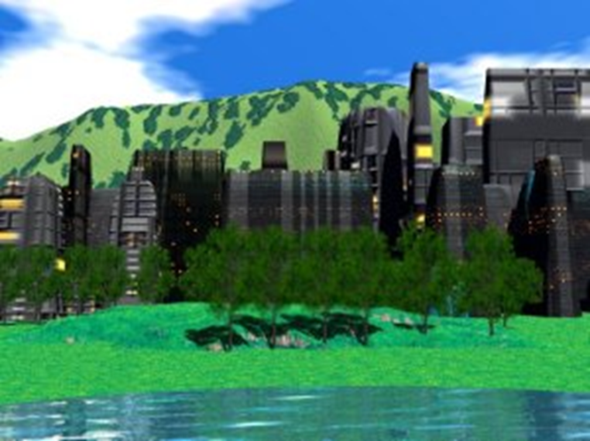
Utopia
A place, state, or condition that is ideally perfect in respect of politics, laws, customs, and conditions.

Slide 8
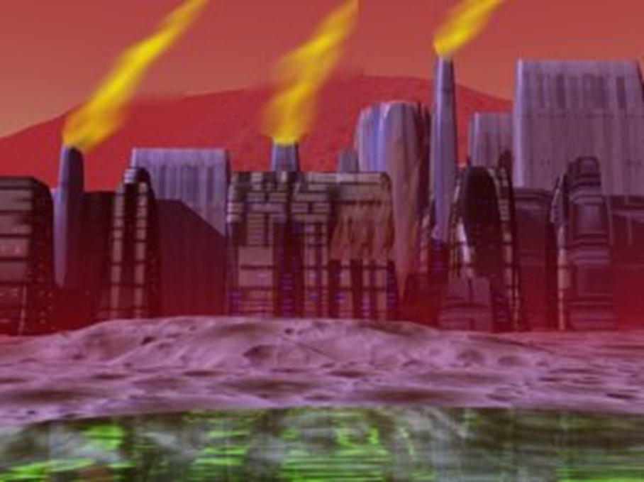
Dystopia
A futuristic, imagined universe in which oppressive societal control and the illusion of a perfect society are maintained through corporate, bureaucratic, technological, moral, or totalitarian control.

Slide 9
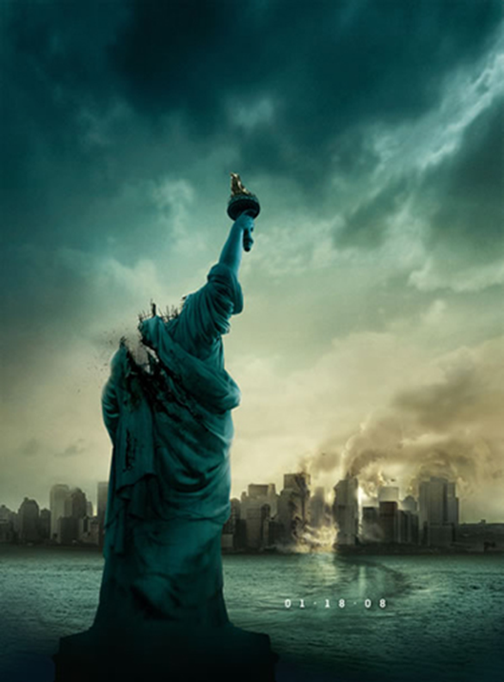
Dystopia (cont.)
Dystopias, through an exaggerated worst-case scenario, make a criticism about a current trend, societal norm, or political system.

Slide 10
Characteristics of Dystopia
Propaganda is used to control the citizens of society.
Information, independent thought, and freedom are restricted.
A figurehead (often a dictator) is worshipped by the citizens of the society.
Citizens are perceived to be under constant surveillance.

Slide 11
Citizens have a fear of the outside world.
Citizens live in a dehumanized state.
The natural world is banished and distrusted.
Citizens conform to uniform expectations.
Individuality and dissent are bad.
The society is an illusion of a perfect utopian world.

Slide 12
Types of Dystopian Controls
Corporate control: One or more large corporations control society through products, advertising, and/or the media. Examples include Minority Report.
Bureaucratic control: Society is controlled by a mindless bureaucracy through a tangle of red tape, relentless regulations, and incompetent government officials. Examples in film include Idiocracy and V for Vendetta.

Slide 13
Types of Dystopian Controls
Technological control: Society is controlled by technology—through computers, robots, and/or scientific means. Examples include The Matrix, The Terminator, and I, Robot.
Philosophical/religious control: Society is controlled by philosophical or religious ideology often enforced through a dictatorship or theocratic government. Examples include Pleasantville.

Slide 14
The Dystopian Protagonist
Often feels trapped and is struggling to escape.
Questions the existing social and political systems.
Believes or feels that something is terribly wrong with the society in which he or she lives.
Helps the audience recognize the negative aspects of the dystopian world through his or her perspective.
Shows courage in acting on all the above.

Slide 15
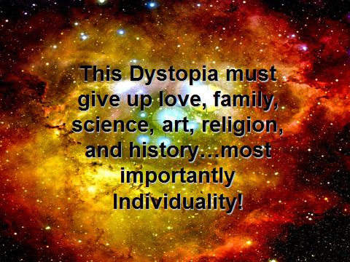

Slide 16
Film Trailers Activity
For each film trailer, fill out the graphic organizer.

Slide 17
Summarizer
Which film clip did you think was the ONE BEST example of dystopia? Why?

