Slide 1
Please get out your copy of “Eldorado” by Edgar Allen Poe.
Question: How does this image relate to the poem?

Slide 2
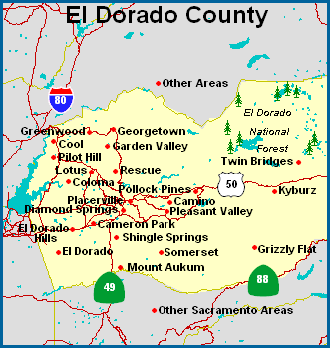
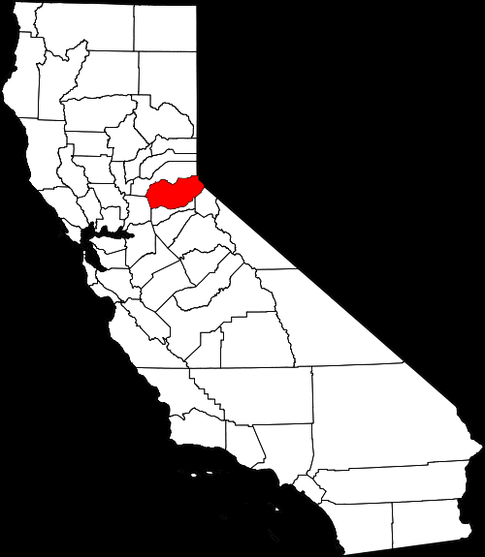

Slide 4
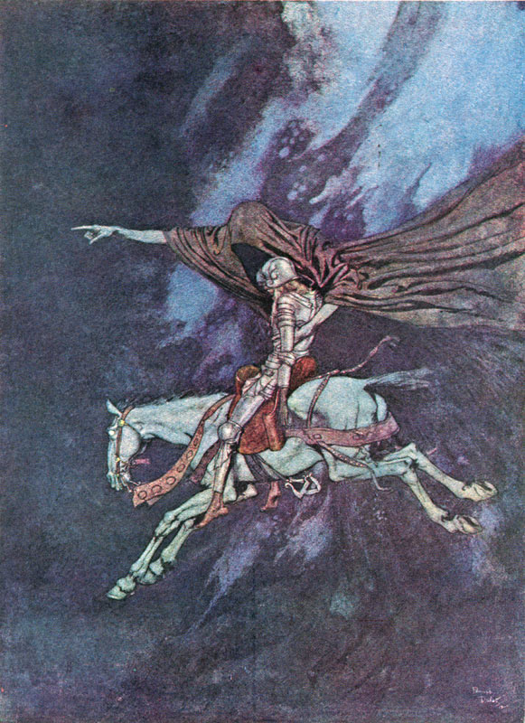
“Eldorado” by Edmund Dulac

Slide 5
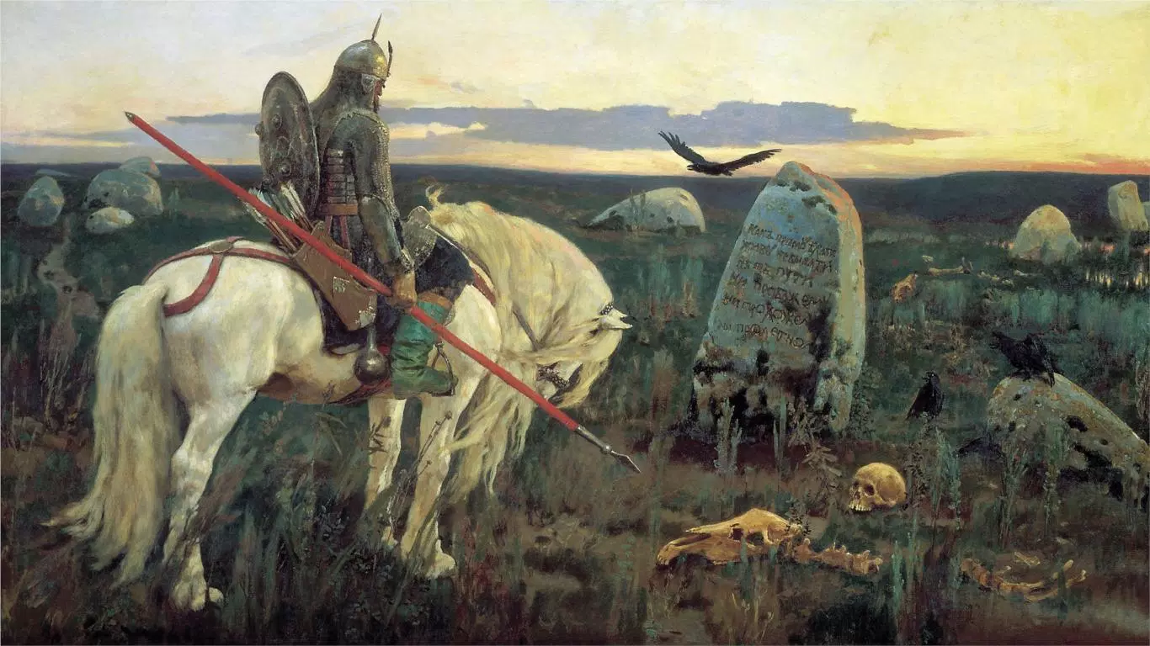
The Knight at the Crossroads by Viktor Vasnetsov

Slide 6
The American Dream Through The Decades
We need 12 groups (2-3 people per group).
Each group will be assigned a primary source from a year in history.
Read the article and fill out the graphic organizer appropriately.
Be ready to share your information with the class in a manageable, bullet-point friendly handful of facts or important points.
Guiding Question: How has the American Dream been viewed throughout history? How has the view changed?

Slide 7
The Other Wes Moore One Name, Two Fates
http://www.youtube.com/embed/udQWOfALwj4

Slide 8
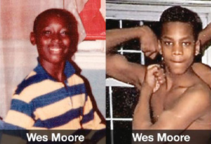

Slide 9
Wes Moore – Scholar

Slide 10
Wes Moore – Prisoner

Slide 11
Things to Note
Italicized Text – Wes and Wes are meeting
1st person POV = Wes the scholar/author
Gray line = shifting POV
3rd person POV = Wes the prisoner

Slide 12
REAding Calendar
Finish Part 1 (Chapters 1-3) should be finished by Tuesday
Part 1 Assessment on Wednesday
Work on the Reading Guide as you read Chapter 1.
The Other Wes Moore Questions are due upon conclusion of the book – Tuesday 2/6.

