Slide 1
Journal
Imagine you’re stranded on a deserted island. Write about your experience, using sensory details, concrete details, and figurative language. Remember to show not just tell.

Slide 2
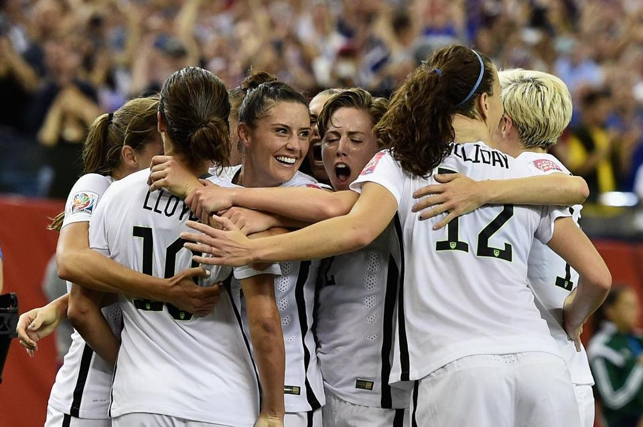

Slide 3
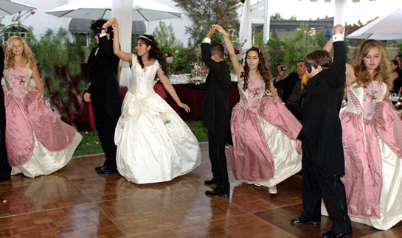

Slide 4
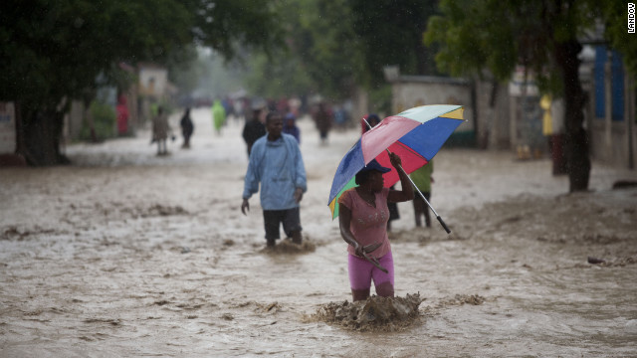

Slide 5
“Hairs” by Sandra cisneros
1) Read once.
2) Read a second time. Make notes.
3) Locate figurative language.
4) Answer the questions and consider the writing and author’s decisions.
5) Model your writing after Cisneros’ by writing a vignette about your and your family’s “hairs.”
6) Turn in your completed paper.
7) Have a good weekend! ☺

