Slide 1
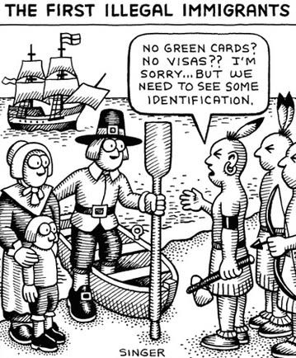
Warm-Up: Write a response the pilgrims would give in this cartoon.

Slide 2
Jose Antonio Vargas
Born in the Phillippines and immigrated to the United States at age 12
At age 16, he found out he was brought here illegally
Award-winning journalist
Focuses on issues surrounding immigration – specifically undocumented immigrants
Author of ground-breaking essay, “My Life as an Undocumented Immigrant,” which was published in The New York Times in 2011

Slide 3
“Actions are Illegal, Never People”
https://www.youtube.com/watch?v=tmz9cCF0KNE
“As I stand here right now, there are tens of thousands of students across America who are here without papers, and I would hate to think that they’re sitting in their classrooms listening to us talk about them and internalizing the word ‘illegal.’
It’s incredibly dehumanizing and pejorative and [so many connotations] come with it — negative, all of them. That we’re criminals. That we’re not supposed to be within even the block that you live in or the school that you go to. Actions are illegal — never people. Something is terribly wrong when we refer to people as ‘illegal.’”

Slide 4
“Actions are Illegal, Never People”
Persuasive Speech – but also both informative and entertaining
Ethos, Pathos, and/or Logos?
Remember, texts very often serve more than one purpose!

Slide 5
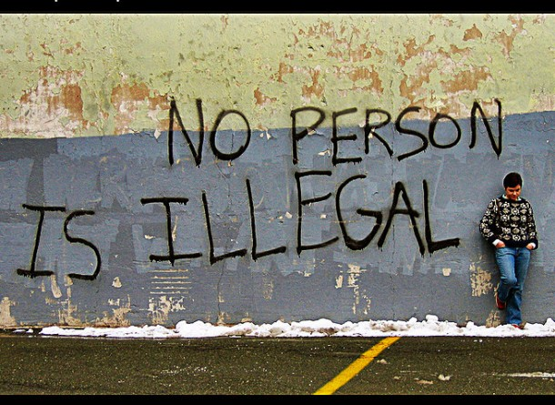
OPTIC

Slide 6
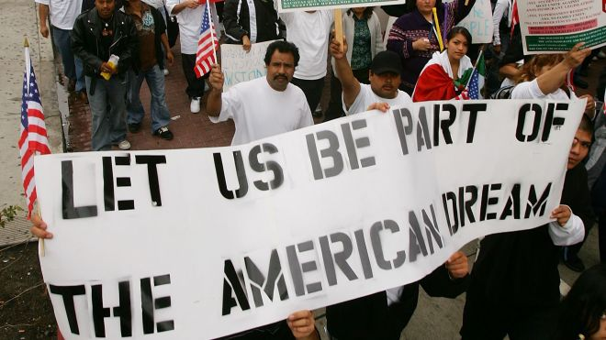
OPTIC

Slide 7
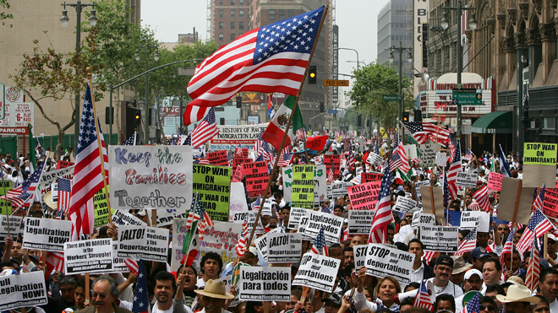
OPTIC

Slide 8
Summarizer: OPTIC Photo Connections
How do the photos connect to Jose Antonio Vargas’ speech? In one paragraph, please explain your thoughts on these questions:
How are the texts connected?
What is one theme or main idea of all the texts?
What have you learned about immigration from looking at these texts together?

