Slide 1
Journal (in your notebook!)
Answer BOTH parts:
What are three things you believe you are good at?
What are three things you believe that you will achieve in the future?

Slide 2
MANDALas
Identity: all the things that combine to make you a unique individual – who you are.
Symbolism: when you use something to represent something else.
Mandala: The word means “circle” in Sanskrit. It is a tool that you use to reflect your identity through symbolism, and often you use it to reflect on your goals.
Believe You Can: Our PHS motto for the year!

Slide 3
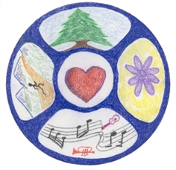

Slide 4
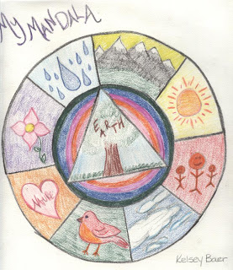

Slide 5
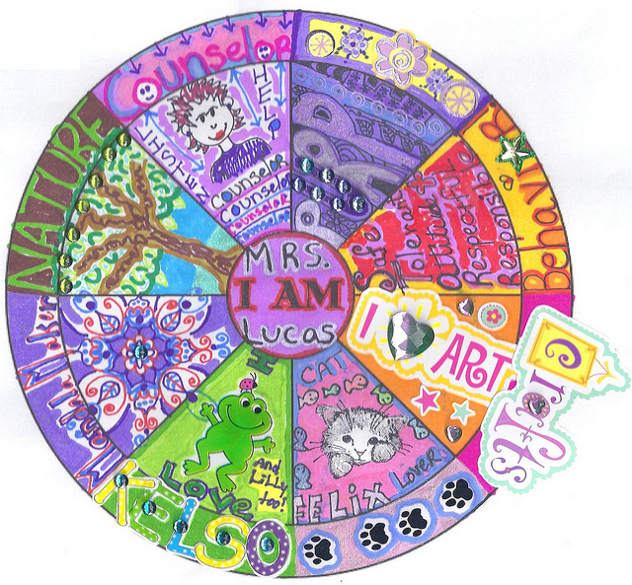

Slide 6
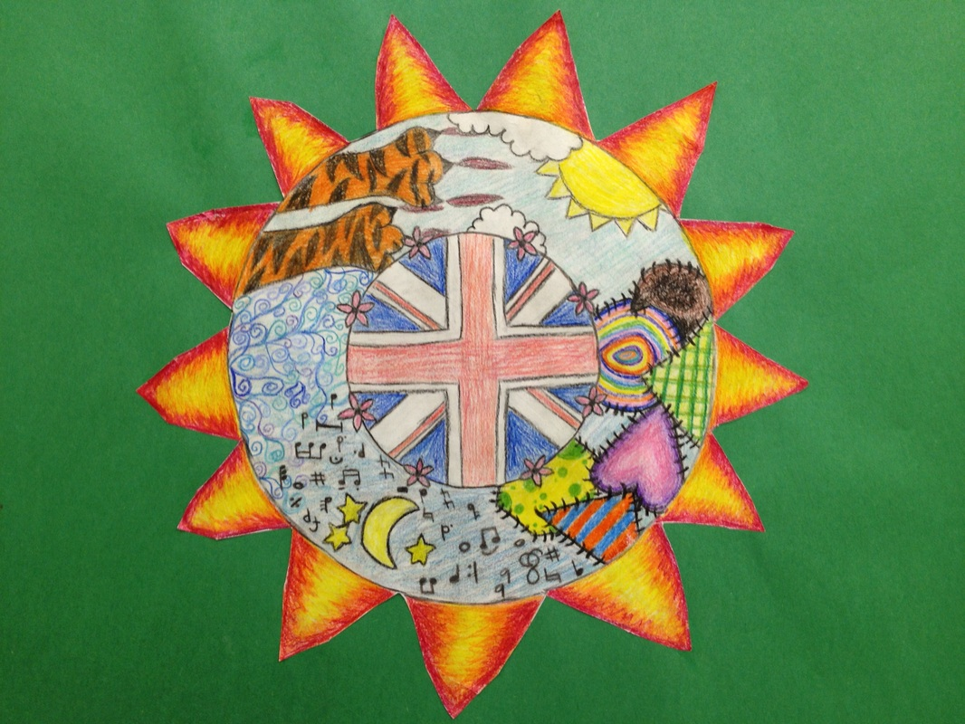

Slide 7
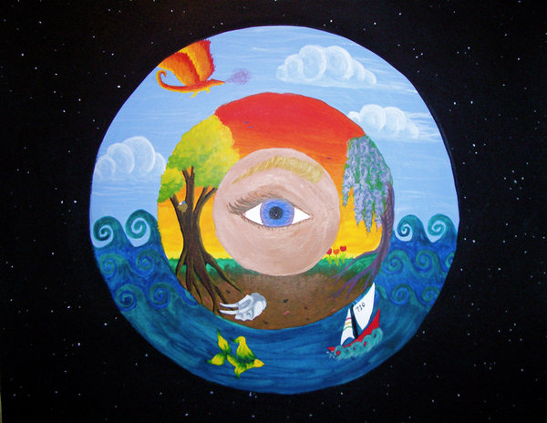

Slide 8
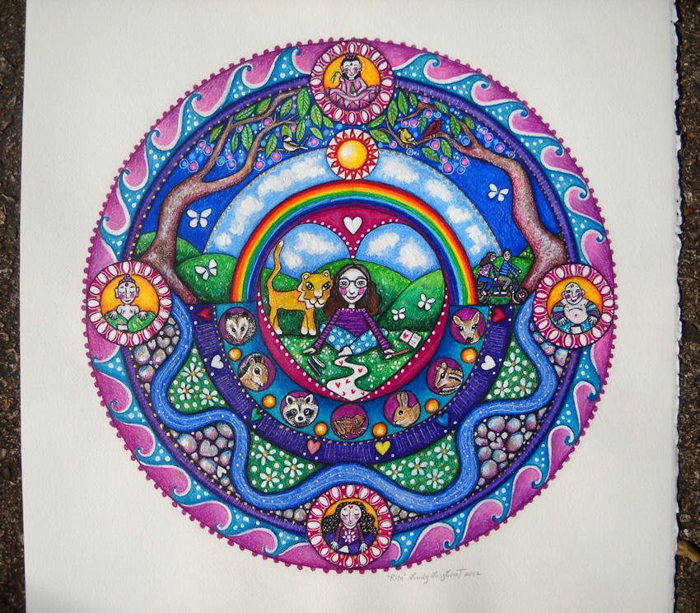

Slide 9
PERSONAL MANDALAS – Believe you Can
1) Prewriting: Complete the questions on the handout. This is part of your grade. Make sure you come up with symbols on each step.
2) Draft: Sketch a rough draft on the back of your pre-writing handout. Don’t color it, and don’t make it perfect – just get an idea of what you are doing.
3) Final Draft: When you are ready to begin your mandala, pick up your final copy paper from me. Be creative!
*Note: To receive full credit, you MUST include a minimum of six symbols (three to represent what you’re good at, and three to represent your goals), and you MUST include color.

