Slide 1
Warm-Up
On your handout from yesterday, make sure you have 3 examples of symbolism.
On the bottom, answer this question: What is the difference between a SYMBOL and a LOGO.

Slide 2
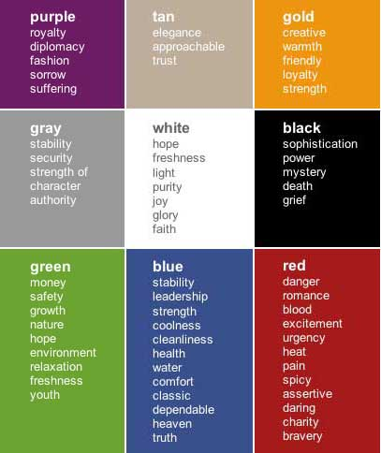

Slide 3
Mandalas
What is a mandala?
The term mandala is from the classical Indian language of Sanskrit and is loosely translated to mean "circle“ or “complete”.
Used chiefly in Hinduism and Buddhism as an aid to meditation

Slide 4
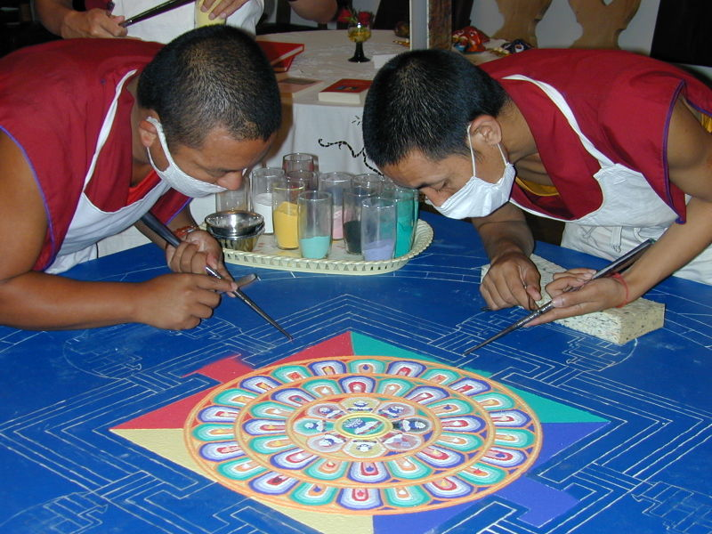
Temporary Sand Mandala
Tibetan monks create impermanent mandalas as an act of meditation. When they’ve completed the mandala, they sweep it up and release the sand into a moving body of water to spread the mandala’s blessings.

Slide 5
What is a Personal Mandala?
In the West, mandala is used to refer to the "personal world" in which one lives, the various elements of the mandala or the activities and interests in which one engages, the most important being at the center of the mandala and the least important at the periphery.

Slide 6
The Mandala
Describing both material and non-material realities, the mandala appears in all aspects of life: the celestial circles we call earth, sun, and moon, as well as conceptual circles of friends, family, and community

Slide 7
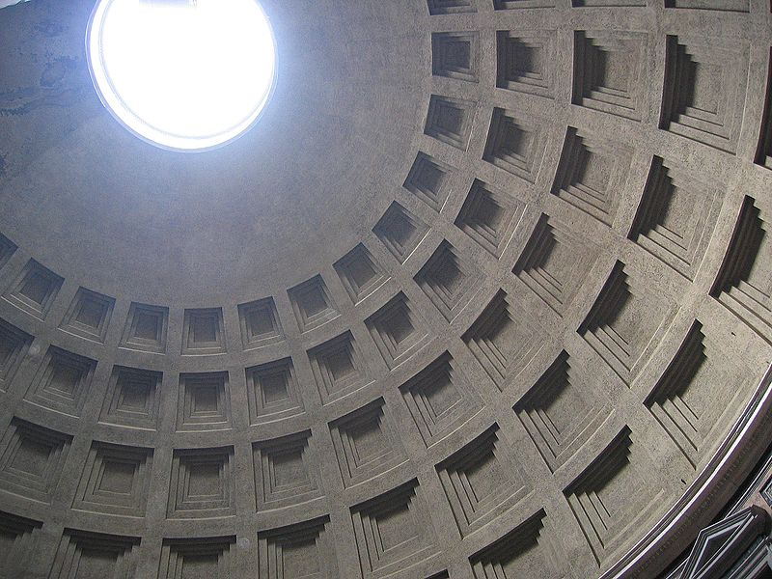
Oculus of the Pantheon, Rome 31 BC

Slide 8
Buddhist Borobudur Temple, Indonesia 800AD

Slide 9
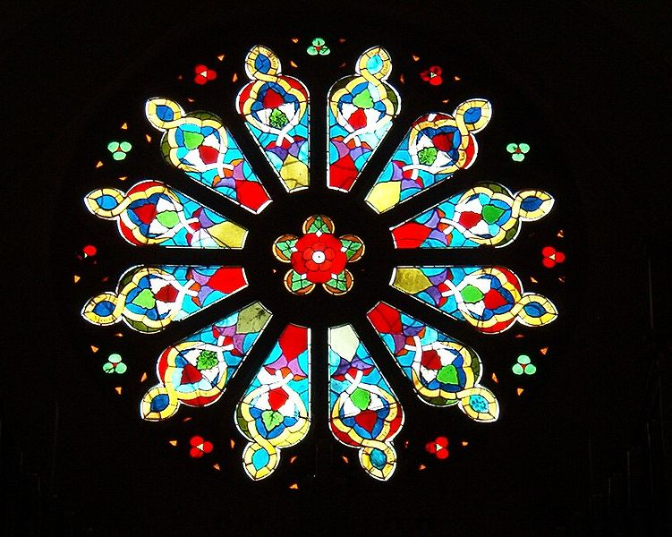
Catholic Church Rose Window, Sweden

Slide 10
Sun

Slide 11
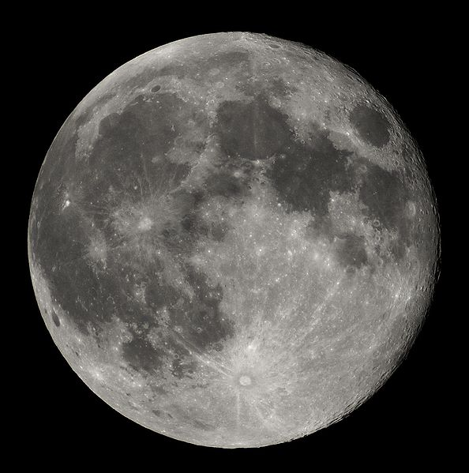
Moon

Slide 12
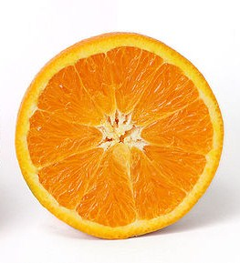
Orange

Slide 13
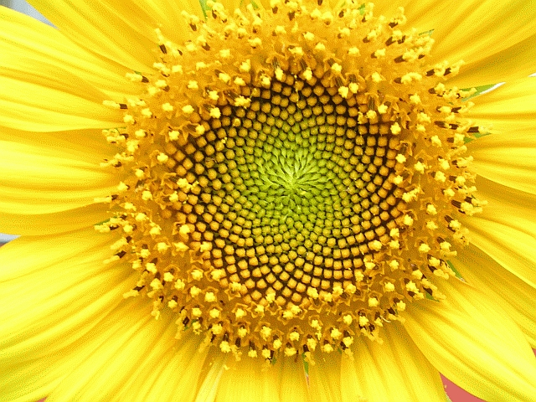
Sunflower

Slide 14
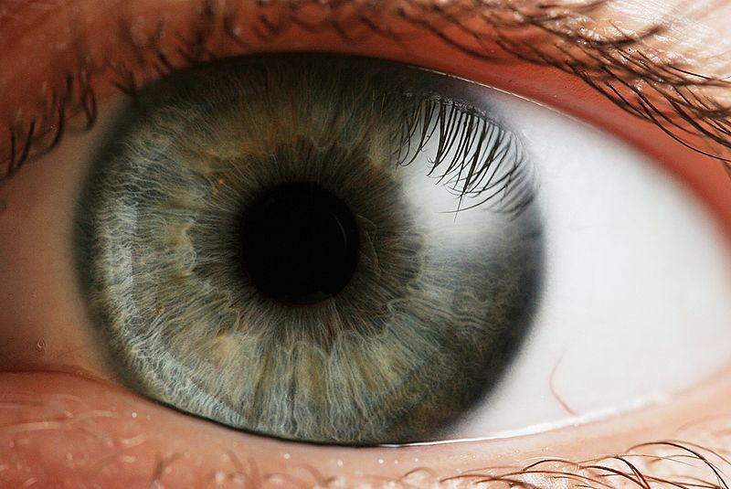
Human Eye

Slide 15
Personal Mandalas
A personal mandala
is a tool used for self observation, growth, or goal making.
combines elements of an individual’s life, making a unique story based on the past, present and future.
is made based on information regarding personal beliefs, relationship to nature, family, animals, and so on.
is often created spontaneously and always unique to the individual - therefore no two are ever the same.
can be used for individuals or groups - for particular themes and occasions- such as weddings, anniversaries, special birthdays and any celebration of new beginnings—the beginning of a new school year or semester.

Slide 16
Your Personal Mandala
To celebrate a new school year, you are going to design your own personal mandala. Your personal mandala will represent you as a diverse and unique individual who is needed to create our class dynamic, and will be displayed among the other student’s mandala designs to symbolize you as an important part of our class, thus illustrating the concept of part of a whole.
You must use symbolism of both objects and colors to represent yourself and your identity.

Slide 17
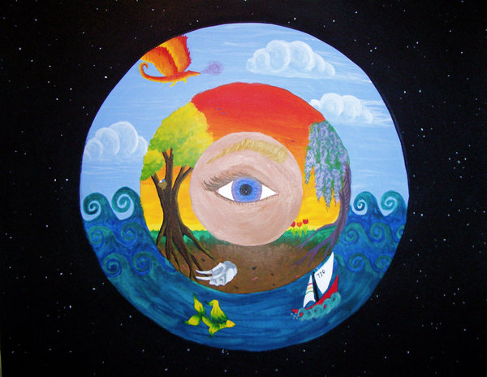

Slide 18
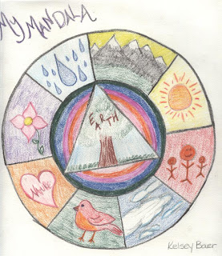

Slide 19
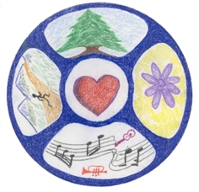

Slide 20
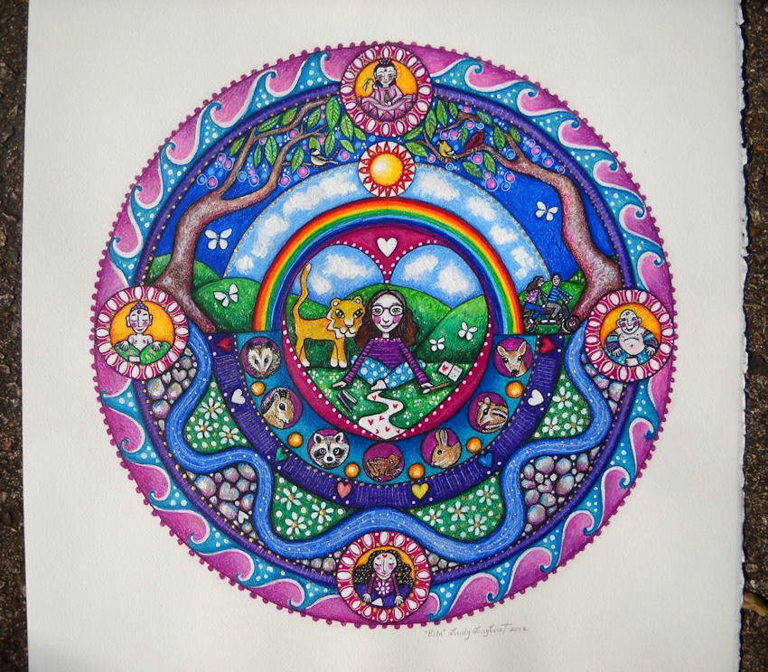

Slide 21
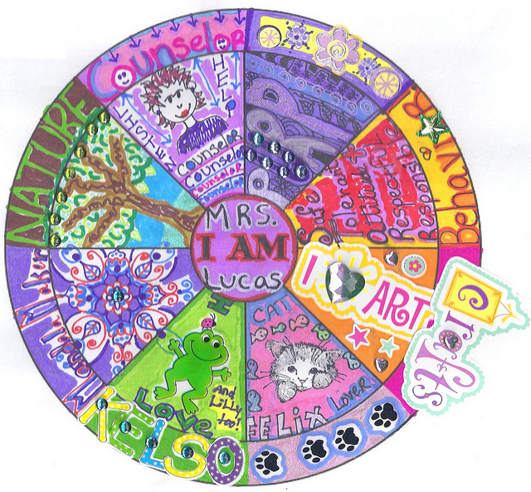

Slide 22
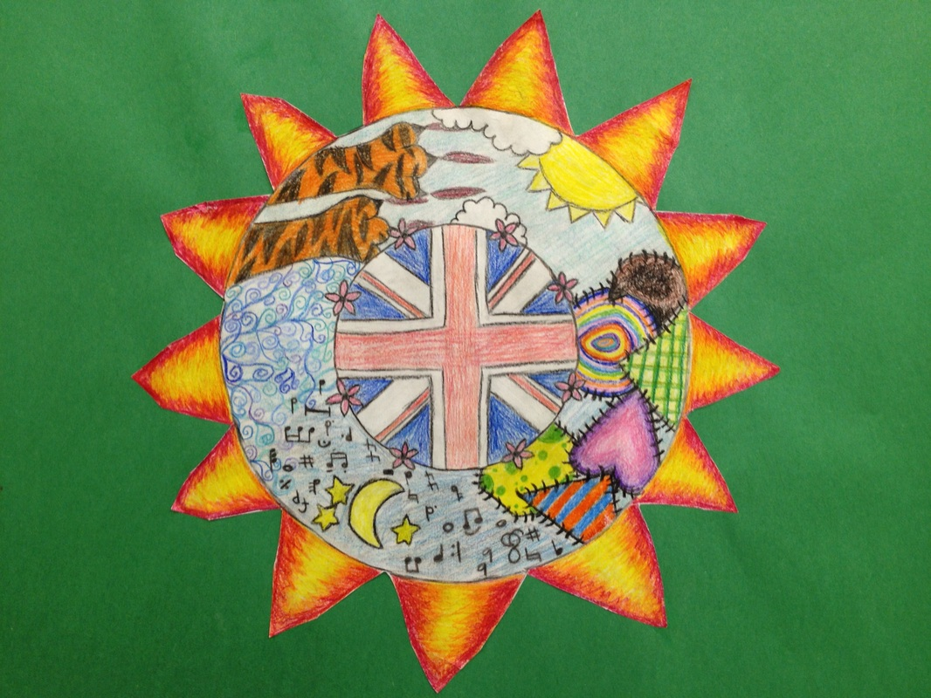

Slide 23
PERSONAL MANDALAS
Complete Steps 1 & 2. This will be a grade for pre-writing.
When you are ready to begin your mandala, get started. Make sure that you:
Use symbolism (AT LEAST 3 symbols)
Use color (think about color symbolism)
Use creativity to reflect your personality
Use MINIMAL writing (only if necessary)
Cut it out when finished
Put your full name and block on the back in pencil

