Slide 1
Please begin working on the EPL Review Sheet!
Welcome back from spring break!
Please remember your new assigned seats. ☺

Slide 2
Brainstorm
Why do immigrants CHOOSE to leave their countries?
What factors could make an immigrant CHOOSE to move to a new country?
Make a list.
Make a list.

Slide 3
It’s easy to become an American citizen. Why don’t all immigrants just try to do that?
Be at least 18 years old at the time of filing the application for naturalization.
Be a permanent resident (have a “Green Card”) for at least 5 years.
Show that you have lived for at least 3 months in the state or district where you apply.
Demonstrate continuous residence in the United States for at least 5 years immediately preceding the date of filing the application.
Show that you have been physically present in the United States for at least 30 months out of the 5 years immediately preceding the date of filing the application.
Be able to read, write, and speak basic English.
Have a basic understanding of U.S. history and government (civics).
Be a person of good moral character.
Demonstrate an attachment to the principles and ideals of the U.S. Constitution.
Approximately 12 months after filing the application, you may be able to take the test.

Slide 4
Could you pass the citizenship test?
Work together.
NO PHONES!! NO GOOGLE!! NO CHEATING!!
You have 15 minutes to answer as many questions as you can.
Good luck!

Slide 5
“Actions are Illegal, Never People”
Jose Antonio Vargas: Filipino journalist
2012 TED Talk
If someone is KNOWN for being a strong speaker, then they are most likely skilled at the use of ethos, pathos, and logos – a speech is rhetoric
https://www.youtube.com/watch?v=tmz9cCF0KNE

Slide 6
Closing: MythBusters
Bust two myths for today:
It’s easy to become a citizen.
Immigrants are called illegal aliens.

Slide 7
Tuesday Warm-Up
Answer the following questions in your journal:
Do you know where your family/ancestors immigrated from?
What do you know about that culture?
What do you know about that immigrant group in America?

Slide 8
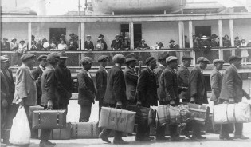

Slide 9
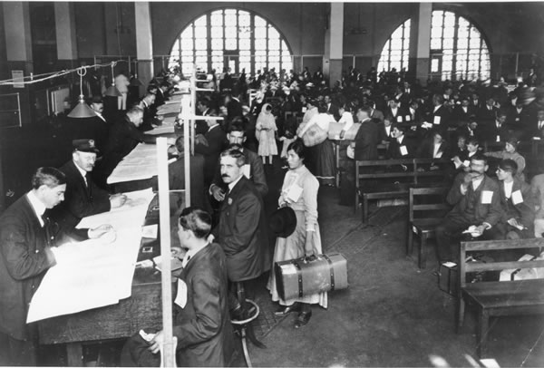

Slide 11
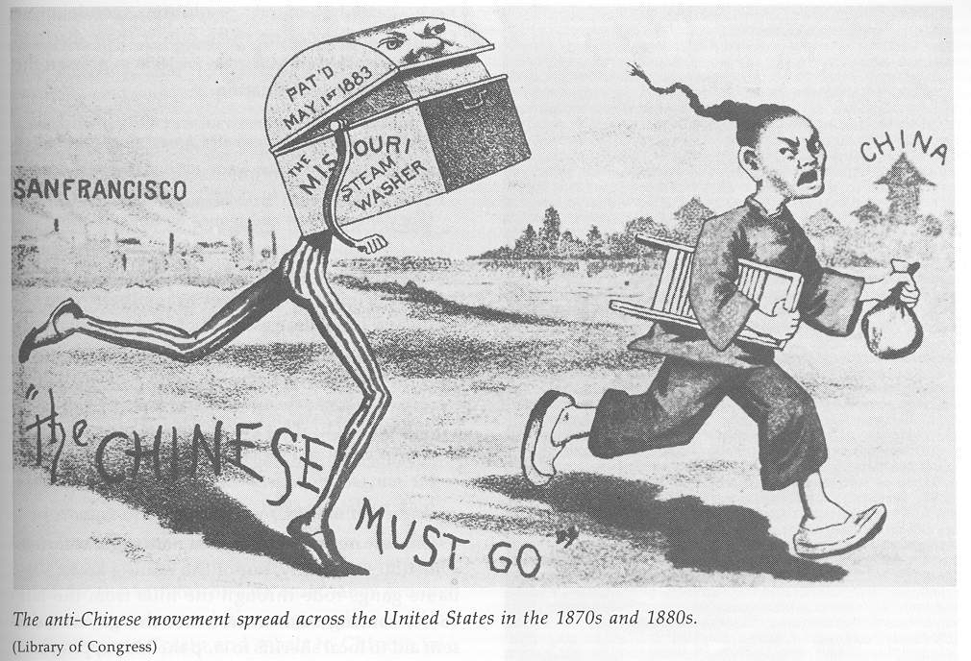

Slide 12
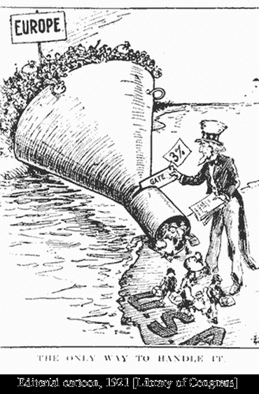

Slide 14
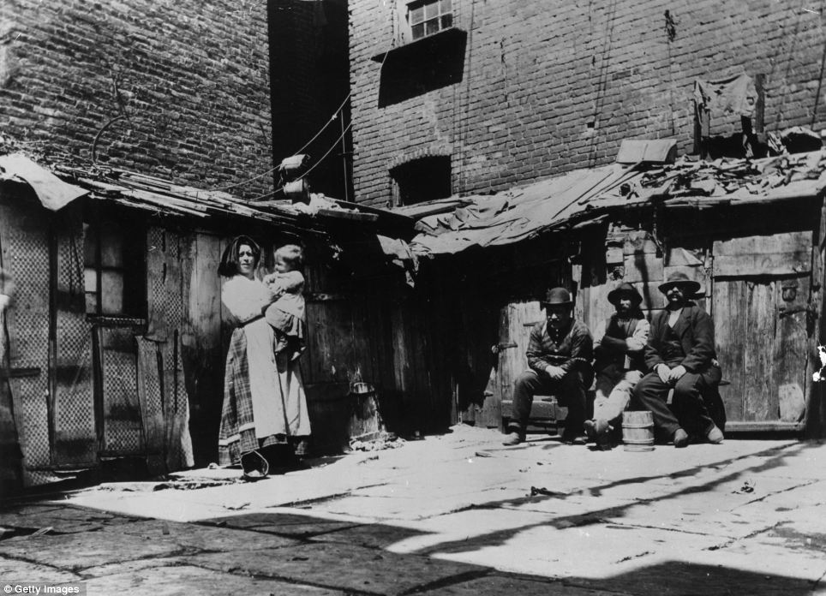

Slide 15
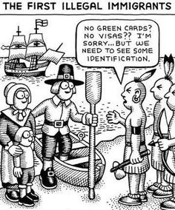

Slide 16
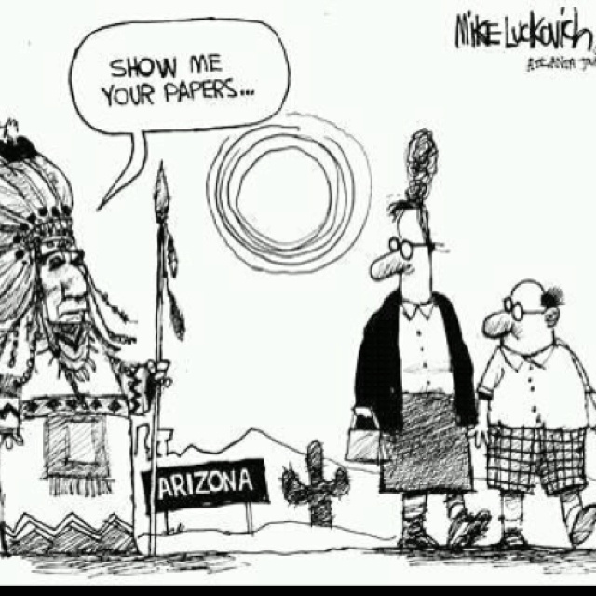

Slide 17
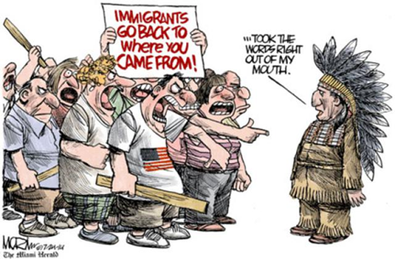

Slide 18
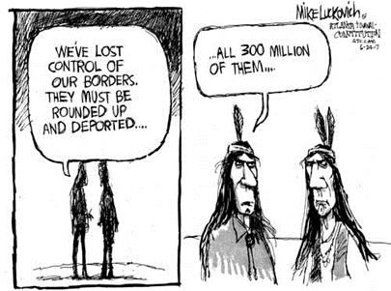

Slide 19
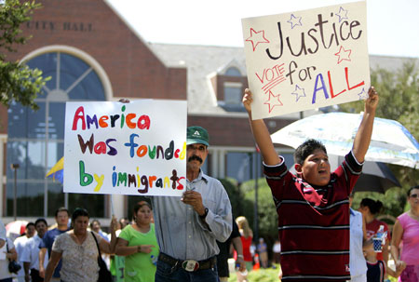

Slide 20
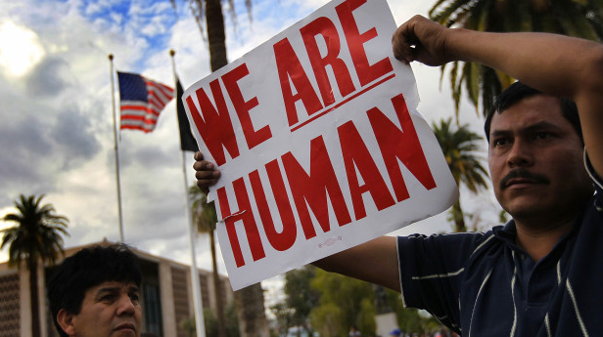

Slide 21
Unit 3 Project
Working in your assigned group (it’s for a reason, it’s a standard, and it’s a life skill)
Researching an immigrant group to the United States
Push/Pull Factors
Their experiences in America
Stereotypes and Prejudices (Myths)
Contributions to our Society
Culture

Slide 22
Unit 3 Project
Creating a thorough and engaging presentation with multiple elements:
Multimedia component (website, slideshow, etc.)
Persuasive Commercial or Public Service Announcement
Handout for the class
Oral Presentation (8-10 minutes total, including showing your commercial/PSA)

Slide 23
Group Brainstorming
Choose the project manager.
Choose a recorder for today.
Everyone can fill out the brainstorming sheet (it helps your brain learn and retain information when your write it down)… but make sure the recorder keeps an official copy to turn into me by the end of class.
Tomorrow: Meet in the 706 lab (upstairs). You will start with individual research.

