Slide 1
Journal
What are you an “expert” on or in? List at least three different things (and yes, you are an expert on something!)

Slide 2
Activity
Write step-by-step instructions on how to make a peanut butter and jelly sandwich.
You have five minutes.

Slide 3
Instructional Writing
Critical to making products, procedures, and systems safe and “user friendly”

Slide 4
Analyzing your Audience
Background (social, education)
Skill level
Use appropriate vocabulary
Translate necessary terms
Needs and use

Slide 5
How do people read instructions?
Some, but only a few, read instructions all the way through before beginning to follow any of the steps
Others read and perform each step without looking ahead to the next
And still others begin a task without reading any instructions and turn to them only when difficulties arise

Slide 6
How do people read instructions?
Assume you are writing for readers who will read and perform each step without looking ahead. Therefore, all instructions must be in a strict chronological order.

Slide 7
Organization & Design
Separate your instructions into logical pieces (chronological order)
Use relevant instructions/graphics
Make the sections of your instructions visually distinct
Separate and label info that isn’t directly part of your instructions

Slide 8
A brief example… (Shhh… no talking during this example!)
Take out a sheet of paper
Fold the paper in half (top to bottom)
On the right-hand side of the page, write the words “instructions test”
Fold the paper in half again (side to side– this will make your paper look like a greeting card)
Draw a smiley face on the front of the card
Write your name on the card
Fold the paper in half from top to bottom again
Ignore step five
Pass the paper to the instructor

Slide 9
Any problems?

Slide 10
Elements of Instructions
Clear and specific title
Poor: Snow Removal
Better: Using Your Acme Snow Blower
General introduction: Explain the purposes of the instructions (even if it is obvious)
These instructions are for nurses who must inject dye into a vein through a balloon-tipped catheter.
If readers needs to gather items in order to follow the instructions, list those items in the introduction (materials and tools needed)

Slide 11
Elements of Instructions
Step-by-step instructions:
Number (or otherwise organize) steps
Use present tense and imperative mode (and don’t omit articles – a, am, though, to create brevity)
Provide the right amount of info for each step
Separate steps from background info or tips
Conclusion
Tell readers what to expect after following the instructions and suggest other uses and options if appropriate

Slide 12
Remember
Know your audience
Keep your instructions simple
Start with an introduction
Use a clear and effective visual hierarchy
DON’T SKIP STEPS JUST BECAUSE THEY SEEM OBVIOUS
Conclude with a summary or description
And, one more time, just so we’re clear on this…

Slide 13
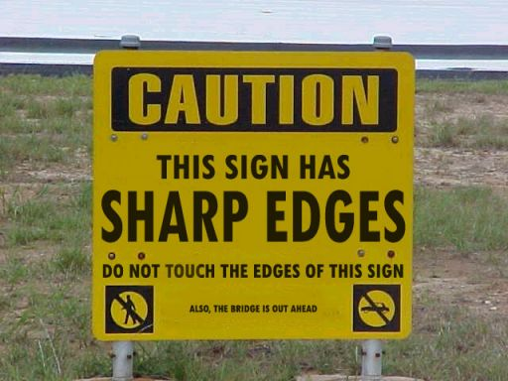
State the Obvious

Slide 14
Don’t Forget…
An incorrect audience analysis is the biggest reason why instructions and manuals fail
Language should always be clear, concise, and brief
Do not use long or complex sentences

Slide 15
Assignment: How to write instructions
Today you will practice writing instructions on a topic of your choice. This helps you master the skill of technical writing. Before you begin, you will need today’s journal entry, the brainstorming handout, one piece of notebook paper, and a writing utensil.
Look at the journal you wrote today.
Circle one of the items you said you are an “expert” on or in.
Complete the instructional writing brainstorming handout, starting at step one and writing your answers down until you reach the final step.

