Slide 1
Warm-Up
Use the handout received at the door to start the Myers-Briggs questionnaire. We will go over it in a few minutes.

Slide 2
Myers-Briggs personality types
What is your type?
What does it say about you?
Do you agree or not? Why?

Slide 3
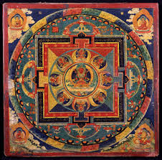
What is a Mandala?

Slide 4
What is a Mandala?
Originated in Tibet 2000 years ago
Tibetans use it to calm themselves and think about the meaning of life
Intricately illustrated
Used for meditation
Show individual or cultural uniqueness
Many cultures use it
Aztec
Asia
Native Americans

Slide 5
Why a circle?
Represents harmony and wholeness of life
Universal shape: eye, sun snowflake, moon, circle of friends, the atom, cells, nucleus

Slide 6
.
You are going to create your own mandala representing aspects of your life. The symbols you choose and the finished mandala will show us about your personality, past, present, and future.

Slide 7
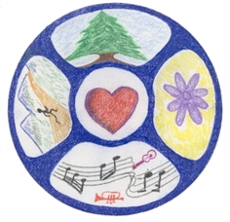

Slide 8
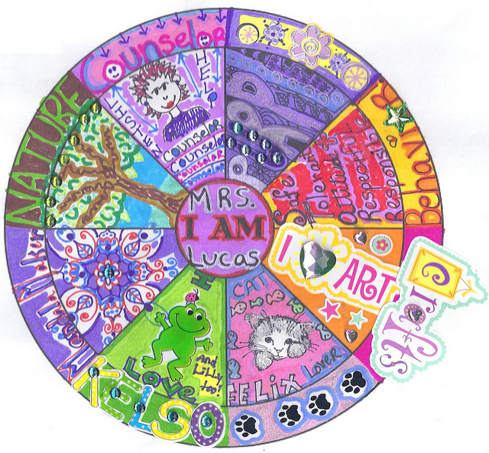

Slide 9
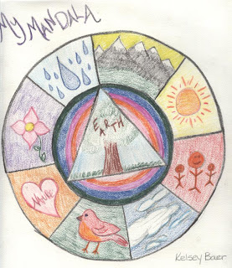

Slide 11
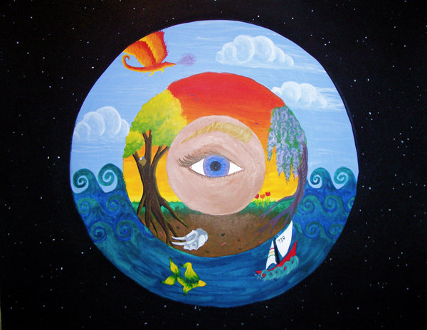

Slide 12
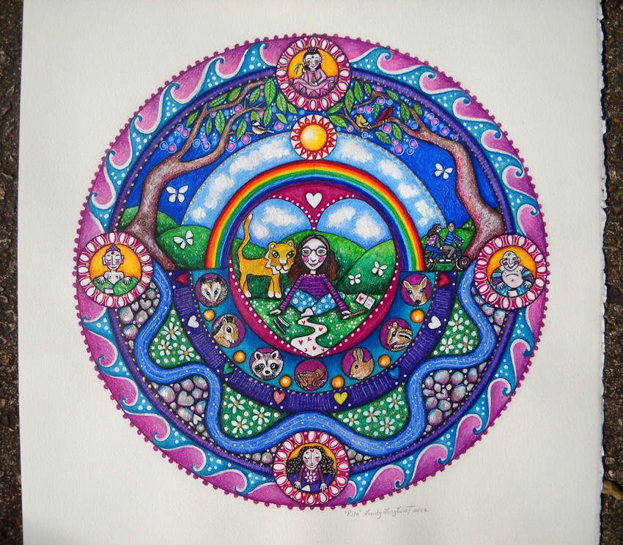

Slide 13
PERSONAL MANDALA ASSIGNMENT
1) Brainstorming: Complete the questions on the handout. This is part of your grade. Make sure you come up with symbols on each step.
2) Rough Draft: Optional but recommended. Don’t spend too much time or waste time coloring!
3) Final Draft: When you are ready to begin your mandala, pick up your final paper from me. It is due at the end of class tomorrow. On the back you must write one paragraph describing the symbols you chose and why.
GRADING: The assignment is worth 50 points total. You must use at least six symbols (-5 for each one missing), you must have color (-15 if not), and you must have a written explanation on the back (-20 if not).

Slide 14
Happy Friday!
Today’s warm-up will be a listening quiz.
Please get out one piece of notebook paper.
Label the top with your name, today’s date, and “Week 1 Listening Quiz.”
Number the paper 1-10.
Wait for further directions ☺

Slide 15
PERSONAL MANDALA ASSIGNMENT
Your final draft is due by the end of class. (Weekend homework if you don’t complete it). On the back you must write one paragraph describing the symbols you chose and why.
CUT YOUR CIRCLE OUT BEFORE WRITING YOUR PARAGRAPH!
MAKE SURE YOUR NAME IS ON IT!!!!
Also make sure you turn in your brainstorming sheet.
GRADING: The assignment is worth 50 points total. You must use at least six symbols (-5 for each one missing), you must have color (-15 if not), and you must have a written explanation on the back (-20 if not).

