Slide 1
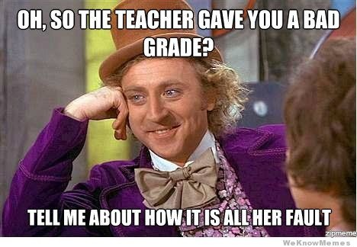
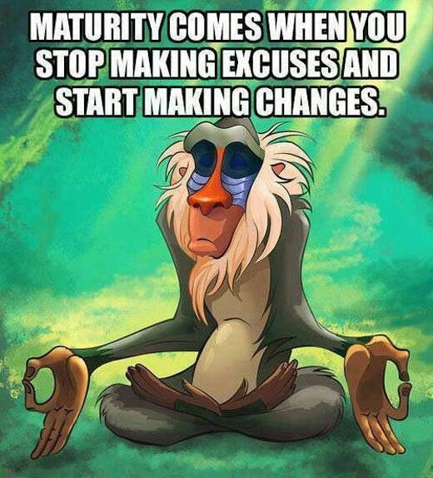
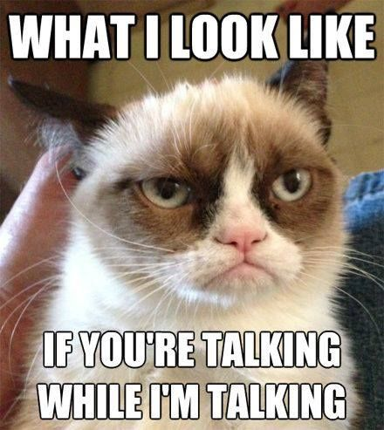
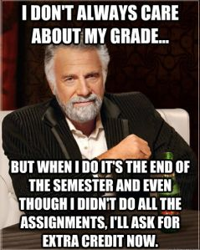
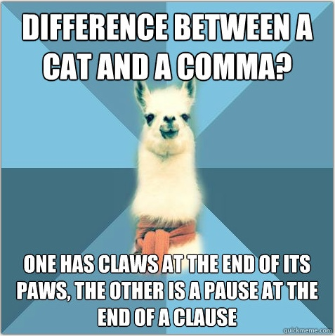
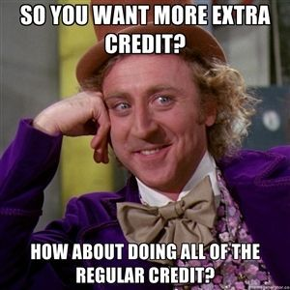

Slide 2
What is a Meme?
an element of a culture or system of behavior that may be considered to be passed from one individual to another by non-genetic means, esp. imitation.

Slide 3
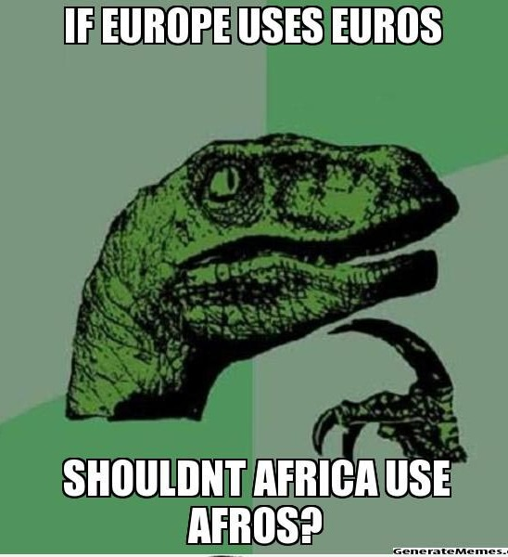
Internet Memes
a concept that spreads rapidly from person to person via the Internet
the majority of internet memes are transmitted by teenagers

Slide 4
What are memes all about?
Humor-centered – humor appeals to the most people
Some about shock value
Some teach a life lesson or a lesson that many people need to understand
Some are deep
Some are about social/cultural issues

Slide 5
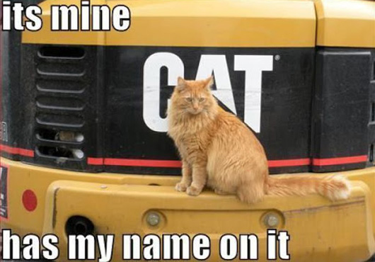
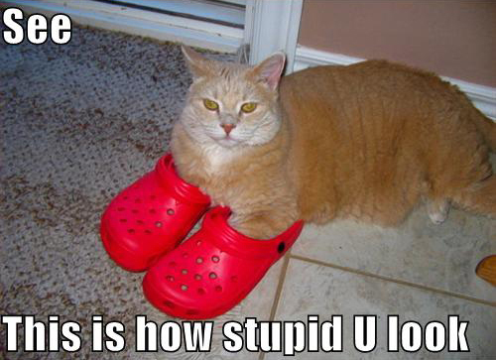
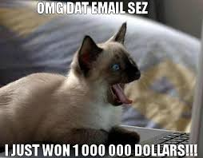
LOLCats
Attaches human behaviors (often dumb or absurd ones) and captions to photos of housecats

Slide 6
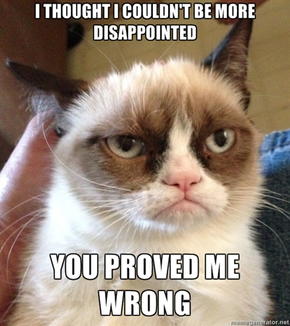
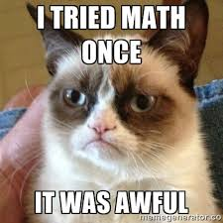
Grumpy Cat
Grumpy Cat: real name Tardar Sauce, is a female cat and Internet celebrity known for her grumpy facial expression
The meme attaches a picture of grumpy cat with a caption about something that makes you grumpy

Slide 7
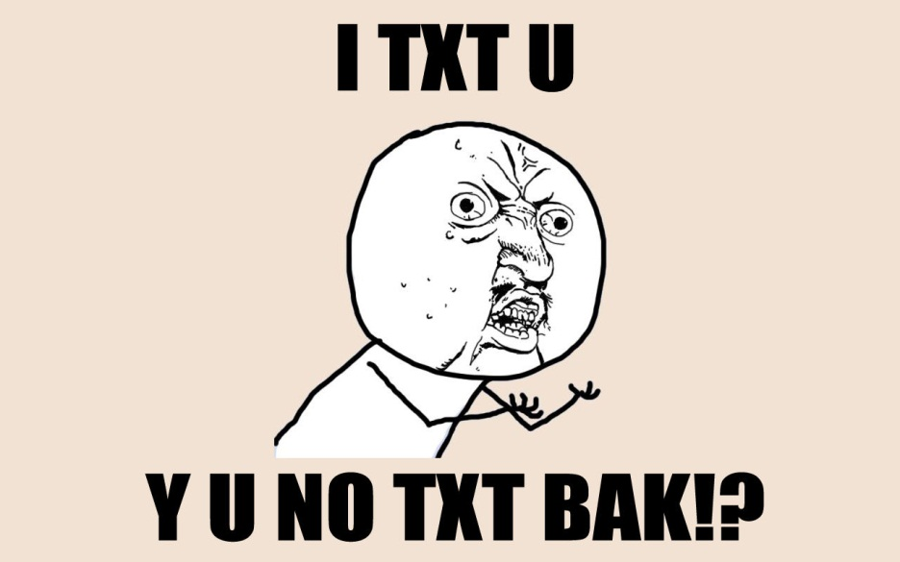
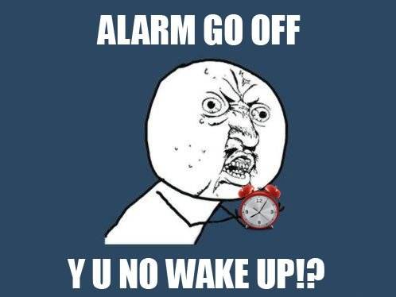
“Y U No” guy
This guy likes to remind people about their oversights/the things they forgot to do/the things they did incorrectly.

Slide 8
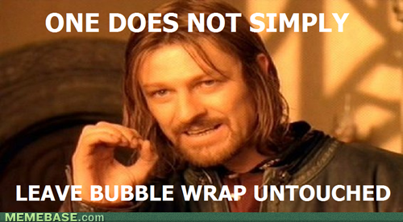
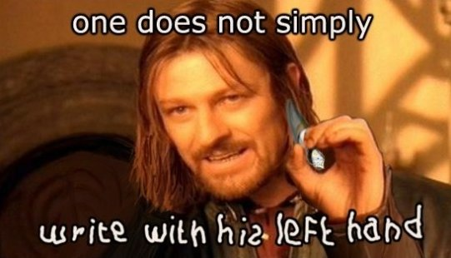
One does not simply…
Explains things that you just can’t do too easily
The guy is from “Lord of the Rings” (in case you didn’t know)

Slide 9
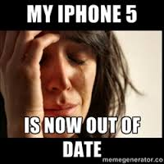
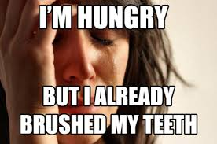
First World Problems
Points out that some things we consider to be huge issues are really trivial in the big picture
Makes fun of the American “I want it all”

Slide 10
The Most Interesting Man in the World
“I don’t always _________________, but when I do, I ___________________.”

Slide 11
Success Kid
Celebrates small victories – that might not seem important, but he makes them awesome

Slide 12
Philosoraptor
Philosophizing dinosaur – asks big questions about life – sometimes serious, sometimes sarcastic

Slide 13
Other Memes
No doubt, there are many others you probably have seen.

Slide 14
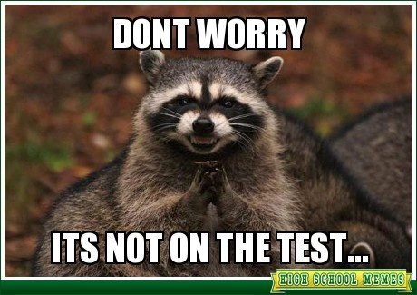
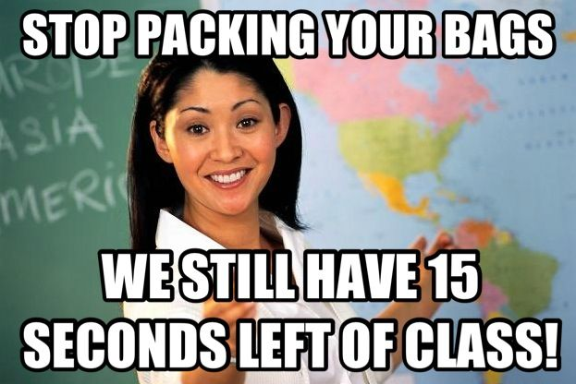
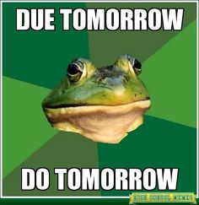
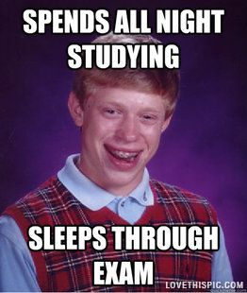
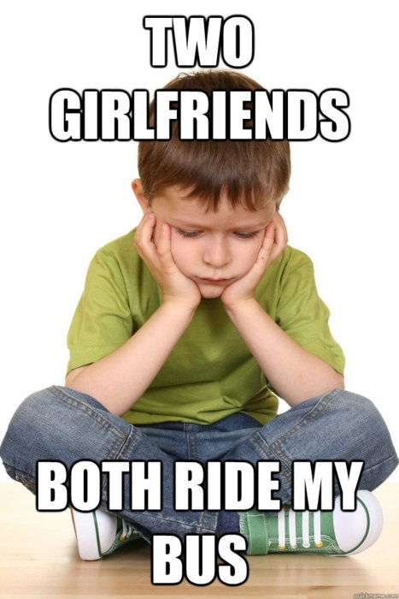

Slide 15
Your Assignment Today!
Create a meme that spreads some knowledge or message about World Literature. This can be a warning to future students, something heard over and over again in this class (what would Ms. Yeganegi say?), some pertinent information that you learned in this course, whatever – as long as you can clearly explain how it connects to this class.

Slide 16
Requirements/Suggestions
Start with a popular meme or choose your own
Focus on making sure the caption (your message) connects with the image you chose
Use any technology you know OR use a meme generator (websites on your paper)
Work alone or with a partner
Finish TODAY!
Write a brief explanation of how your meme connects to World Literature
Have fun!

