Slide 1
Warm-Up: Multiple intelligences
Happy Monday!
Please complete the handout you received at the door, which is a multiple intelligences assessment. Read and follow the directions on the sheet, then wait for further instructions!

Slide 2
Intrapersonal vs. interpersonal
Intrapersonal: This means you are quite intuitive about yourself, what you learn, and how it relates to you. You tend to be in touch with your feelings, values, and ideas. You may be more reserved or quiet, but that doesn’t necessarily mean you are shy.
Interpersonal: This means you are typically people-oriented and outgoing, and you like to learn cooperatively in groups or with a partner. You may be talkative and social, so you do best when working with others.

Slide 3
Multiple intelligences
Verbal/Linguistic (Words): You are probably strong at speaking, writing, reading, and listening.
Kinesthetic (Body): You learn best through activity: games, movement, hands-on tasks, building. You don’t like to sit still for long!
Spatial (Visual): You learn best through visual aids and organizers. You need to see in order to understand, so you typically like charts, graphs, maps, illustrations, art, etc.

Slide 4
Multiple Intelligences
Logical (Mathematical): You are great with numbers, reasoning, and problem solving.
Musical: You learn well with songs, patterns, rhythms, instruments, and musical expression.
Naturalist: You love the outdoors, animals, and field trips. You are very good at picking up subtle differences in meaning and reading between the lines.

Slide 5
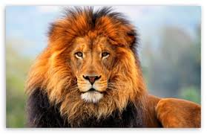
L = Lion
Lions are leaders. They are usually the bosses at work…or at least they think they are!
They are decisive.
They love to solve problems.
They love to seek new adventures
and opportunities.
Lions are very confident and self-reliant.
In a group setting, if no one else instantly takes charge, the Lion will. Unfortunately, if they don’t learn how to tone down their aggressiveness, their natural dominating traits can cause problems with others.

Slide 6
O = OTTer
Otters are excitable, fun seeking,
cheerleader types who love to
talk!
They’re great at motivating
others and need to be in an
environment where they can talk
and have a vote on major decisions.
They can be very loving and encouraging unless under pressure, when they tend to use their verbal skills to attack.
They have a strong desire to be liked and enjoy being the center of attention.
They are often very attentive to style, clothes, and flash.
Otters are the life of any party; and most people really enjoy being around them.

Slide 7
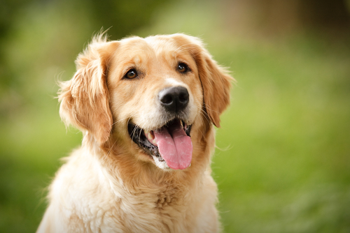
G = Golden Retriever
One word describes these people:
LOYAL.
They can deal with a good deal of emotional pain and punishment but
still stay committed.
They are great listeners, incredibly empathetic and warm encouragers.
They are good team players, but
because they are such pleasers and
care about harmony, they may not be
assertive at times when it’s needed.
Golden retrievers tend to focus on the present and devote lots of time to helping others and building relationships.

Slide 8
B = Beaver
Beavers have a strong need to
do things right and by the book.
They are great at providing
quality control in any situation.
Because rules, consistency and
high standards are so important
to beavers, they are often frustrated with others
who do not share these same characteristics.
Their strong need for maintaining high (and oftentimes unrealistic) standards decrease their ability to express warmth in a relationship.
Beavers are good listeners, communicate details, and are usually diplomatic; they do not like to make decisions.

Slide 9
Next Step
Write your name on one more paper square (two for 2nd block).
Add two TINY drops of glue to your squares.
Chart your name in the appropriate spot (please stick the wall, and not on the signs).
We will use these throughout the semester to determine assignments and groups for you.

Slide 10
DATA CARD (TURN IN NOW!)
On an index card, please write the following:
Center: Your Name
Top Left: Block
Top Right: Color Test Result
Bottom Left: 5-Minute Personality Test Result
Bottom Right: Multiple Intelligences Result

Slide 11
homework
Write one paragraph reflecting on what you learned about yourself through the different personality tests. What did your results show you that you didn’t realize before or that surprised you? What do you agree with? What do you disagree with? How could you use your test results to do better in this class or in school as a whole?

Slide 12
Moving on… symbolism
What is a symbol?
Symbol vs. Logo
Review/Practice

Slide 13
MANDALas
You know that identity is all the things that combine to make you a unique individual – who you are.
You know that symbolism is when you use something to represent something else.
What is a mandala? → The word means “circle” in Sanskrit. It is a tool that you use to reflect your identity through symbolism, and often you use it to reflect on your past, present, and future.

Slide 14
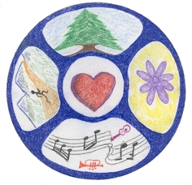

Slide 15
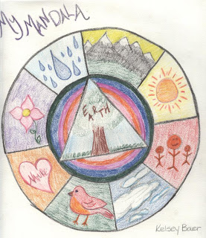

Slide 16
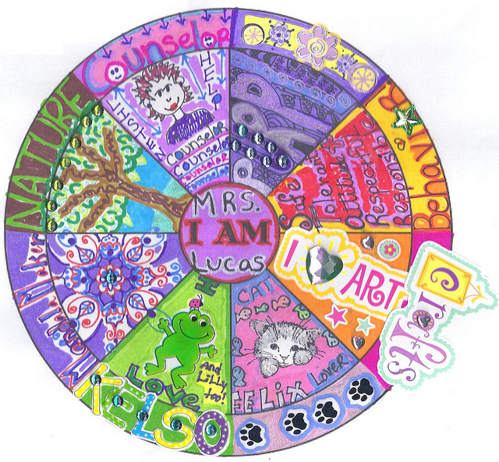

Slide 17
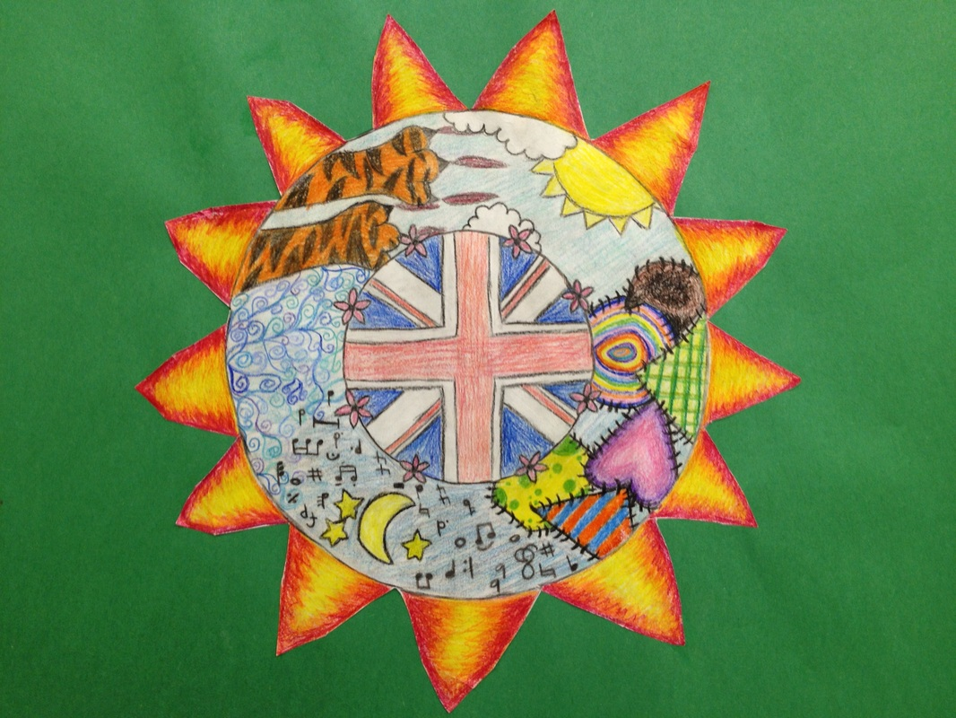

Slide 18
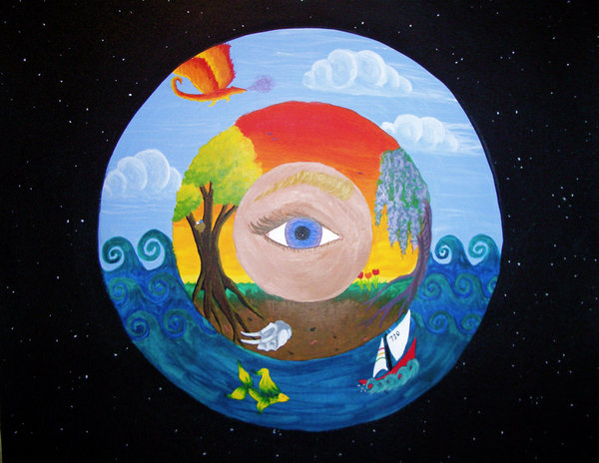

Slide 19
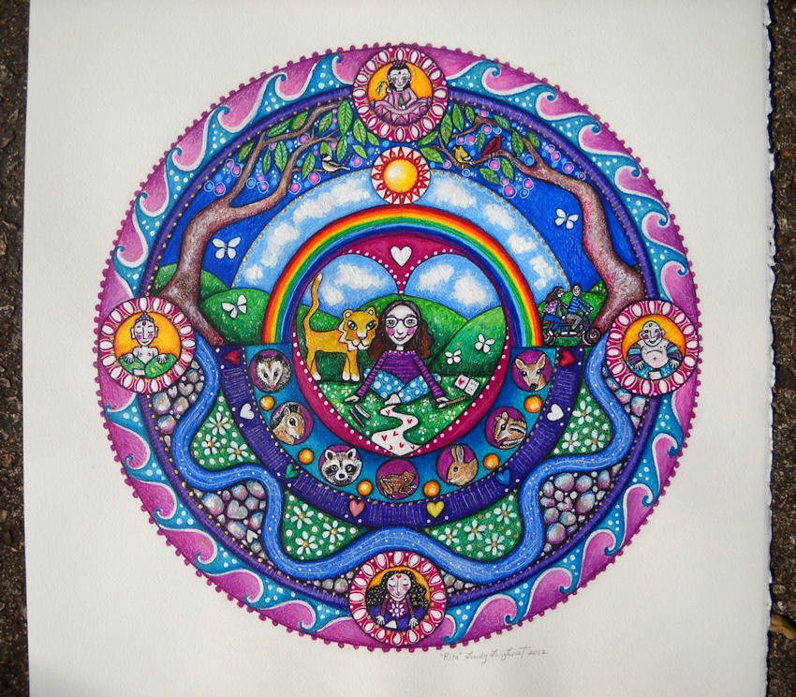

Slide 20
PERSONAL MANDALAS
Complete the questions on the handout. This is part of your grade. Make sure you come up with symbols on each step.
Sketch a rough draft on the back of your pre-writing handout. Don’t color it, and don’t make it perfect – just get an idea of what you are doing.
When you are ready to begin your mandala, pick up your final copy paper from me. Be creative! Be awesome! Show off you who you are!

Slide 21
Summarizer
Share your current progress on your mandala with someone at your table.
Feedback:
One positive compliment
One constructive suggestion

