Slide 1
Warm-Up
As you think about your life, some memories are bound to stand out more than others.
List a few of your most significant memories. They could be things that were extremely happy, extremely sad, potentially life-changing, or moments that inspire(d) you. Try to come up with at least three.

Slide 2
Presentations
Last call. If you don’t go → 0 on the Speaking/Listening section of your project grade.

Slide 3
VOCABULARY
Narrative: Any real or imagined story.
Autobiography: An account of a person’s life, written by that person.
Biography: An account of a person’s life, written by another person.
Memoir: An account of specific memory – think of it as a “snapshot” in time.
Vignette: A brief, detailed, description, account, or episode of a story.

Slide 4
Characteristics of a memoir
A memoir tells the story of a single memory.
It focuses on the relationship between the writer and a particular person, place, or thing.
The story makes clear the significance of that relationship. Why is it important?
It makes clear what the author learned or took away from that memory. The audience must understand the lesson or impact the memory had.
It is based on truth and reveals the true feelings of the author.

Slide 5
Characteristics of a memoir
When reading or writing a memoir, make sure it includes:
A catchy title
A hook or introduction that grabs the reader’s attention and gives some background knowledge
Many details
Imagery and other figurative language
A conclusion that shows the author’s reflection on the memory

Slide 6
Cultural memoirs
Includes all the same characteristics of a memoir, but focuses specifically on a memory that is important because of the way it makes the person reflect on their culture.
Cultural memoirs often focus on particular elements of a person’s culture:
Food
Family
Neighborhood/Environment
Holidays/Special Events
Others’ Perceptions of you (stereotypes)
Etc.

Slide 7
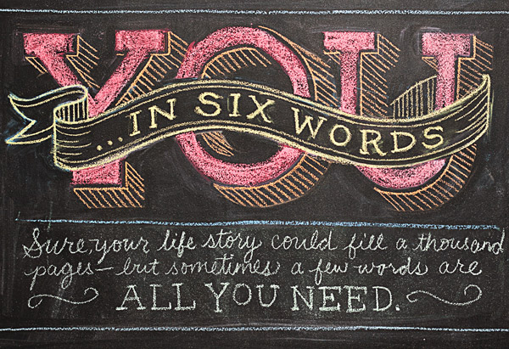
Six-Word memoir
In November 2006, SMITH magazine issued a challenge to fans. They asked readers to describe their lives in six words. The Six-Word Memoir contest officially ended after a month, but the stories kept coming. Five years on, participants have contributed more than half a million mini-memoirs.

Slide 8
SIX-WORD MEMOIR
Author Ernest Hemingway technically started this, with his famous shortest of short stories:
"For sale: Baby shoes, never worn“
https://www.youtube.com/watch?v=ejndNExso9M
https://www.youtube.com/watch?v=DW8hOX6QcLk

Slide 9
Six-word memoir activity
First (5 minutes):
Brainstorm some possible six-word memoirs.
Play with the words, punctuation, and possible meanings.
Second (15 minutes):
Once you have one that you are happy with, pick up a bumper sticker strip, write your memoir on it, and decorate.

Slide 10
Exit Slip
One thing you learned today.
One question you need to ask.

