Slide 1
Warm-Up: KWL
On #1 on your handout, please complete the K (what do you know?) and the W (what do you want to know?) about refugees.

Slide 2
What does it mean to be a refugee?
Read each section. Annotate as a reading strategy (note your questions, thoughts, reactions, main ideas, key words, etc.)
Summarize at the end of each section.
Define the vocabulary terms using context clues.
Answer the 3 “After Reading” questions when you are done.

Slide 3
The Refugee Crisis - 2015
https://www.youtube.com/watch?v=v13kTeAHY4c
https://www.youtube.com/watch?v=v13kTeAHY4c
What are 10 things the videos helped you understand about the current crisis?

Slide 4
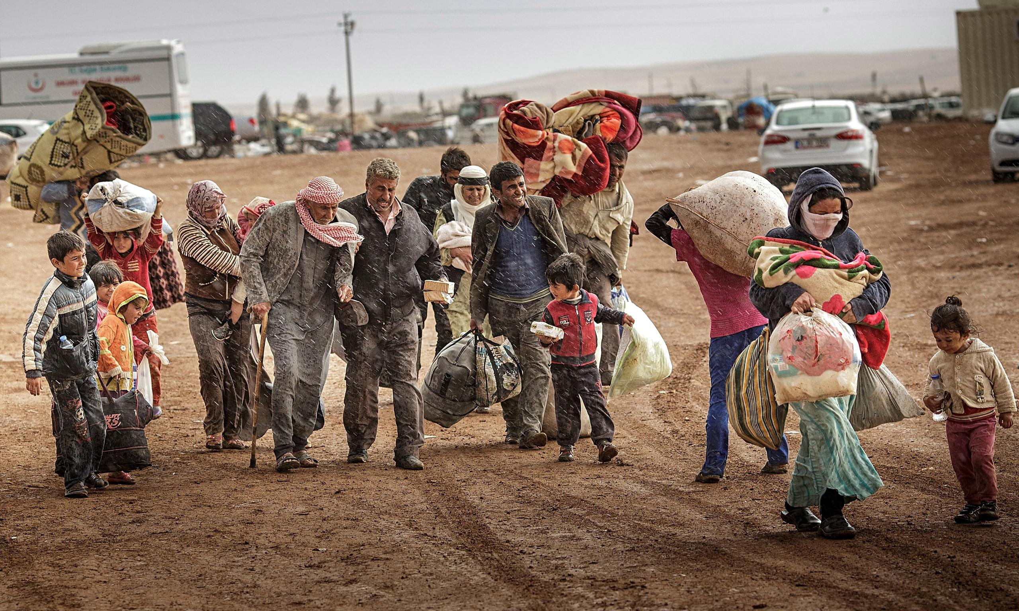

Slide 5
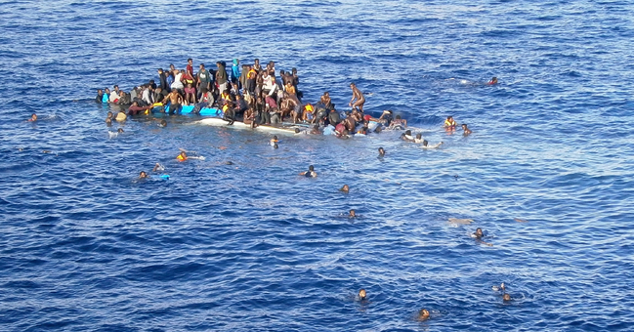

Slide 6
Tuesday: Please read and follow the directions here. Be good!
1) Read and annotate the speech by Angelina Jolie.
  Annotate means:
    Underline/circle key words
    Define unknown vocabulary words
    Star important ideas
    Write notes in the margins – your questions, thoughts, and reactions
    Identify ethos, pathos, and logos
2) Do a SOAPSTone for the speech.
3) Write a one paragraph rhetorical analysis: Is the speech effective? Why or why not? Give specific details/cite textual evidence to support your analysis (ethos, pathos, and logos use).
4) What are the top three things this article helped you understand about refugees?
5) Turn your completed work in to the sub. No late work will be accepted. Use your time wisely, and you will be done! ☺

Slide 7
Warm-Up: Journal
Imagine that one night you are asleep when a bomb drops by your house.
What would you….
See?
Smell?
Hear?
Taste?
Feel?
Say?
Think?
Do?

Slide 8
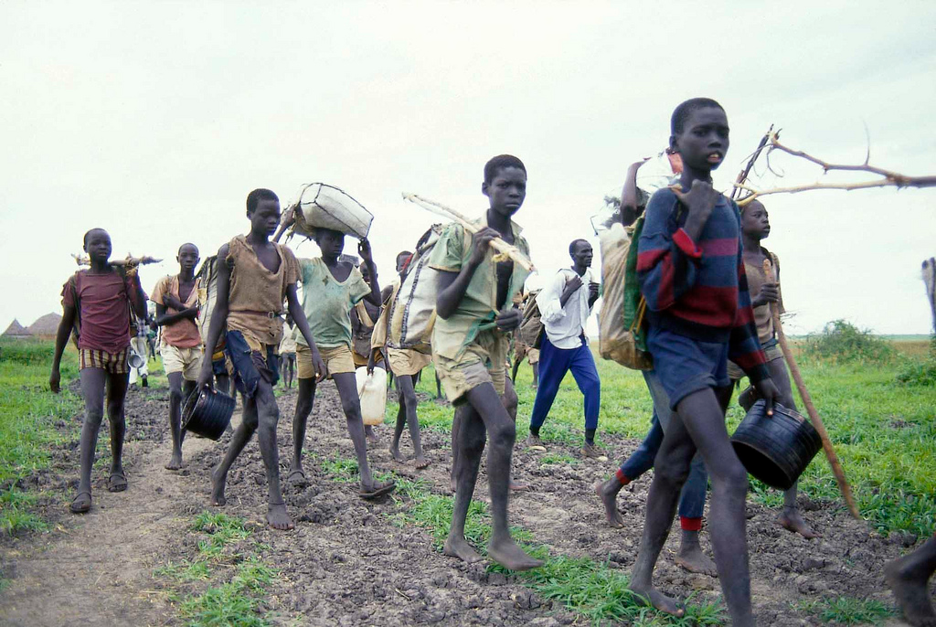

Slide 9
The Lost Boys of Sudan
1) Read the text.
2) Add 10 quality annotations during reading – questions, comments, connections. Underlining/highlighting does not count.

Slide 10
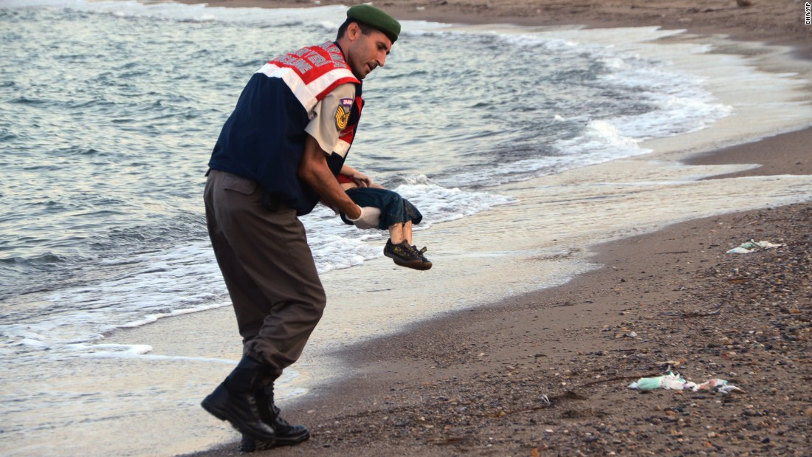

Slide 11
“God Grew Tired of Us”
Finish the handout.
Make sure you use textual evidence/specific details from the film in your reflection.

Slide 12
Friday: Directions. Please be on your absolute best behavior today!
1) Read and annotate the Humans of New York interview.
  You need at least 20 quality annotations – comments, questions, reactions, thoughts, connections.
  2) Answer the questions in complete sentences.
  3) Complete the written response.
  4) Turn your completed work in to the sub at the end of class. DO NOT LEAVE WITHOUT TURNING IT IN.

