Slide 1
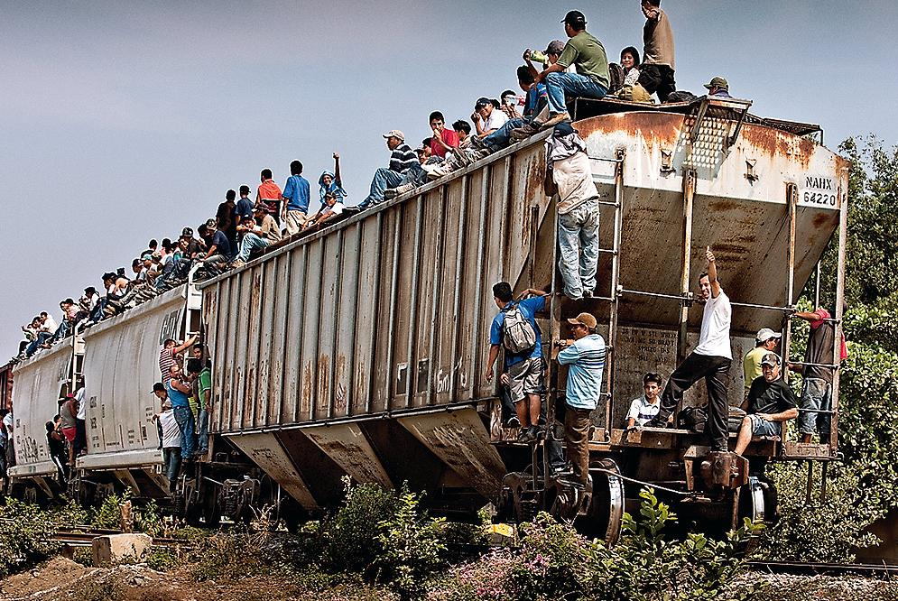
Warm-Up

Slide 2
Media Center-Guidance Lessons
1st Bl: 8:30 – 9:15 am
2nd Bl: 10:15 – 11:00 am + Surveys at 11:05
4th Bl: 2:00 – 2:45 pm

Slide 3
Unit 2 Vocabulary Quiz
Word Bank
Immigrant Emigrant Refugee
Undocumented Stereotype Ethos
Pathos Logos OPTIC
Discrimination Single Story Call-to-
Action
Counterargument Persuasive Lost Boys
Writing of Sudan

Slide 4
Closing
On the back of your paper, write an Acrostic Poem to show what you have learned about immigrants so far. You can use words, phrases, or sentences. Use TEXTUAL EVIDENCE to enhance your response!
I
M
M
I
G
R
A
N
T

