Slide 1
Warm-Up - Happy Monday!
On the paper provided, draw a 5-panel graphic novel/comic strip that tells the story of your spring break!
Be sure to use graphic novel features like speech balloons and captions to communicate your story to your reader.

Slide 2
Partner Share
Exchange your graphic novel strip with a partner.
Read the story. WITHOUT TALKING or ASKING QUESTIONS, come up with one sentence to explain your partner’s spring break. Write the sentence on the back.
Take back your strip, read your partner’s sentence, and make sure that they accurately summarized your break. ☺

Slide 3
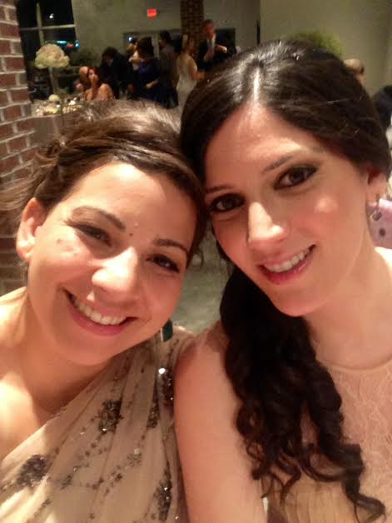
Ms. Yeganegi’s Spring Break
I was a bridesmaid in one of my best friend’s weddings. This is me and my best friend (not the bride).

Slide 4
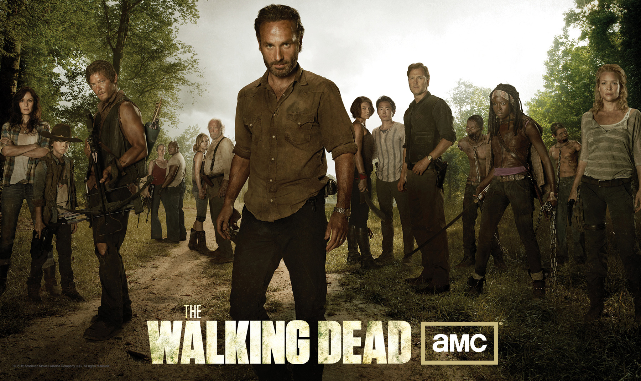
Ms. Yeganegi’s Spring Break
The next day, I stayed on the couch and watched this for 9 hours straight. →

Slide 5
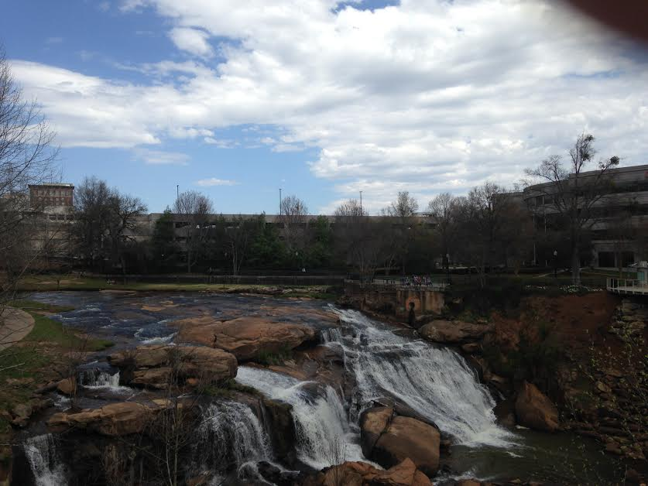
Ms. Yeganegi’s Spring Break
My mom and I went to Greenville, SC, for a day and night. It was lovely!

Slide 6
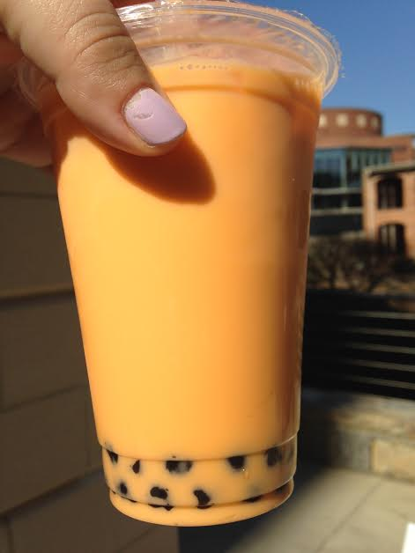
Ms. Yeganegi’s Spring Break
Remember bubble tea from ABC? I drank some – and took a picture to show you!

Slide 7
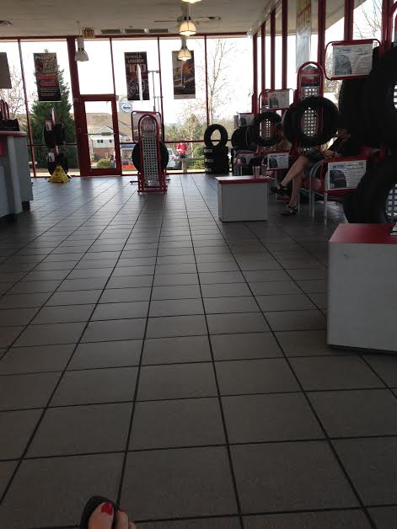
Ms. Yeganegi’s Spring Break
Sadly,I did a lot of boring grown-up stuff, like buying new tires and cleaning. Cars are expensive.

Slide 8
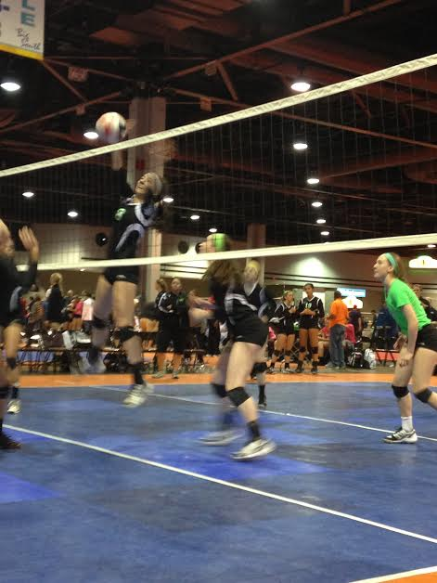
Ms. Yeganegi’s Spring Break
I went to a huge volleyball tournament downtown to watch my cousin’s team play (they’re from Louisville). A lot of family came from out of town for the weekend.

Slide 9
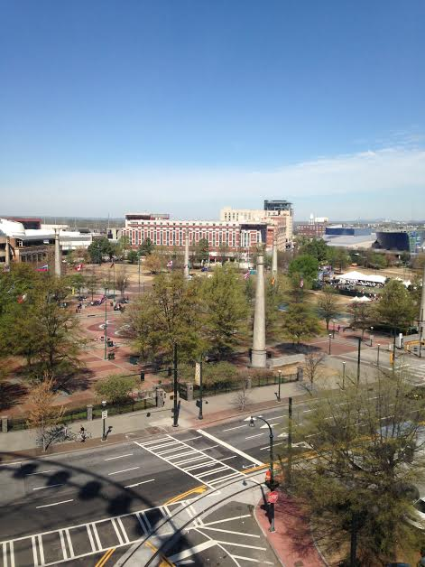
Ms. Yeganegi’s Spring Break
The rest of the weekend, we hung out downtown doing touristy things, like riding the Sky View Ferris Wheel and going to Piedmont Park. Atlanta is beautiful from the sky!

Slide 10
Graphic Novel Project
This week, you will be creating your own graphic novel about teen angst.
As we go over the requirements and rubric, make sure you take notes and ask questions.
The final project is due Friday.

Slide 11
Step 1: Brainstorm/Free Write
Task: Free write a rough draft of your story. This means write in paragraph form or list form (however you think best).
Theme: Teen Angst
May be real or imagined
Needs a full plot: exposition, rising action, climax, falling action, resolution
Needs characters (duh!) [I would suggest one major character and at least 2-3 supporting characters]
Other things to consider today: setting, time, etc.

Slide 12
Housekeeping & Reminders
Snow Day Work is due next Wed., April 16.
Graphic Novel is due THIS Friday! You have plenty of time in class, but if you get behind/miss school, make sure you work on your own time!
We start Unit 3 next Monday.
32 days left. Make them count.

