Slide 1
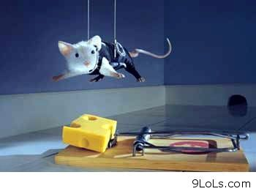
Journal: you are the mouse. Tell the story in 50 words (Exactly).

Slide 2
elements of fiction
1) Brainstorm
2) Vocabulary Group Activity
3) Review

Slide 3
Short story Writing
Put your Character and Context together and write a short story in the given time.
Try to incorporate as many elements of fiction as you can. At the minimum you need a developed character and a full plot. Who are they? What do they want? What happens?

Slide 4
3rd block – word wall
REQUIREMENTS:
1) Write your assigned term in the center in LARGE LETTERS.
2) Write the definition/meaning IN YOUR OWN WORDS.
3) Write three related examples/sentences of the term.
4) Include one large illustration or two-three small ones that help visualize the term. PLEASE USE COLOR!!!
5) Put your name on the back.

Slide 5
3-2-1 Exit Slip
Tell me…
3 new terms you learned today
2 things you will include in your short stories
1 question/concern/comment about your day

