Slide 1
JOURNAL
Good morning and welcome back!
How was your fall break? What was the best thing you did? What is something that you did not do but wish you had?

Slide 2
Unit 2 Intro: Quick Writes
1) What is persuasion?
2) What are some things that you do to persuade people?
3) How do other people try to persuade you?
4) What is a fact?
5) What is an opinion?

Slide 3
Persuasion and the Rhetorical Triangle
For each term, jot down some key words. Make sure you keep this handout in your notes.
PERSUASION
RHETORIC
ETHOS
PATHOS
LOGOS

Slide 4

ETHOS
Trust
Authority
Credibility
Good character
Good motives
Someone well-known
Someone experienced

Slide 5

Pathos
Emotions
  Happiness
  Sadness
  Anger
  Pride
  Guilt
  Etc.
Sensory Details
Emotional language
Images

Slide 6

Logos
Logic
Facts
Statistics
Evidence
Expert Testimony
Definitions
Witness Statements

Slide 7
Look For…Listen To… Pay Attention!
Visuals
Actors
Written Words
Spoken Words
Music

Slide 8
1) Coca Cola
https://www.youtube.com/watch?v=SgevyjvywLs

Slide 9
2) Doritos
https://www.youtube.com/watch?v=2JqRXLQYF9o

Slide 10
3) Microsoft
https://www.youtube.com/watch?v=wLXRt-qRBfU

Slide 11
4) Budweiser
https://www.youtube.com/watch?v=EM8azoZjI4U

Slide 12
5) UnderArmour
https://www.youtube.com/watch?v=ikmd-vtRCqo

Slide 13
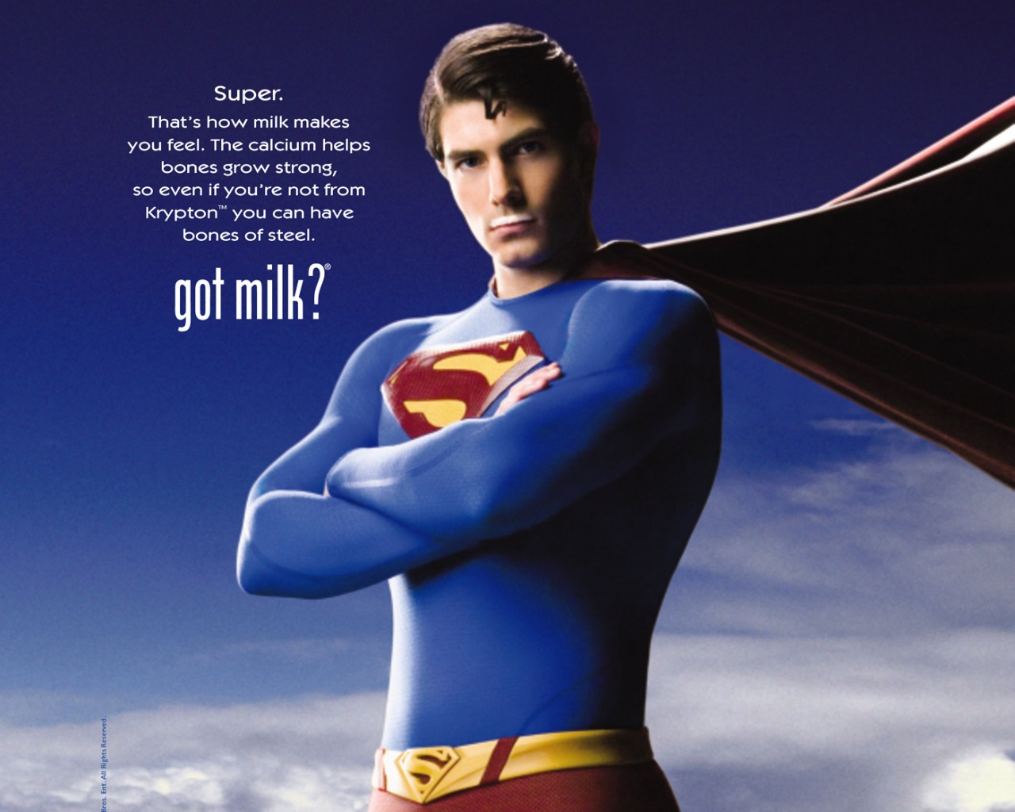
Ethos, Pathos, or Logos?

Slide 14

Ethos, Pathos, or Logos?

Slide 15

Ethos, Pathos, or Logos?

Slide 16
Closing
Convince a teacher to let you make up a test – use 2/3: Ethos, Pathos, Logos.

