Slide 1
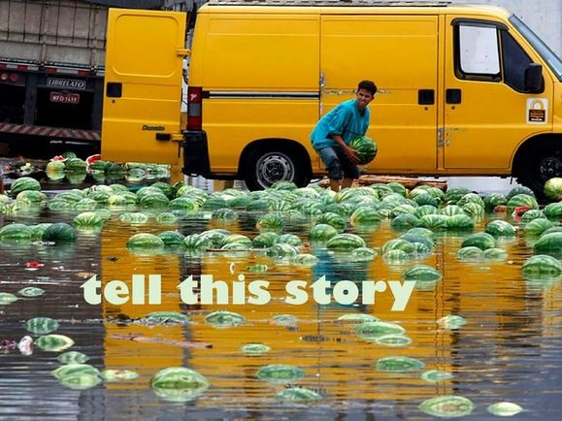

Slide 2
Peer Reviewing
DIRECTIONS:
1) THIS IS A GRADE. YOU MUST PARTICIPATE IF YOU WANT CREDIT.
2) You will work with five different people today.
3) One person will read one of your pieces, and fill out your peer reviewing packet. If you get a paper that is incomplete or does not exist, you will write your name in the blank and then write a note that says their piece could not be reviewed.
4) We will spend about 6-7 minutes per piece and then rotate. Do not go until I call time.
5) You MUST keep up so the other person has enough comments to help them improve their writing. YOU will lose points if you don’t complete your sections on each paper.
6) Once all the rotations are done, you will take your papers home and make any changes you want to make. You MUST turn the packet into me tomorrow to get your grade.

Slide 3
SECRET ENVELOPES WRITING ACTIVITY
You may work alone or with one partner. Please decide now!
Combine your character, emotion, and setting to write a fictional narrative.
Your stories may be as ridiculous or as serious as you want!
This is timed writing practice. Please write until the end of the time!
Be ready to share!

