Slide 1
Warm-Up… Penny for your thoughts!
1) What do I need to do to succeed in this class?
2) What does Ms. Yeganegi need to do to help me succeed?
3) What needs to happen in this classroom to make it a positive learning environment?
4) Why is writing important?
5) What do I hope to learn in this class?
Any other questions/comments/concerns?

Slide 2
Multiple intelligences test
Please read and respond carefully to each item on the test.
Tally your totals.
Graph your results.
On your index card, please write your first and last name, and your multiple intelligence(s).

Slide 3
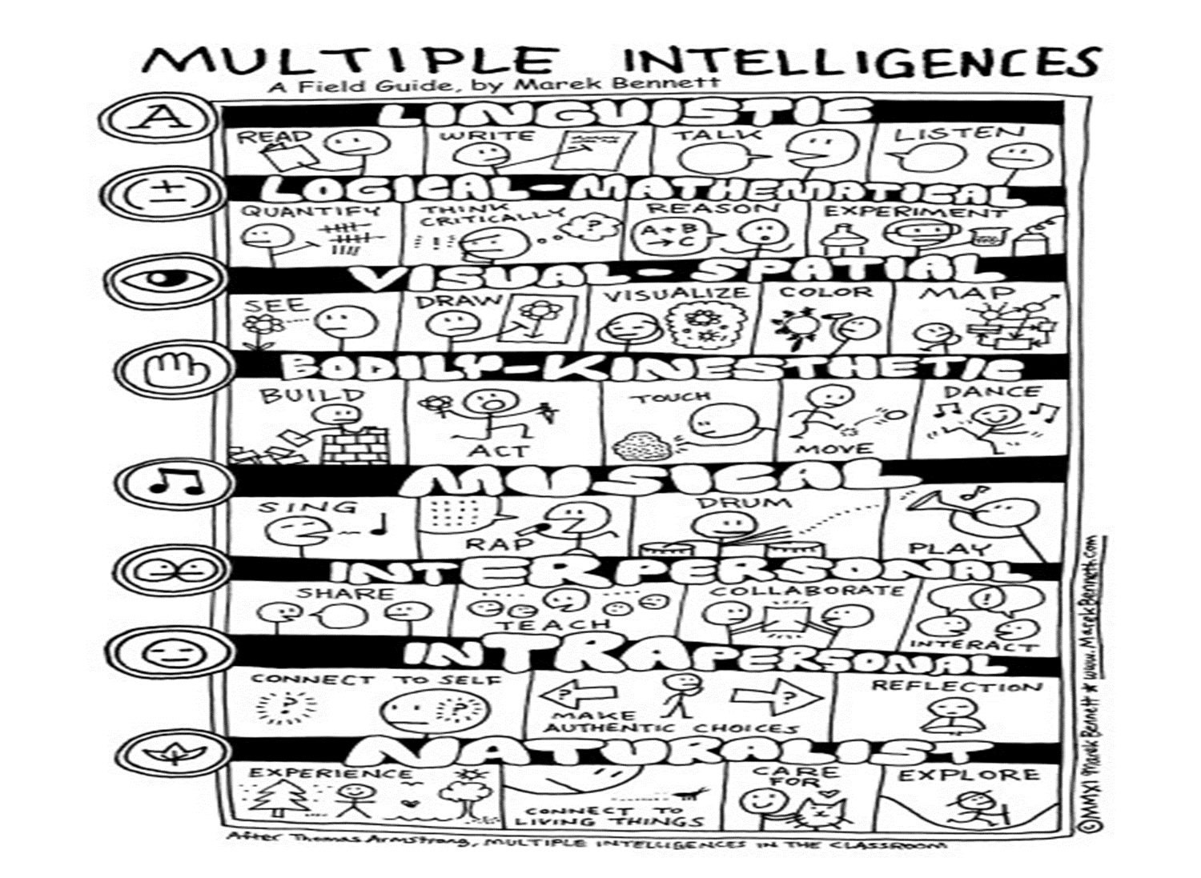

Slide 4
Multiple intelligences activity
Get in a group with peers who have your intelligence style.
You have 20 minutes to figure out a way, using your intelligence, to present something to the class about this course (based on the syllabus, the brochures, yesterday’s overview, etc.)
You can focus on the whole class or on just one aspect, but you MUST use your intelligence style.

Slide 5
Reminders…
Summer Reading!!
Supplies!!

