Slide 1
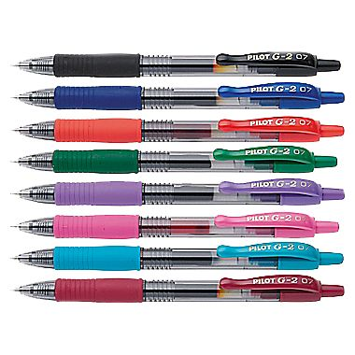
Warm-Up
Convince me (Ms. Yeganegi) to buy these pens.
Ethos:
Pathos:
Logos:

Slide 2
Persuasive Techniques Review
Work in your group to complete the “Persuasive Techniques in Advertising” Review sheet (8 items). You MAY have the same answers, as long as you collaborate and don’t copy.
The back side (“Persuasive Techniques”) is for homework and is due tomorrow. You MAY NOT have the same answers. Use your brain alone.

Slide 3
How well can you sell?
What’s your all-time favorite, “can’t live without it” product?
Goal: To convince us all to use/buy this product.
Task 1: Write a one-page persuasive speech, using ethos, pathos, AND logos to convince us about the benefits of your product.
Task 2: Create a colorful and neat magazine ad for your product, using AT LEAST one of the advertising techniques (more than one is good, as long as your message remains clear).

Slide 4
One-Word Summarizer
What technique are you relying on to sell your product?

Slide 5
Happy Friday!
Spend a few minutes reviewing your note sheet for a short vocabulary quiz on the persuasive techniques.

Slide 6
How well can you sell?
What’s your all-time favorite, “can’t live without it” product?
Goal: To convince us all to use/buy this product.
Task 1: Write a one-page persuasive speech, using ethos, pathos, AND logos to convince us about the benefits of your product.
Task 2: Create a colorful and neat magazine ad for your product, using AT LEAST one of the advertising techniques (more than one is good, as long as your message remains clear).

Slide 7
Volunteers Needed!
Can you convince your audience to buy YOUR product?!?
Volunteers will receive extra credit in the Speaking/Listening category for presenting.

