Slide 1
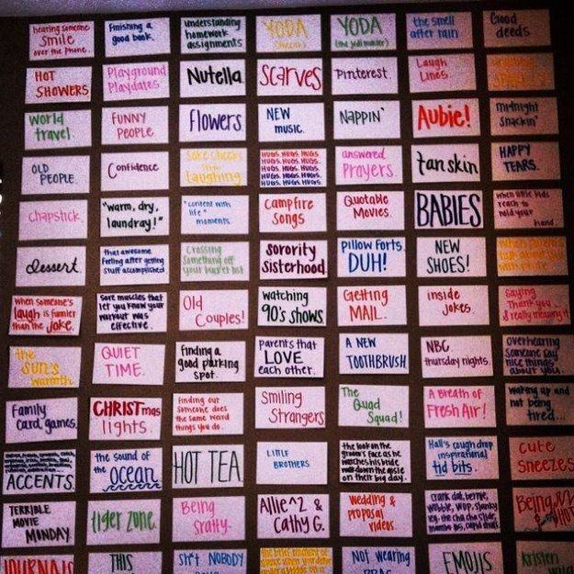
Warm-Up – what makes you happy?
Choose one thing that makes you happy. It can be a small, seemingly meaningless thing, or it can be something huge and important.
On an index card, please write in LARGE LETTERS the thing that makes you happy.
Decorate it! (Yes, you must.)

Slide 2
FAq
How many books will be reading in this class?
Can we chew gum during class?
Are we going to have homework every day?
How can I pull up my GPA?
Can we listen to music at the end of the period if we work throughout the period?
Will you help me reach my goals?
Do you love stories, including dark stories?
Is this class fast-paced, and do you leave students behind?
Do you like kids?
Will we take many notes?
Do you let students charge their phones?

Slide 3
HOW TO SUCCEED IN WORLD LIT GROUP ACTIVITY
Your Task: Using information from former students, as well as what you have gathered in the past two days, you will create a poster about this class. Things you may want to include:
Advice on how to succeed
Information about the content – what are we going to learn
Interesting facts/tidbits
Color, creativity, and personality

Slide 4
PRESENTATIONS
Each group will give a brief (2 minute) presentation of what you learned from your letters and what you think your peers need to keep in mind as we begin this semester.
Please decide what you will say and who will say it, so you’re ready when it is your turn.

Slide 5
Ms. Yeganegi’s advice- How to succeed!
Start strong!
Pay attention.
Stay on task.
Complete your work.
Turn IN your work.
Ask for help when you need it.
Come to tutoring early on.
Don’t slack off in two months.
Do any extra credit you receive.
Be nice.

Slide 6
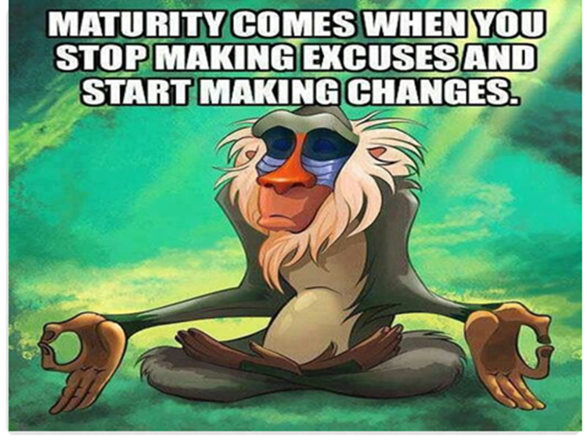
CLOSING: Journal
Think of a time that this quote had some meaning in your personal life. Write about what happened, what you learned, and how the experience helped you grow.
If you cannot think of anything, then write about how you might use this quote to help you in the future.

