Slide 1
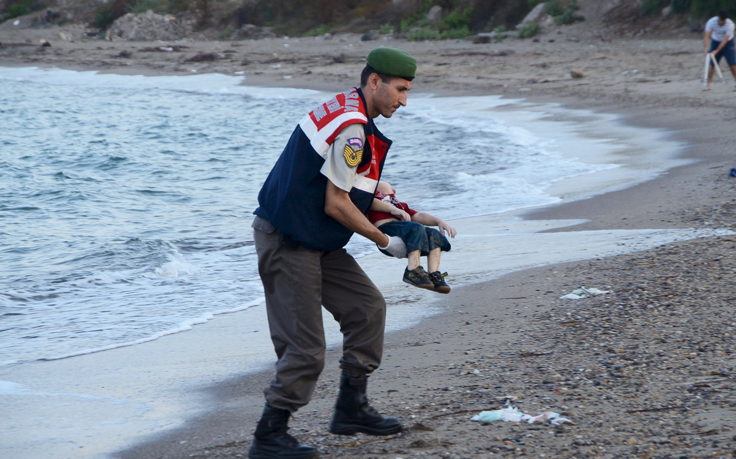

Slide 2
Journal – 3rd block
Imagine that you are a refugee who has left your home and family behind. Write a letter to your family and friends, telling them about your new life and your feelings at this time.

Slide 3
“God Grew Tired of Us”
Please answer the four “Before Viewing” questions and be prepared to discuss the responses.
During Viewing: Complete the four questions.

