Slide 1
Warm-Up
A “mise-en-scene” is when you pick one scene from a text to illustrate.
1) Pick ONE SCENE from “No Speak English” that you can visualize in your head.
2) Use the imagery to draw in detail your chosen scene.
3) Add the exact quote to your paper, on the top or bottom, to show the scene you drew.

Slide 2
“No Speak English”
Finish annotating. Let’s get at least 20 SOLID annotations on the page.
Work in groups to answer the questions. Hint: Use your annotations to answer the questions. You have 20 minutes.

Slide 3
“Hairs”
This is another very short vignette from The House on Mango Street.
Read and locate examples of figurative language. Please add the page number to your quote.

Slide 4
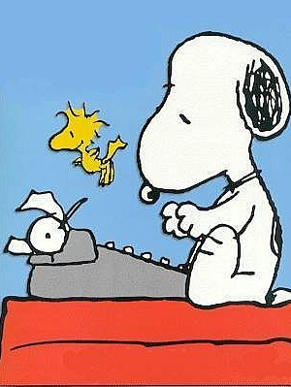
The Personal Memoir
Now that you’re an expert on memoirs and vignettes, it’s time to write your own version!
We will work on this today and tomorrow; the final draft is due on Monday (we’ll be in the media center).
Remember:
Single Memory
DETAILS!!!! and Imagery
First-Person Point of View
Dialogue
Catchy Title and Hook
Have fun with it!! ☺

Slide 5
Exit Slip
What is the topic of your personal memoir?

