Slide 1
Unit 4 Activator
1) Describe your perfect mate. What does he/she look like, dress like, act like? What are his/her hobbies, goals, etc.?
2) Joe has recently entered your 2nd period class, and is clearly from another country. He struggles with the English language, and some in the class make fun of his mistakes. How do you act in this case?
3) You are approached by a poorly-dressed person on the street. What do you think this person wants? Why do you think that?
4) Does money change people? If you answered “yes,” explain how you think it changes them. If you answered “no,” explain how a person can remain unchanged by money.
5) What does “success” mean to you? What do you have to do in order to achieve success?

Slide 2
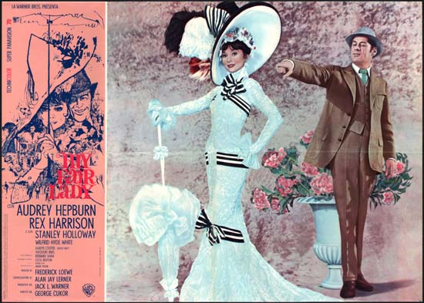
Pygmalion – Unit 4
We’re going to be studying a play called Pygmalion – the original “Rags to Riches” story.
You might already know the story, if you know this movie:

Slide 3
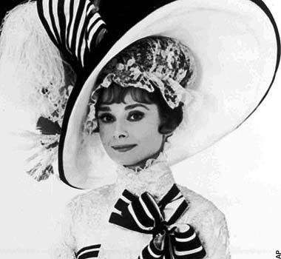
Pygmalion by George Bernard Shaw

Slide 4
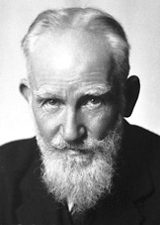
AUTHOR: George Bernard Shaw
English
Lived from 1856-1950
Very outspoken about politics and often criticized for his radical views
Won Nobel Prize for Literature in 1925
Believed that the transformation of the individual could lead to the transformation of society

Slide 5
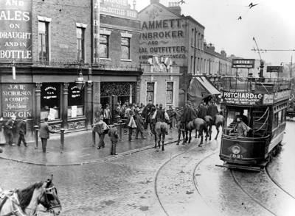
SETTING
London 1912
During this era, both in the play and in real life, there were huge differences between the rich and the poor.
Social classes were clearly defined, and it was hard to move from one class to another.
Women did not have the same rights as men and were often looked at as inferior.

Slide 6
HISTORICAL CONTEXT: Social Class
Upper Class: didn’t work, noble men and women
In the play: HOST and HOSTESS of the Embassy Ball
Upper Middle Class: worked but were employed in safe, clean jobs (lawyers, doctors, professors)
In the play: HENRY HIGGINS, COLONEL PICKERING

Slide 7
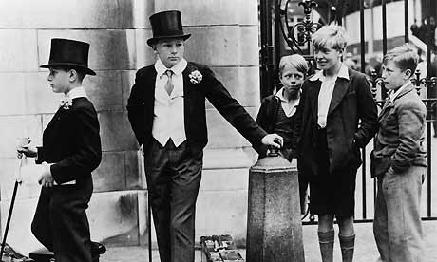
HISTORICAL CONTEXT:
Social Class
Lower Middle Class: worked in dangerous jobs and unsanitary conditions
Lower Class: did not work or worked little, had no financial freedom, were often servants
In the play: ELIZA DOOLITTLE

Slide 8
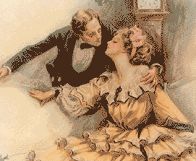
VICTORIAN ROMANCES What comes to your mind when you hear the term “Romance?”
Pygmalion is not the typical romance we think of today.
Victorian romances, such as Pygmalion set out to examine social issues.
They often showcased poor but honorable leading ladies and male protagonists who learned that wealth and social class do not define a person’s character.

Slide 9
SHAVIAN DRAMA
Shavian Drama is a type of politically and socially charged “discussion play” made popular by George Bernard Shaw and Oscar Wilde.
In Pygmalion, Shaw tackles issues about women’s rights, language, social class, and the idea of self-transformation.

Slide 10
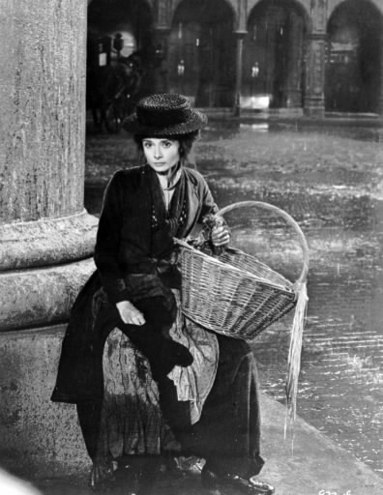
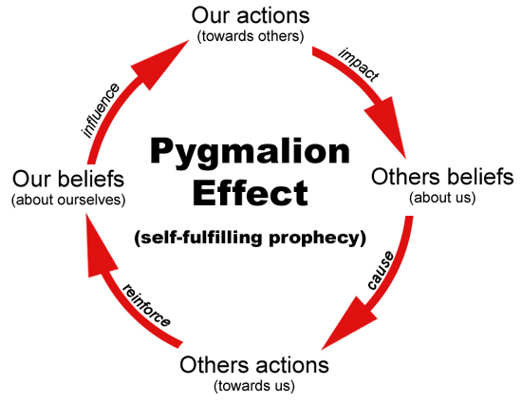
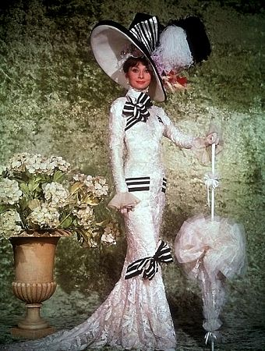

Slide 11
What does “Pygmalion” mean?
Allusion to Greek mythology.
You have to understand this, in order to understand the play!

Slide 12
The Myth of Pygmalion
Read and annotate the myth.
Respond:
In the myth, the love between Pygmalion and Galatea is strong and passionate—we even know it is at least somewhat lasting as they produce a son. Would you consider the love between them true or not? Why? If Galatea developed non-physical human qualities (i.e. personality traits), how do you think Pygmalion might have felt about her then? Why?

Slide 13
Closing
Exit Slip: What’s one new thing you learned today?

