Slide 1
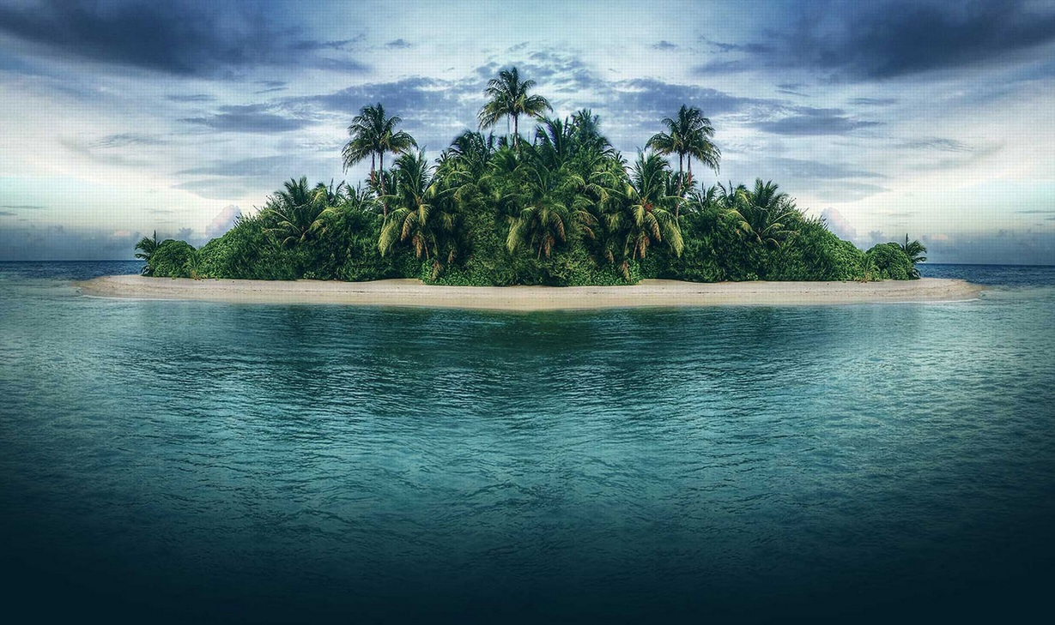
Journal
Imagine you’re stranded on a deserted island. Write about your experience, using sensory details, concrete details, and figurative language. Remember to show not just tell.

Slide 2
Writing Activity
1st block – Write the paragraph (on handout from yesterday).
2nd & 3rd blocks – Share paragraphs.

Slide 3
“Hairs” by Sandra cisneros
1) Read and annotate.
2) Answer the questions.
3) Model your writing on hers!
4) Turn in when complete. (Homework if not done today.)

