Slide 1
Warm-Up: Journal (in your notebook)
What is the best thing you bring to the world? Why?

Slide 2
Multiple Intelligences
For each category, check off all those that apply to you.
Tally your results in each category.
Circle/highlight your highest total(s).

Slide 3
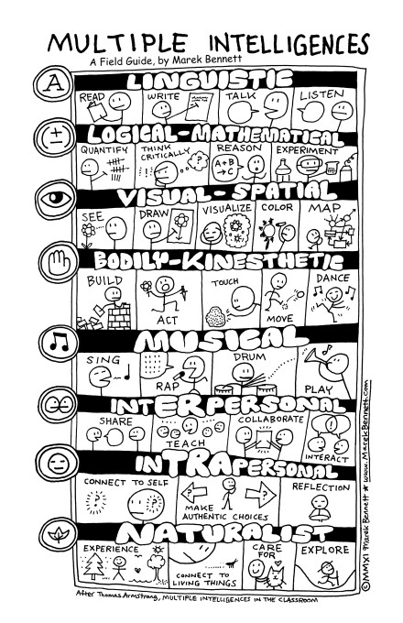

Slide 4
Data Card
On your index card:
True Colors Result |  | 5-Minute Personality Test Result
 | Name (First + Last) Day of Birth
Myers-Briggs Result (4 Letters + Title) |  | Multiple Intelligences Result(s)

Slide 5
Letter assignment
Write Ms. Yeganegi a letter, reflecting on your test results and what they say about you as a learner.
Considerations:
How long should a piece of writing in a 10th grade level class be?
How do you address a letter? End one?
Who are you as a student?
How can I best teach you and help you learn?
How do you work best? Why?
What did you learn from your personality test results? What was surprising or not?
What are your thoughts on day 4 of school? Do you have any questions or concerns about this class?

