Slide 1
Warm-UP
Complete the Figurative Language Review handout (both sections). Please work INDEPENDENTLY. I need to know what YOU know, not what the people at your table know.

Slide 2
GROUP ACTIVITY AND PRESENTATIONS
Work Time?
What makes a good presentation?
Finish Presentations of the Guides to Success in World Lit.

Slide 3
SYMBOLISM REVIEW
What is symbolism?
What are some examples?

Slide 4
COLOR SYMBOLISM ACTIVITY
What do you remember about color symbolism?
Activity:
Each group will be assigned one color.
Work together to brainstorm every possible meaning/symbolism this color has. Write your words/thoughts directly on the butcher paper.
Be prepared to share.

Slide 5
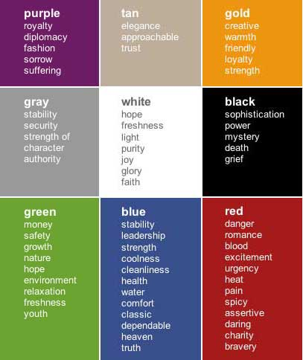

Slide 6
Mandalas
What is a mandala?
The term mandala is from the classical Indian language of Sanskrit and is loosely translated to mean "circle“ or “complete”.
Used chiefly in Hinduism and Buddhism as an aid to meditation

Slide 7
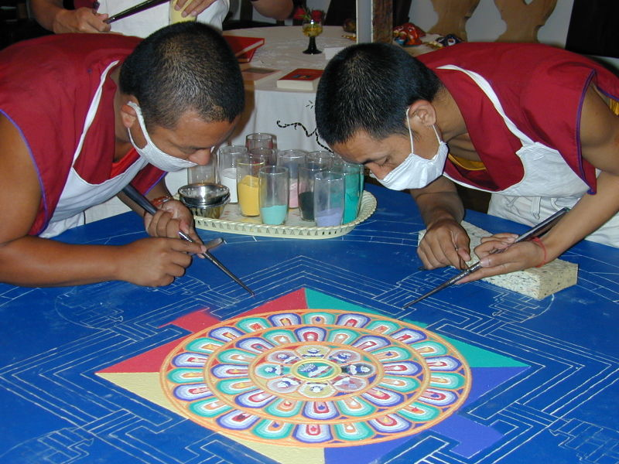
Temporary Sand Mandala
Tibetan monks create impermanent mandalas as an act of meditation. When they’ve completed the mandala, they sweep it up and release the sand into a moving body of water to spread the mandala’s blessings.

Slide 8
What is a Personal Mandala?
In the West, mandala is used to refer to the "personal world" in which one lives, the various elements of the mandala or the activities and interests in which one engages, the most important being at the center of the mandala and the least important at the periphery.

Slide 9
The Mandala
Describing both material and non-material realities, the mandala appears in all aspects of life: the celestial circles we call earth, sun, and moon, as well as conceptual circles of friends, family, and community

Slide 10
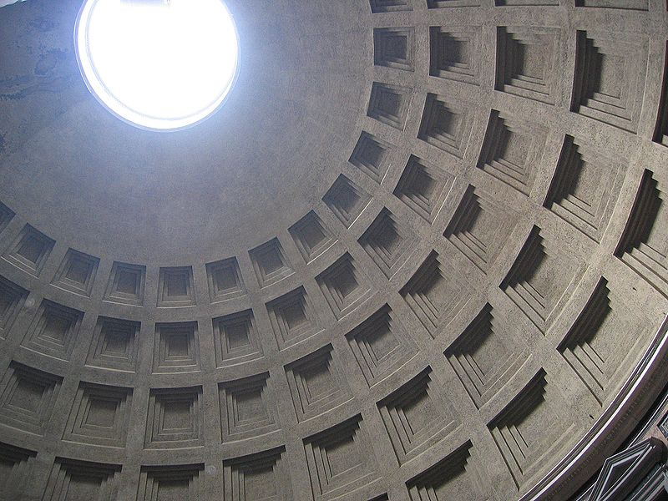
Oculus of the Pantheon, Rome 31 BC

Slide 11
Buddhist Borobudur Temple, Indonesia 800AD

Slide 12
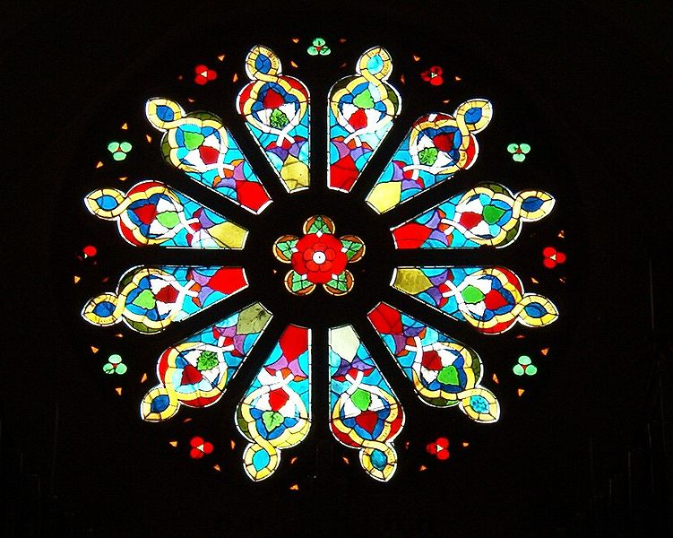
Catholic Church Rose Window, Sweden

Slide 13
Sun

Slide 14
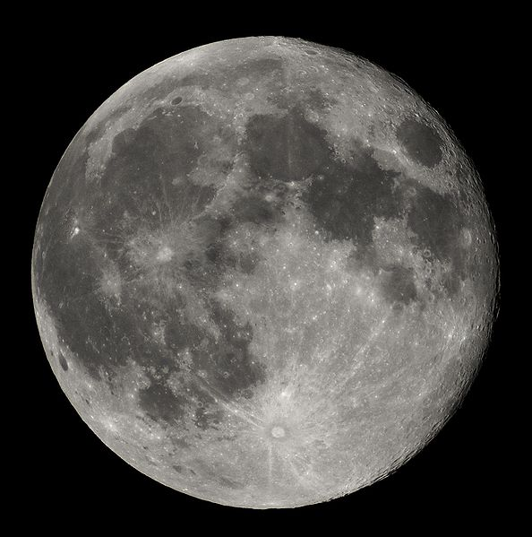
Moon

Slide 15
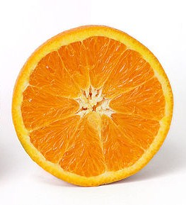
Orange

Slide 16
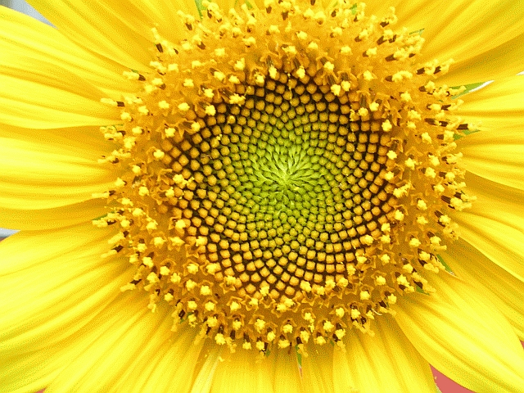
Sunflower

Slide 17
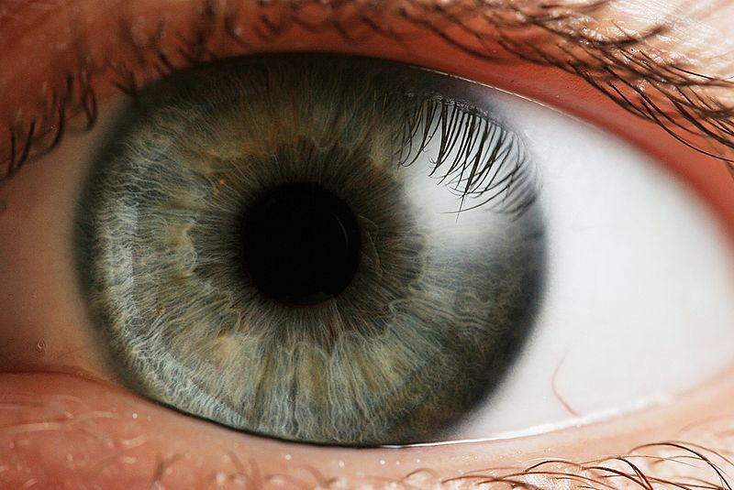
Human Eye

Slide 18
Personal Mandalas
A personal mandala
is a tool used for self observation, growth, or goal making.
combines elements of an individual’s life, making a unique story based on the past, present and future.
is made based on information regarding personal beliefs, relationship to nature, family, animals, and so on.
is often created spontaneously and always unique to the individual - therefore no two are ever the same.
can be used for individuals or groups - for particular themes and occasions- such as weddings, anniversaries, special birthdays and any celebration of new beginnings—the beginning of a new school year or semester.

Slide 19
Your Personal Mandala
To celebrate a new school year, you are going to design your own personal mandala. Your personal mandala will represent you as a diverse and unique individual who is needed to create our class dynamic, and will be displayed among the other student’s mandala designs to symbolize you as an important part of our class, thus illustrating the concept of part of a whole.
You must use symbolism of both objects and colors to represent yourself and your identity.

Slide 20
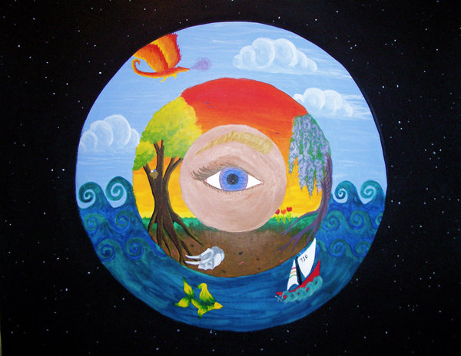

Slide 21
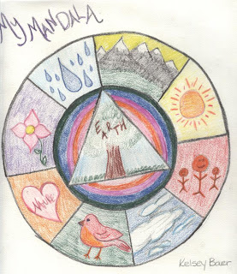

Slide 22
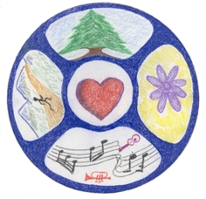

Slide 23
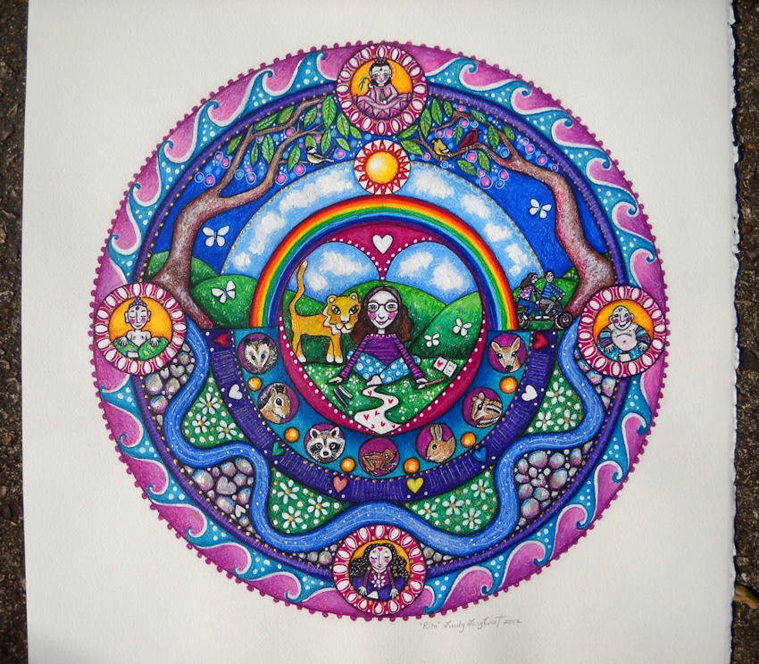

Slide 24
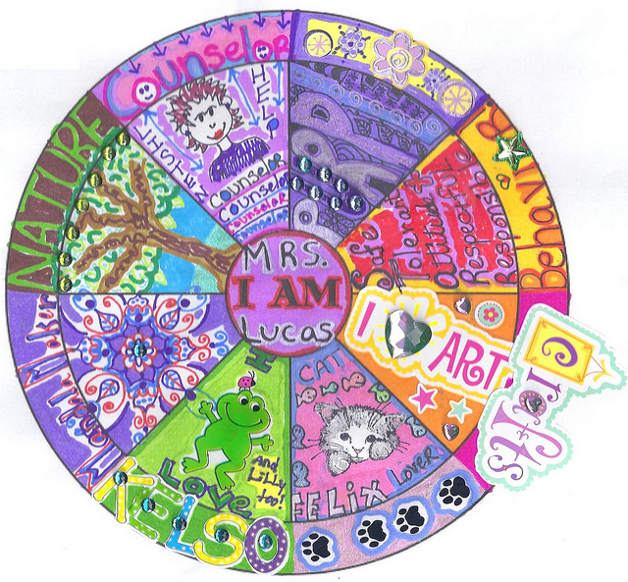

Slide 25
