Slide 1
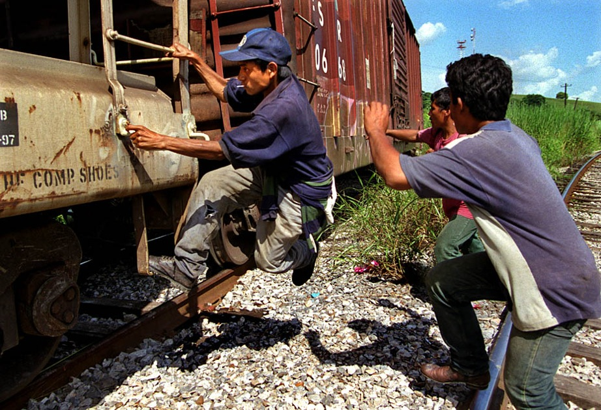

Slide 2
A brief touch

Slide 3
Documentary Film
A nonfictional motion picture intended to document some aspect of reality, primarily for the purposes of instruction or maintaining a historical record.
They typically serve 3 purposes: to inform, to entertain, and to persuade.
We are going to specifically look at how they seek to persuade.

Slide 4
Documentary Film
There is certain vocabulary used with documentary films. You need to be able to refer to different aspects of the film using this vocabulary.

Slide 5
“Which Way Home”
Released in 2010
Directed by Rebecca Camissa
Same concept as Enrique’s Journey – follows unaccompanied minors on their journey through Central America and Mexico as they try to become immigrants to America
http://www.hulu.com/watch/295708

Slide 6
Summarizer – Exit Slip
One question/comment about the film so far

