Slide 1
Warm-Up: Unit 1 Quiz
Using your knowledge of the vocabulary and concepts from Unit 1, please complete the quiz.
Notes and phones away, and of course no talking!

Slide 2
What is a brochure?
A small book or magazine containing pictures and information.
*May be written to inform, to persuade, AND to entertain.

Slide 6
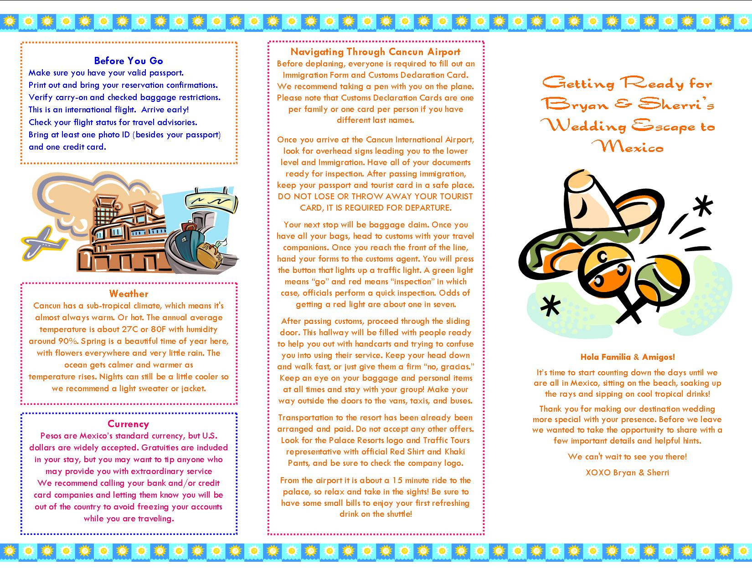

Slide 7
Real World Writing Brochure
Create a brochure about real-world technical writing.
Think about what we have learned and worked on and turn that into information for someone who does not know much about real-world writing.
Draw on your expertise to inform others on how to successfully write an email, resume, cover letter, thank you note, etc. You also might want to include information about job skills.
Make it helpful, interesting, and physically appealing in order to entertain your reader.

Slide 8
Brochure Requirements
Your brochure should include, at the minimum:
Cover Page
Five Panels (filled with text and visuals)
Clear and Logical Section Headers
Plenty of written information
Plenty of visuals and graphics

Slide 9
2nd block
Work with your group to create an information, thorough, and visually appealing (neat, colorful, legible) poster on your assigned topic from Unit 1.
Please be prepared to present your posters to the class.

Slide 10
Wednesday’s Warm-Up – Put your name on it and turn in when done!
Reflect on your semester so far:
1) What is your current grade in this class? Are you happy with it?
2) Have you been completing and turning in your assignments?
3) Do you think there is anything you need to improve in terms of your work or behavior? Explain.
4) Is there anything you need from Ms. Yeganegi right now?

Slide 11
Real World Writing Brochure
Create a brochure about real-world technical writing.
Think about what we have learned and worked on and turn that into information for someone who does not know much about real-world writing.
Draw on your expertise to inform others on how to successfully write an email, resume, cover letter, etc.
Make it helpful, interesting, and physically appealing in order to entertain your reader.

Slide 12
Brochure Requirements
Your brochure should include, at the minimum:
Cover Page
Five Panels (filled with text and visuals)
Clear and Logical Section Headers
Plenty of written information
Plenty of visuals and graphics

