Slide 1
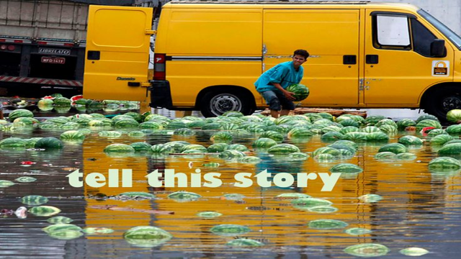

Slide 2
What is a vignette? – Vignette Notes
Paraphrase the definitions given to create your own definition of a vignette.
Check the characteristics of the Cisneros’ stories you read yesterday.
How are those vignettes?
Are there any characteristics they are missing?

Slide 3
Narrative Writing Assignment: Vignette
Tuesday: Brainstorm and rough draft.
Wednesday: Finish rough draft; edit; start final draft.
Thursday: Finish final draft; post to blog; read and comment.
You must have or create a blog for your writing.
Your final draft must be published to your blog by the end of the day on Thursday.

Slide 4
Today: Brainstorm & Rough Draft
Use the pre-writing on the handout and the chart on the back to do your brainstorm.
Write your rough draft on the paper provided.
Have your rough draft completed when you come in tomorrow.

Slide 5
Grading
Pre-Writing: 10 points
Rough Draft: 10 points
Editing/Revision: 10 points
Final Draft: 30 points (24 points for writing; 6 points for blog post requirements)
Commenting on Blogs: 10 points

