Slide 1
Warm-Up
What makes reading easy for you?
What makes reading difficult for you?
Are you a visual learner?
Have you ever heard of a graphic novel? If so, what is it?
Why do you think people like comic books and graphic novels?

Slide 2
What is a graphic noveL?
https://www.youtube.com/watch?v=DTkfcL8iPtc

Slide 3
Graphic Novel Terms and Concepts

Slide 4
Layout
Panel: a distinct segment containing a combination of image and text in endless variety. Panels offer a different experience then simply reading the text:
The spatial arrangement allows an immediate juxtaposition of the present and the past.
Transitions are instantaneous and direct, but the timing is determined by the reader’s speaker and focus.

Slide 5
Layout
Frame: the lines and borders that contain the panels
Gutter: the space between framed panels
Bleed: an image that extends to/beyond the edge of the page

Slide 6
Layout
Foreground: the parts closest to the viewer
Midground: The artists places an image centered or off centered to create visual tension .
Background: provides additional, subtextual information for the reader

Slide 7
Layout
Graphic Weight: a term to describe the way some images draw the eye more than others, creating a definite focus using color and shading.
Artists use light and dark colors or shades to offer contrast or highlight certain sections of an image.
A pattern or repeated marks are often used, sometimes symbolically
Colors can also be more vivid or deeper than others for effect

Slide 10
Figures
Faces: Some face depict an actual person, others are iconic or symbolic.
They can be dramatic when placed against a detailed backdrop
They can be drawn without much expression or detail, which invites the audience to figure out what the character is thinking. This is called an “open blank”

Slide 11
Figures
Hands and Feet: the position of hands and feet can be used to express what is happening in the story. Hands with palms out might suggest surprise. Hands over the mouth might depict fear, shame, shyness, etc. Feet that appear in motion might create a sense of panic, urgency, etc.

Slide 12
Text
Captions: these boxes contain a variety of text elements, such as scene-setting, description, etc.?
Special-Effects lettering: highlights or draws attention to the text. Think about onomatopoeia in Batman comic strips (Blam! Pow!)
Speech balloons: these enclose dialogue and come from a specific speaker’s mouth.
External dialogue is speech between characters
Internal dialogue is a though enclosed by a balloon that has a series of dots or bubbles going up to it.

Slide 13
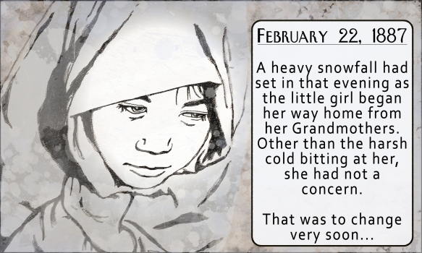
How does this panel establish graphic weight?

Slide 19
Vocabulary practice
Using the panels from Persepolis, label each and every part using your vocabulary notes. Make sure you do not miss any of the terms!

