Slide 1
Journal
Write about a time that you won an argument. What did you say? How did you convince the other person that you were right?
                OR
If you have never won an argument… think about one that you have lost, and what you could have done differently to win.

Slide 2
Check your answers from yesterday’s pre-test…
C
B
A
B
A
C
D
C
A
B

Slide 3
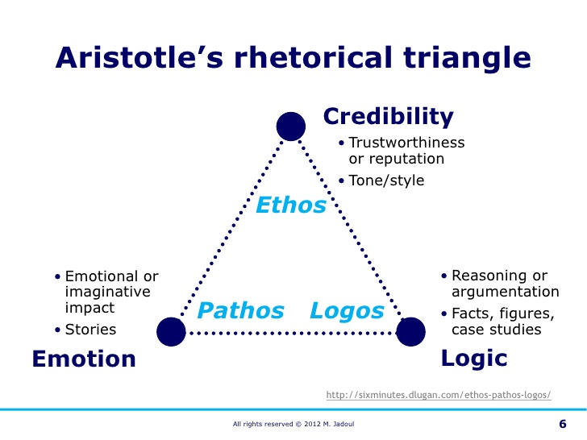
Rhetoric = The Art of Persuasion

Slide 4

ETHOS
Trust
Authority
Credibility
Good character
Good motives
Someone well-known
Someone experienced

Slide 5

Pathos
Emotions
  Happiness
  Sadness
  Anger
  Pride
  Guilt
  Etc.
Sensory Details
Emotional language
Images

Slide 6

Logos
Logic
Facts
Statistics
Evidence
Expert Testimony
Definitions
Witness Statements

Slide 7
Rhetorical Appeal of Commercials
Commercials and other advertisements rely on rhetorical appeal to persuade the audience to do something, buy a product, believe in an idea, etc.
Ethos, pathos, and logos are EVERYWHERE.
Fill out the graphic organizer as we watch commercials.

Slide 8
#1 Microsoft
https://www.youtube.com/watch?v=wLXRt-qRBfU

Slide 9
#2 UnderArmour
https://www.youtube.com/watch?v=ikmd-vtRCqo

Slide 10
#3 Hyundai
https://www.youtube.com/watch?v=-R_483zeVF8

Slide 11
#4 Colgate
https://www.youtube.com/watch?v=b1zefG07jMA

Slide 12
#5 Orkin
https://www.youtube.com/watch?v=E7D20sZvmQg

Slide 13
#6 Doritos
https://www.youtube.com/watch?v=MNRAdrB9TSs

Slide 14
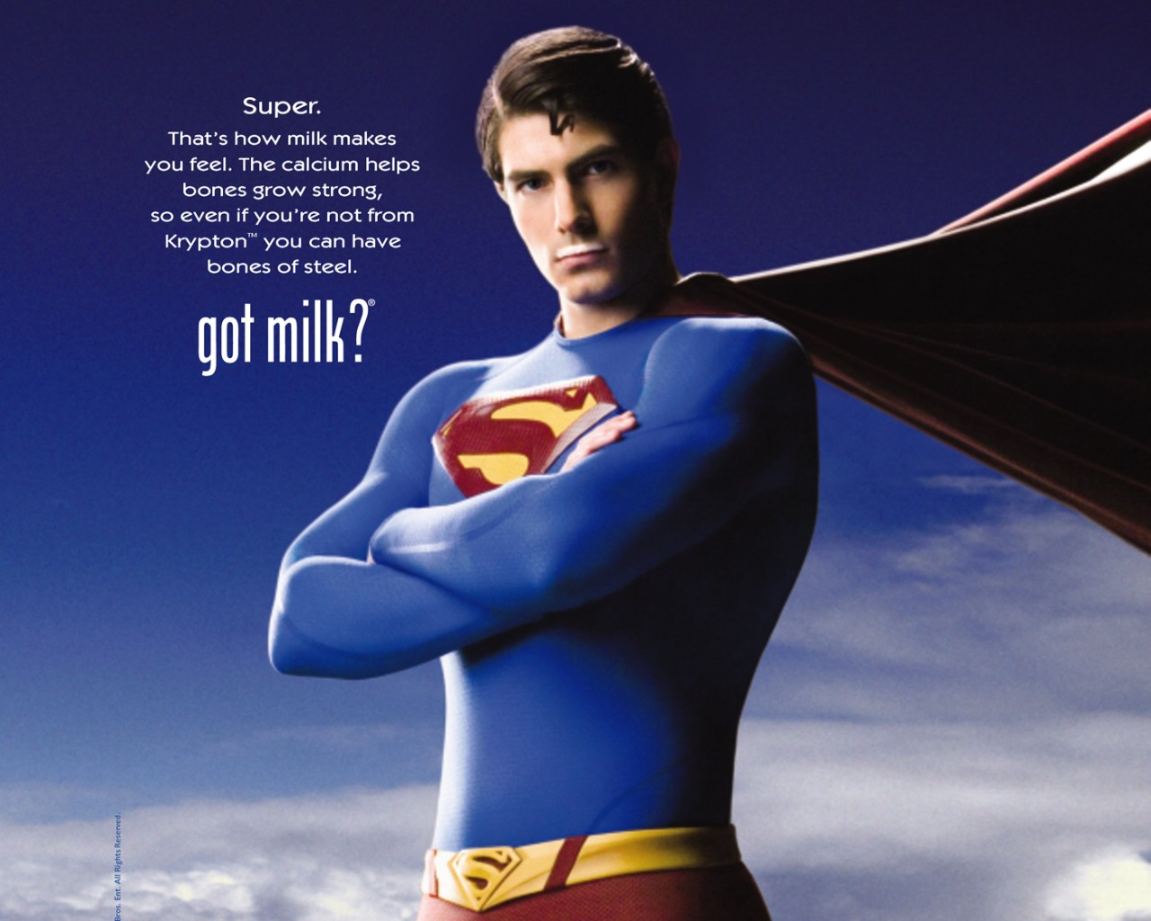
Ethos, Pathos, or Logos?

Slide 15

Ethos, Pathos, or Logos?

Slide 16
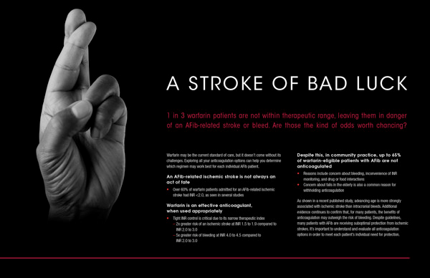
Ethos, Pathos, or Logos?

Slide 17
Closing
Convince a teacher to let you make up a test – use 2/3: Ethos, Pathos, Logos.

