Slide 1
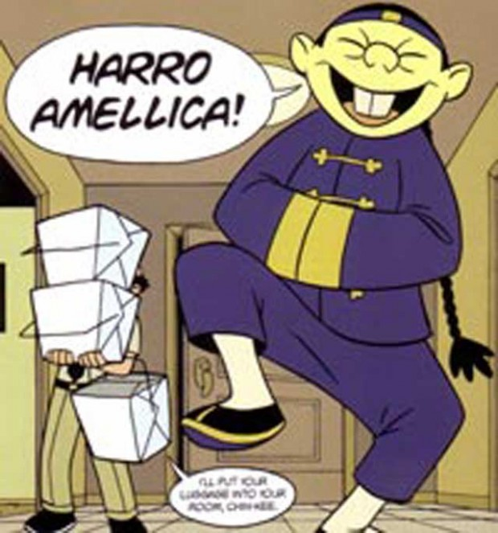
Warm-Up
If your birthday is between January and June: Describe this image in a six-word memoir.
If your birthday is between July and December: Choose and explain 2 stereotypes in this image.

Slide 2
Poll-Everywhere
http://www.polleverywhere.com/free_text_polls/Ksv0mWhHb1WpqhI

Slide 3
Ch. 4
Before Reading: Journal
During Reading: Answer Questions
After Reading: Character Sketch & Discussion Questions

Slide 4
Ch. 5
Before Reading: Journal
During Reading: Answer Questions
After Reading: Character Sketch & Discussion Questions

