Slide 1
Welcome back! Hope you had a great break!
For your warm-up, please begin work on the EOC practice handouts found on the table!
Work with your group.
We will go over the answers in about 20 minutes.

Slide 2
American Literature EOC
Wednesday, Thursday, and Friday
1st block – Media Center / 4th block – ID Lab
3 sections:
Section 1: Extended Response (90 min. max)
Section 2: Multiple Choice/Constructed Response (75 min. max)
Section 3: Multiple Choice/Constructed Response (75 min. max)

Slide 3
UNIT 4: Change in America
Brainstorm how each of the categories has been treated and has changed in the past, present, and future (in America).

Slide 4
Harlem Renaissance: 1919-1935
https://www.youtube.com/watch?v=LAN42382vxo&t=257s
Key Points?
How was the Harlem Renaissance a time of change in America?

Slide 6
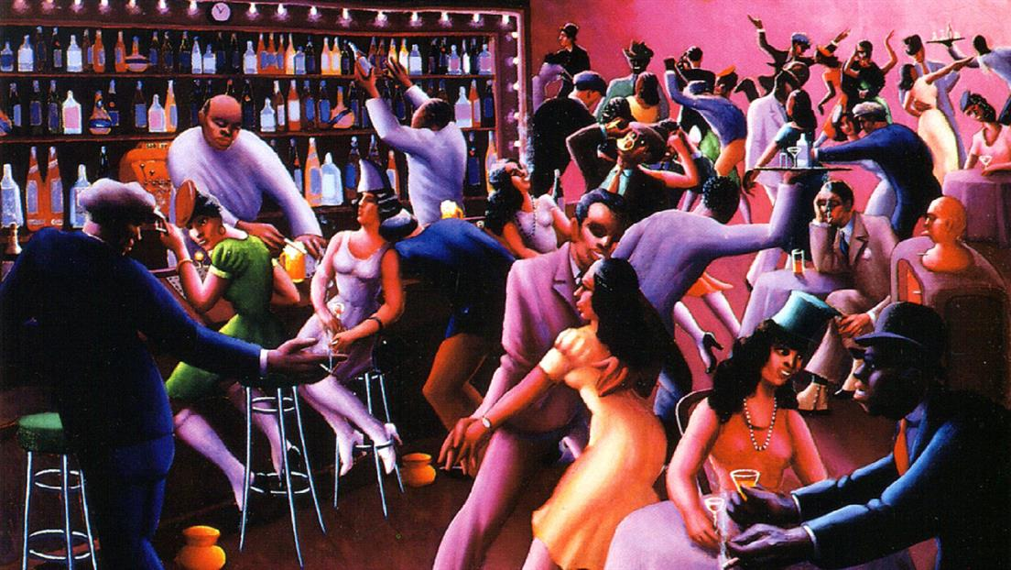

Slide 8
Langston Hughes Poetry
1) What is the rhyme scheme? Why do you think the poet chose this form?
2) Identify various types of figurative language in the poem. How do they enhance the meaning of the text?
3) Discuss both the tone and the mood of the poem.
4) How do you think this poem comments on the progress/change in America (or lack thereof)?

