Slide 1
Warm-Up: p. 89/90 (wherever you left off yesterday)
Review the Pygmalion effect.
Choose a time in your life where you can see evidence of the Pygmalion effect.
Write a journal entry in which you explain what happened. Make sure you include where in the cycle your experience started and explain in detail all the causes and effects.
EXAMPLE: When I started my first job out of college, I was very nervous. However, the people I worked believed in me and immediately treated me with respect and gave me responsibility. Because they treated me like this, I believed that I could do a great job. I started working harder than I ever had, and put more effort into that job than I had ever put into school. I studied on my own time and did a lot of things to ensure I would be very good at the job, which led to my becoming fairly successful in that career.

Slide 2
The Myth of Pygmalion
Read and discuss.
Respond – p.90 (wherever you left off)
In the myth, the love between Pygmalion and Galatea is strong and passionate—we even know it is at least somewhat lasting as they produce a son. Would you consider the love between them true or not? Why?
If Galatea developed non-physical human qualities (i.e. personality traits), how do you think Pygmalion might have felt about her then? Why?

Slide 3
Elements of Drama - Notes
The time period in which the play was written
The playwright’s biography and his/her other writing
The language of the play
Setting
Plot
Themes
Characters

Slide 4
Test Yourself (Review from yesterday) - What do you already know about Pygmalion?
The time period in which the play was written
The playwright’s biography and his/her other writing
The language of the play
Setting
Plot
Themes
Characters

Slide 5
The Importance of Language in a Play
Two things to think about:
1) How characters are constructed by their language
Playwrights often distinguish their characters with idiosyncratic or at least individualized manners of speaking.
Speech of a character contributes to what the audience feels about the character – it gives you information about their personality.
2) How language contributes to scene and mood
Ancient, medieval, and Renaissance plays often use verbal tricks and nuances to convey the setting and time of the play because performers during these periods didn’t have elaborate special-effects technology to create theatrical illusions. How do you communicate time of day, special effects, action, etc. without any type of technology to help you? (Answer: through speech, stage directions, etc.)

Slide 6
Pygmalion Notes
You are responsible for creating your own notes for each act. You will be able to use them on your assessment, so it will work in your favor to create yourself some awesome notes for each act!
For each act, I will give you vocabulary you need to know as well as any background information.
I would recommend that you make notes as we read – anything we talk about, quotes we discuss in depth, etc… write it down if you think it’s important.
You will answer questions for each act on these pages as well.
Basically, these pages you create in your notebook are your record of the work and thought you put in during this unit, and they will be graded.

Slide 7
Pygmalion
Preface –
What is the purpose of a preface?
Read and respond:
1) What is Shaw’s “big beef” and what is his opinion about rhetoric in general?
2) Do you agree that art should always be didactic (have a lesson to teach, usually moral)? Why or why not? Do you think most art and literature is didactic or not? Why?
3) How can you connect the preface to the importance of language?

Slide 8
Act 1: Activator
When you meet someone for the first time, what do you notice first about that person?
Do you believe that physical appearance and presentation is important?
http://www.youtube.com/watch?v=V9XaHxJj5Vo
http://www.youtube.com/watch?v=JSDoPY9B0wQ

Slide 9
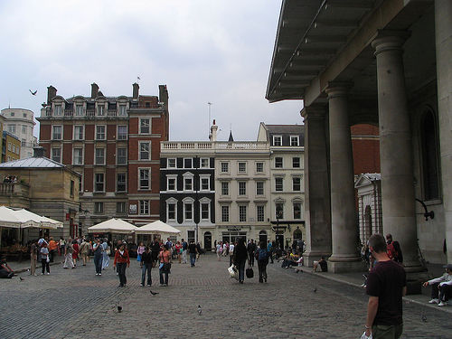
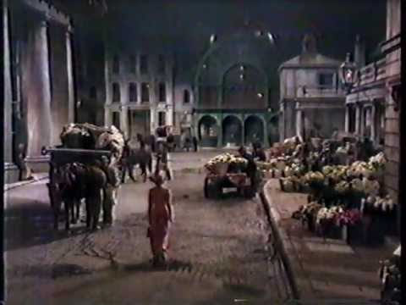
Act 1
Covent Garden: A neighborhood in London that hosted a huge fruit and vegetable market. It was originally an upper class area, but in the 17th century fell into disrepute, as taverns, theatres, coffee-houses and brothels opened up; the gentry moved away, and rakes, wits and playwrights moved in. By the 18th century it had become a well-known red-light district, attracting notable prostitutes. Parliament stepped in soon after to rebuild the area, get rid of the brothels, and restore it as a center for trade and markets. This is where the play opens.

Slide 10
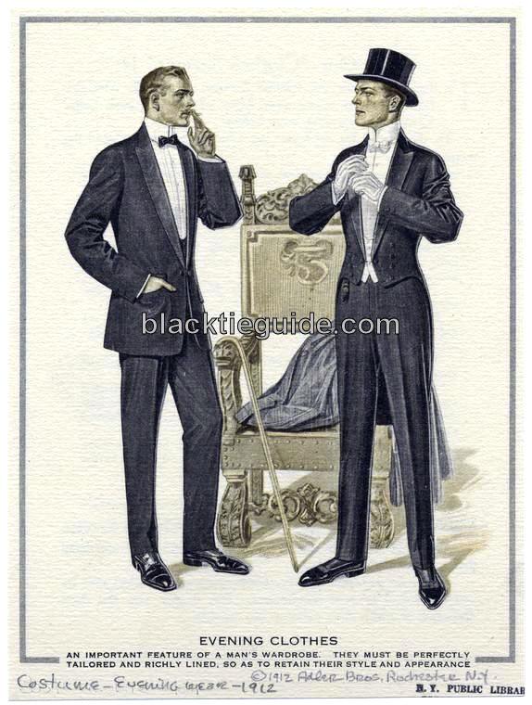
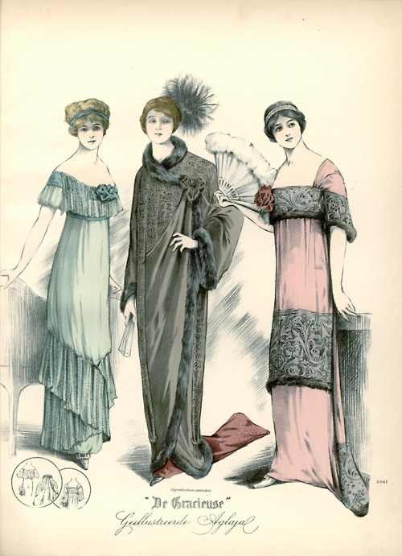
Act 1
Evening wear of the upper class – wear to the theatre, parties, etc.

Slide 11
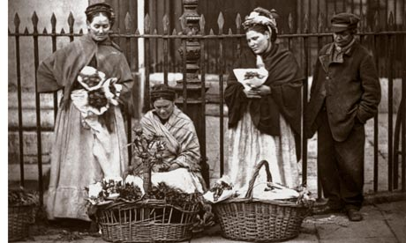
Act 1
Flower Girl: A young lady whose job is to sell flowers or plants at the street market

Slide 12
Act 1
Cockney: Refers to working-class Londoners in the East End. Linguistically, it can refer to the accent and form of English spoken by this group. This accent is considered to signal low social status or lack of education, as it generally would have been a “blue-collar” accent. When the professor hears the flower girl in the market, she is speaking in a Cockney accent.
Professor Higgins will refer to it as, “the English that will keep her in the gutter to the end of her days.”
http://www.youtube.com/watch?v=mMN9VNhpy_8

Slide 13
Act 1
English Money: crown, pound, tuppence, half-pence

Slide 14
Act 1
The Note Taker: He is a professor of linguistics and can recognize where people are from simply by listening to their accents. He is fascinated with the English language and how people speak.
He says: “Simply phonetics. The science of speech. That’s my profession: also my hobby. Happy is the man who can make a living by his hobby! You can spot an Irishman or a Yorkshireman by his brogue. I can place any man within six miles. I can place him within two miles in London. Sometimes within two streets.”

Slide 15
Act 1 Summarizer
What is your first impression of the flower girl?
What is the Note Taker’s first impression of the flower girl?

