Slide 1
Journal
Imagine that you want to drive yourself to the basketball game this weekend, and you will have to miss your curfew.
You have to persuade your parent that you can handle it and they should let you go.
Write the persuasive “speech” you will give them, using ethos, pathos, and logos, in order to convince them.

Slide 2
EPL Review
http://www.readwritethink.org/classroom-resources/lesson-plans/video/persuasive-techniques-advertising-1166.html

Slide 3
Annotate your Notes on Advertising Techniques!
Circle/underline/highlight key words.
Add extra notes that we discuss and seem important.
Jot down the examples to help you remember them later.

Slide 6
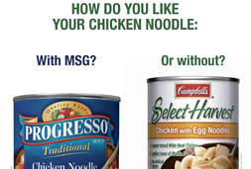

Slide 7
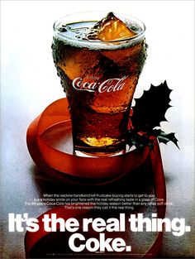

Slide 8
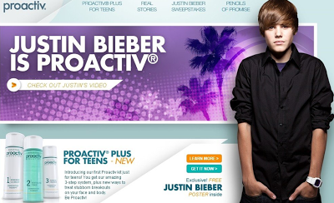

Slide 10
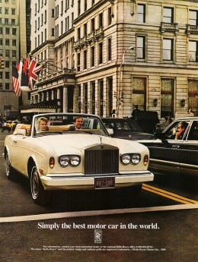

Slide 11
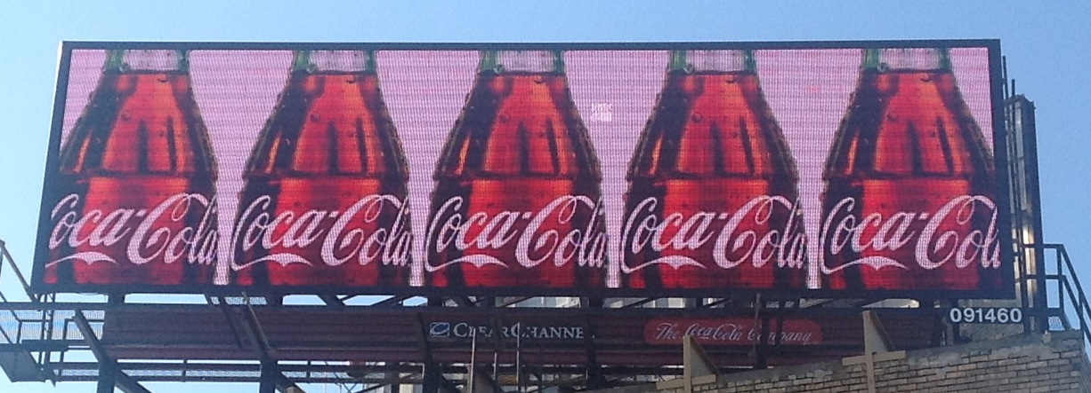

Slide 15
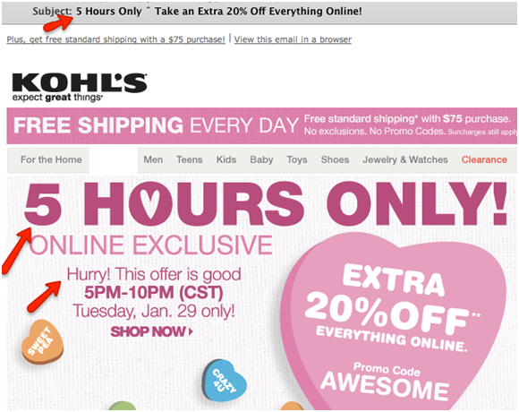

Slide 16
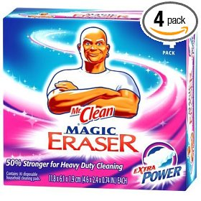

Slide 19
Scavenger Hunt!
Work in your groups.
Use ONLY the magazines assigned to you.
Complete the graphic organizer (one per group – so share or nominate a recorder – either one is fine).
Check off each technique as you find it. Only one ad should be used per one technique.
Make sure you record the name of the ad/product and how you knew it used the technique (explain your rationale).
You have 30 minutes!

Slide 20
Closing
Work with your group and answer the following questions in the blank space under your graphic organizer:
Which advertising technique seems to be used the most?
What are some things you noticed that a lot of magazine ads have in common?
Of all the ads your group used, which one do you think is most effective? Why?

