Slide 1
warm-Up: Would you rather…?
Consider the following questions. Write your answers on notebook paper. Make sure you explain why!
Would you rather be able to fly or be invisible?
Would you rather be super strong or super fast?
Would you rather have a third eye or a third arm?
Would you rather go 100 years in the past or 100 years in the future?
Would you rather live deep under the ocean or live far out in space? (You can never come back to Earth).

Slide 2
SYLLABUS SCAVENGER HUNT
Read through the syllabus, completing your Syllabus Review handout as you go.
On the back of your paper, write three more things from the syllabus that you think are important to remember.
Please feel free to work with the people at your table!

Slide 3
TONIGHT’S ASSIGNMENT
Please take home your Syllabus Review Sheet and go through it with your parent/guardian.
Have them read it, write any questions or comments they have, sign it, and provide their contact info.
Turn it in tomorrow to earn your grade.

Slide 4
FAQ
Will this class be fun? Will this class be boring?
What if I’m late? I come from the other side of campus and it takes me 4-6 minutes to get here.
Will we have a lot of projects?
Should I do the summer reading?
What do I do if I got the wrong book for summer reading?
What else will we do besides book work?
What is the next English class after this? Is there an honors class, and what are the requirements?
Do you give out extra credit?
Do you speak another language?

Slide 5
Class Rules Review
What are the three main rules?
Activity:
In your group’s folder, you will find some memes.
Work together to decide which rule each of your memes applies to.
Discuss why; be prepared to explain your reasoning.

Slide 6
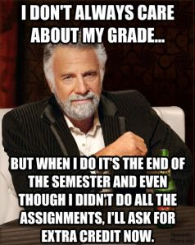

Slide 7
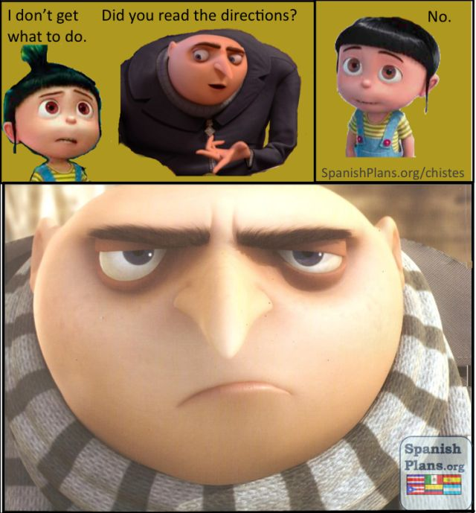

Slide 8
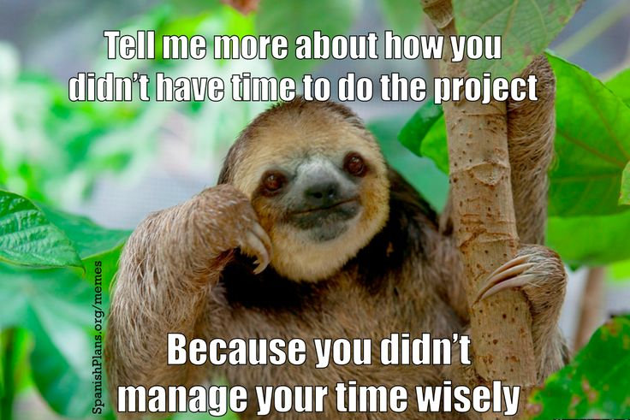

Slide 9
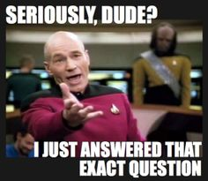

Slide 10
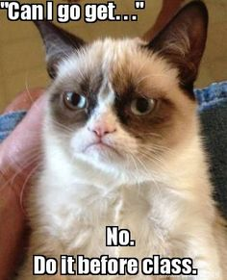

Slide 11
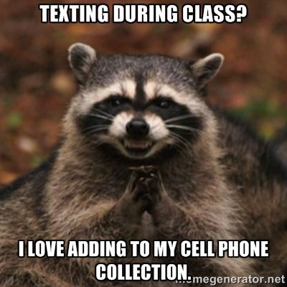

Slide 12
HOW TO SUCCEED IN WORLD LIT group activity
Each group has two letters from students from last semester. The letters offer you advice, information about what you will learn, and valuable insight that you will need. You will read your letters, discuss them with your group, and complete the activity.
The final product will be presented tomorrow.

Slide 13
HOW TO SUCCEED IN WORLD LIT GROUP ACTIVITY
Your Task: Using information from former students, as well as what you have gathered in the past two days, you will create a poster about this class. Things you may want to include:
Advice on how to succeed
Information about the content – what are we going to learn
Interesting facts/tidbits
Color, creativity, and personality

Slide 14
If you have any questions, please write them on a post-it note and put it on the cabinet!

