Slide 1
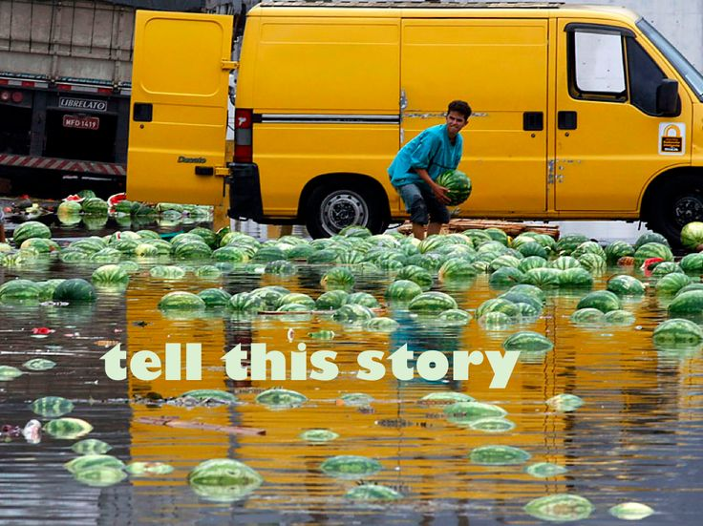
Journal

Slide 2
Where I’m from
Rough Draft:
1) Use your template first. Remember to add/change as necessary.
2) Write a complete rough draft on notebook paper. Make sure it is legible.
You have 45 minutes to work.

Slide 3
Peer revision
IMPORTANT PART OF THE PROCESS AND YOUR GRADE!
Work with a peer who has not read much of your writing before.
Fill out the entire form for your partner’s poem.

Slide 4
EDITING
Take your peer reviewer’s advice.
Check for spelling and grammar.
Make corrections/ make it perfect.

Slide 5
WHERE I’M FROM: final draft
Tomorrow you must have:
1) Complete final draft (written in ink or typed)
2) Visual Aid (hand-drawn, printed pictures, magazine, etc.)
3) Completed Pre-Writing, Rough Draft, and Peer Revision

