Slide 1
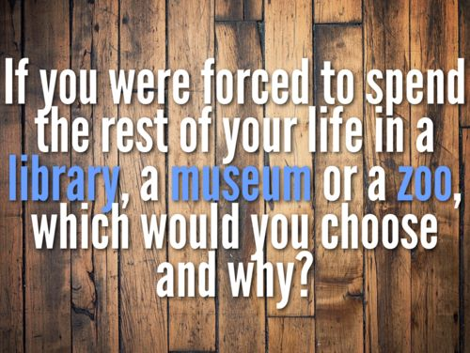

Slide 2
“The Black Cat” by edgar allen poe
1) Annotate as we read.
2) Complete the handout about the writer’s craft and choices.
3) Turn in your annotations plus your handout.
BONUS: What ALLUSIONS can you find in this story? List them and explain what they are alluding to for bonus points.

