Slide 1
Who are you?
Warm-Up:
Jot down about 10 words that you think describe yourself, your strengths, and who you are.

Slide 2
True Colors Test
Consider each group of words.
Which group best describes you? → Give that a 4.
Which group least describes you? → Give that a 1.
For the two middle groups, the one that is closest to you gets the 3, the one that is farthest from you gets a 2.
Add up your totals for each color.

Slide 3
The Colors GREENS
Are innovative and logical
Seek to understand the world
Need to be competent
Are curious
Question authority
Push themselves to improve
Are slow to make decisions
Value concise communication
Look for intellectual stimulation
Enjoy intriguing discussions
Are sometimes oblivious to emotions
Are detached
Are drawn to technical occupations
Focus on the future
Bring innovation to society

Slide 4
The Colors Orange
Are free and spontaneous
Are impulsive risk-takers
Are active
Are optimistic
Resist commitment
Thrive on crises
Like to be the center of attention
Have great endurance
Are drawn to action jobs
Need variety
Are competitive
Deal with the here and now
Are generous
Have difficulty finding acceptance
Like to live in a casual atmosphere
Bring excitement to society

Slide 5
The Colors Gold
Are dutiful and stable
Need to be useful
Want to be self-sufficient
Value organization
Desire punctuality
Schedule their lives
Make and keep commitments
Are goal-oriented
Value rules
Prepare for the future
Are inclined to join groups
Prefer order and cleanliness
Are responsible and dedicated
Are drawn to respected occupations
Enjoy positions of authority
Desire structure
Bring stability to society

Slide 6
The Colors Blue
Are in search of themselves
Need to feel unique
Must be true to themselves
Value close relationships
Encourage expression
Desire quality time with loved ones
Need opportunities to be creative
Compromise and cooperate
Nurture people, plants and animals
Share emotions
Make decisions based on feelings
Are adaptable
Are drawn to literature
Are drawn to nurturing careers
Get involved in causes
Are committed to ideals
Bring unity to society

Slide 7
The 5-minute personality test
The directions are very similar: 4 for the word that best describes you; 1 for the word that least describes you; 2 and 3 in the middle.
Read each row, then add up your totals, and circle your highest: L, O, G, or B.

Slide 8
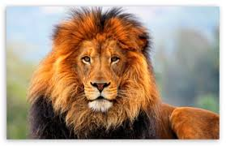
L = Lion
Lions are leaders. They are usually the bosses at work…or at least they think they are!
They are decisive.
They love to solve problems.
They love to seek new adventures
and opportunities.
Lions are very confident and self-reliant.
In a group setting, if no one else instantly takes charge, the Lion will. Unfortunately, if they don’t learn how to tone down their aggressiveness, their natural dominating traits can cause problems with others.

Slide 9
O = OTTer
Otters are excitable, fun seeking,
cheerleader types who love to
talk!
They’re great at motivating
others and need to be in an
environment where they can talk
and have a vote on major decisions.
They can be very loving and encouraging unless under pressure, when they tend to use their verbal skills to attack.
They have a strong desire to be liked and enjoy being the center of attention.
They are often very attentive to style, clothes, and flash.
Otters are the life of any party; and most people really enjoy being around them.

Slide 10
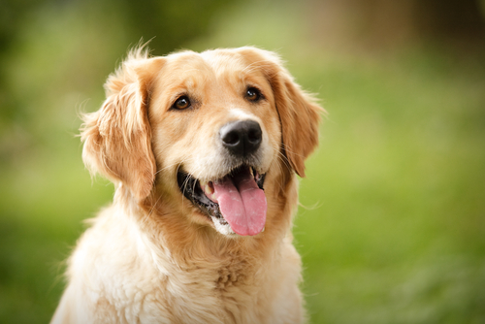
G = Golden Retriever
One word describes these people:
LOYAL.
They can deal with a good deal of emotional pain and punishment but
still stay committed.
They are great listeners, incredibly empathetic and warm encouragers.
They are good team players, but
because they are such pleasers and
care about harmony, they may not be
assertive at times when it’s needed.
Golden retrievers tend to focus on the present and devote lots of time to helping others and building relationships.

Slide 11
B = Beaver
Beavers have a strong need to
do things right and by the book.
They are great at providing
quality control in any situation.
Because rules, consistency and
high standards are so important
to beavers, they are often frustrated with others
who do not share these same characteristics.
Their strong need for maintaining high (and oftentimes unrealistic) standards decrease their ability to express warmth in a relationship.
Beavers are good listeners, communicate details, and are usually diplomatic; they do not like to make decisions.

Slide 12
MYERS-BRIGGS TEST
Add up your totals for each column:
E I S N T F J P
The test is made up of four different dichotomies or personality descriptions. One can either be:
Introverted or Extroverted
Sensing or Intuitive
Thinking or Feeling
Judging or Perceptive

Slide 15
Multiple Intelligences
For each category, check off all those that apply to you.
Tally your results in each category.
Circle/highlight your highest total(s).

Slide 17
Data Card
On your index card:
True Colors Result |  | 5-Minute Personality Test Result
 | Name (First + Last) Day of Birth
Myers-Briggs Result (4 Letters + Title) |  | Multiple Intelligences Result(s)

Slide 18
Letter assignment
Think about all these test results and what you have learned about yourself. Were your results surprising or not? Did you learn anything new about yourself? What do these things mean for you as a student? As a group member?
Your first writing assignment is to write me a letter about who you are as a student and how I can best teach you. Include information from your test results. Explain to me the ways you learn and work best, as well as how I can help you succeed in this class based on that.

