Slide 1
Warm-Up
You have a copy of the syllabus as well as a handout entitled Syllabus Scavenger Hunt.
Read through the syllabus, completing your handout as you go.
Make sure you answer every question! Once completed, signed, and returned, your grade will be recorded as a quiz grade.

Slide 2
How to succeed!
Start strong!
Pay attention.
Stay on task.
Complete your work.
Turn IN your work.
Ask for help when you need it.
Come to tutoring early on.
Don’t slack off in two months.
Do any extra credit you receive.
Be nice.

Slide 4
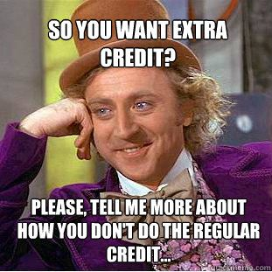

Slide 5
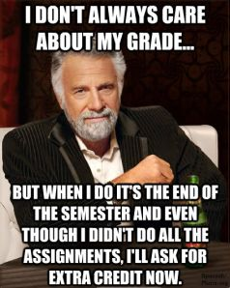

Slide 6
Don’t make silly mistakes…
Come prepared.
Do your work.
Do your best.
Ask for help.
Check everything twice.

Slide 8
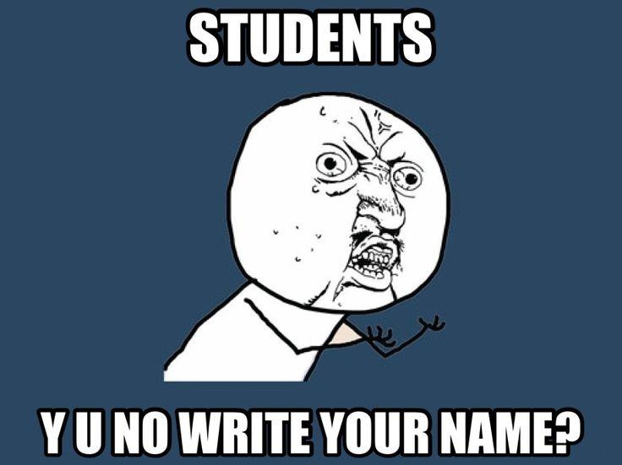

Slide 10
Student advice
https://www.youtube.com/watch?v=JyQysFYQdVs&feature=youtu.be
https://drive.google.com/file/d/0B8loUuigA6cTc1NtcURhaXp4Ym8/edit?usp=sharing

Slide 13
HOW TO SUCCEED IN WORLD LIT group activity
Each group has two letters from former students in this class, offering advice, information about what you will learn, and valuable insight that you will need. You will read your letter(s), discuss with your group, and complete the activity.
Your Task: Using information from former students, as well as what you have gathered in the past two days, create a poster OR a skit about this class. Things to include are…
Advice on how to succeed
Information about the content – what are we going to learn
Interesting facts/tidbits
Color, creativity, and personality

Slide 14
Exit Slip
Answer one of the EQs on a post-it note:
How can I succeed in World Lit?
What is World Lit all about?

