Slide 1
Tuesday – First day of Unit 2!
Journal: Write about a time when you were on the outskirts of a group of people. Why do you think you didn’t fit in? How did you feel? How did you react?

Slide 2
Privilege Walk Reflection
Please respond to the following questions in your notebook:
What just happened?
What were your thoughts during the activity?
What was your “gut reaction” to where you found yourself standing at the end?
How do you think it felt to be at the front? the middle? the back?
What did this activity help you learn? What will you think about in the future?

Slide 3
Brainstorm
What groups or types of people have the least amount of privilege?
What groups would you say are frequently on the outskirts of our society or culture?

Slide 4
Unit 2 Anticipation Guide
Read each statement correctly.
Check AGREE or DISAGREE (you must pick a side).
Choose one statement you wish to discuss further and write an explanation of your opinion on the bottom.

Slide 5
Wednesday Warm-Up
Make a KWL chart in your notebook. Complete the chart about immigrants and refugees.
Know | Want to Know | Learned

Slide 6
Vocabulary Discovery
Work alone or as a group, whichever you are more comfortable with.
Read the assigned texts.
As you read, add important points to your graphic organizer.
When you are done, write one overall definition for each of the terms: “immigrant” and “refugee”
On the back, use the quadruple Venn diagram to compare and contrast immigrants, refugees, emigrants, and migrants. Still use the articles’ information!

Slide 7
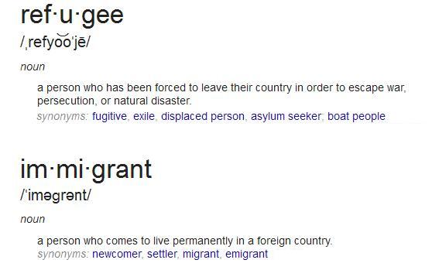

Slide 8
Can you ID me?
1) Read and discuss the 10 descriptions of different people.
2) Identify whether the person is an immigrant, refugee, emigrant, migrant, or undocumented/illegal immigrant.
3) Provide evidence to support your claim. How do you know?
4) Create your own example.
5) You have 10 minutes and then we will go over the answers.

Slide 9
Thursday Warm-Up
Start working on the KWL handout on persuasive writing and ethos, pathos, and logos.
Know | Want to Know | Learned

Slide 11
EPL Practice
https://www.youtube.com/watch?v=aSHJcQhYsSQ
https://www.youtube.com/watch?v=1vf3U4aPiMk
https://www.youtube.com/watch?v=9gspElv1yvc
Speech Practice: https://www.youtube.com/watch?v=aiXuEk_CyWs

Slide 12
Jose Antonio Vargas “Actions are Illegal, Never People”
Filipino American
Well-known and respected journalist
Wrote the article “My Life as an Undocumented Immigrant”
Watch the TED Talk and complete the graphic organizer.
http://tedxtalks.ted.com/video/Jose-Vargas-at-TEDxMidAtlantic

Slide 13
Google Work #2 – DUE MONDAY 9/12
Do your own online research about immigration.
Find and read one article about immigration. You might choose to read about undocumented immigrants, immigrants and how they resettle in America, current immigration topics, etc. Pick something of interest to you.
List five salient points from the article.
Write a one paragraph reflection on what you learned and your personal opinions on immigration.
Cite your source in MLA format:
Author Last Name, First Name. “Title of Article.” Name of Website. Date Published. Web. Date Accessed.

Slide 14
Friday Warm-Up: Write a reflection on this photo. Consider the photos, words, and how it makes you feel.

Slide 15
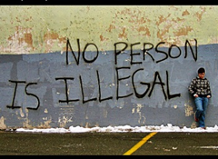

Slide 16
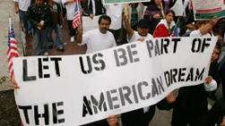

Slide 17
“It’s easy to become a citizen.”
Take the Mock Citizenship Test that immigrants must take in order to become Americans.
Score yourself.
Reflection: How did you do? What does this help you understand about the idea that “It’s easy to become a citizen”? What additional understanding do you gain about immigrants and refugees?

Slide 18
Benchmark Self-Analysis and Test Corrections
On the self-analysis handout, circle the questions that you missed.
For every question (even the ones you got right), write a rationale explaining the correct answer.
You may work with your group.
Staple your corrections ON TOP of everything that was returned to you.
Turn it back in.

Slide 19
Google Work #2 – DUE MONDAY 9/12
Do your own online research about immigration.
Find and read one article about immigration. You might choose to read about undocumented immigrants, immigrants and how they resettle in America, current immigration topics, etc. Pick something of interest to you.
List five salient points from the article.
Write a one paragraph reflection on what you learned and your personal opinions on immigration.
Cite your source in MLA format:
Author Last Name, First Name. “Title of Article.” Name of Website. Date Published. Web. Date Accessed.

